Slide 1
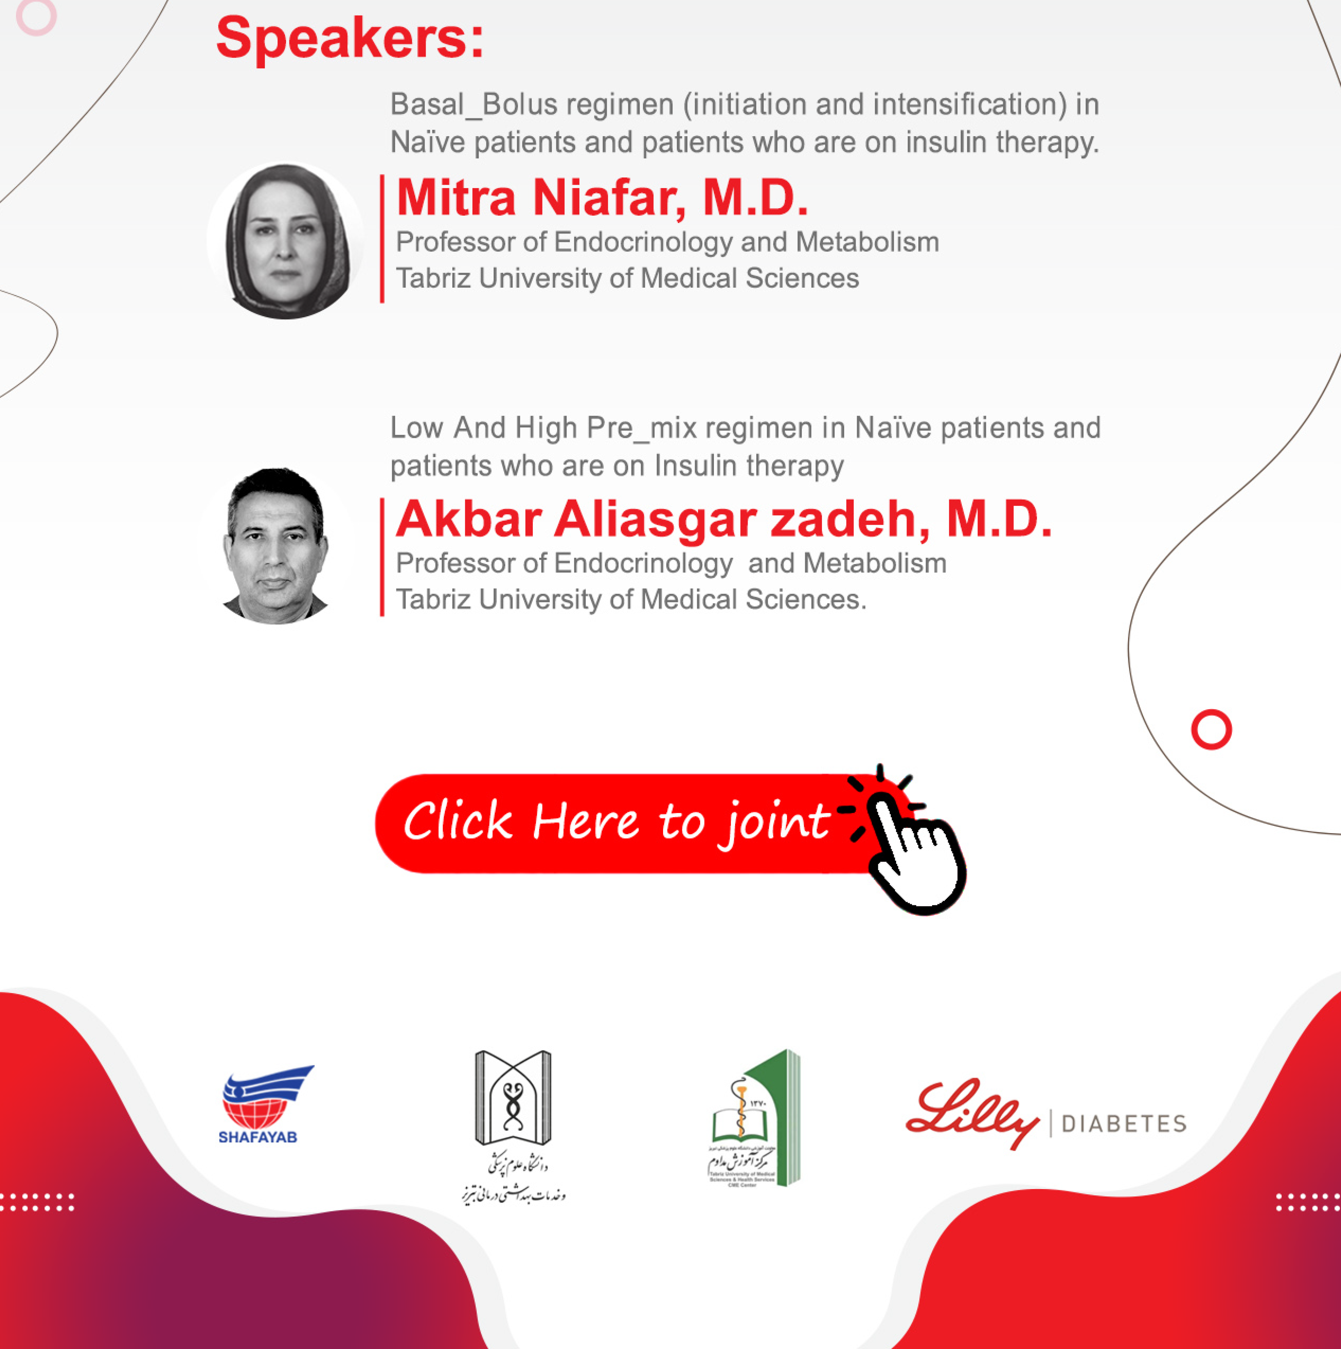


Slide 2
Lilly’s Commitment to Diabetes Care:
Through Research and Collaboration, a Broad and Growing Product Portfolio, Support Programms, and More

Slide 3
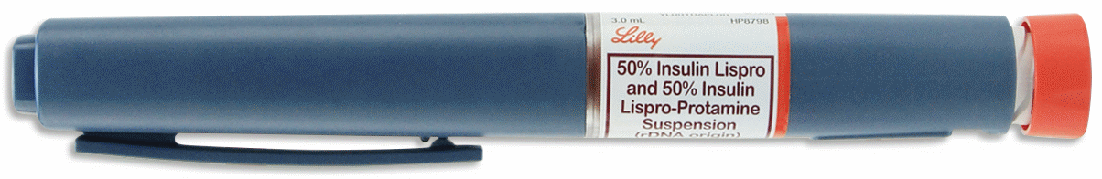
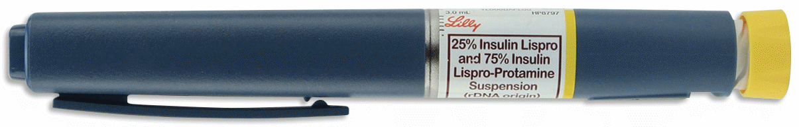
Low and High Pre_Mix regimen in Naïve patients and patients who are on Insulin therapy
Akbar Aliasgarzadeh, M.D.
Professor of Endocrinology and Metabolism
Tabriz University of Medical Sciences

Slide 4
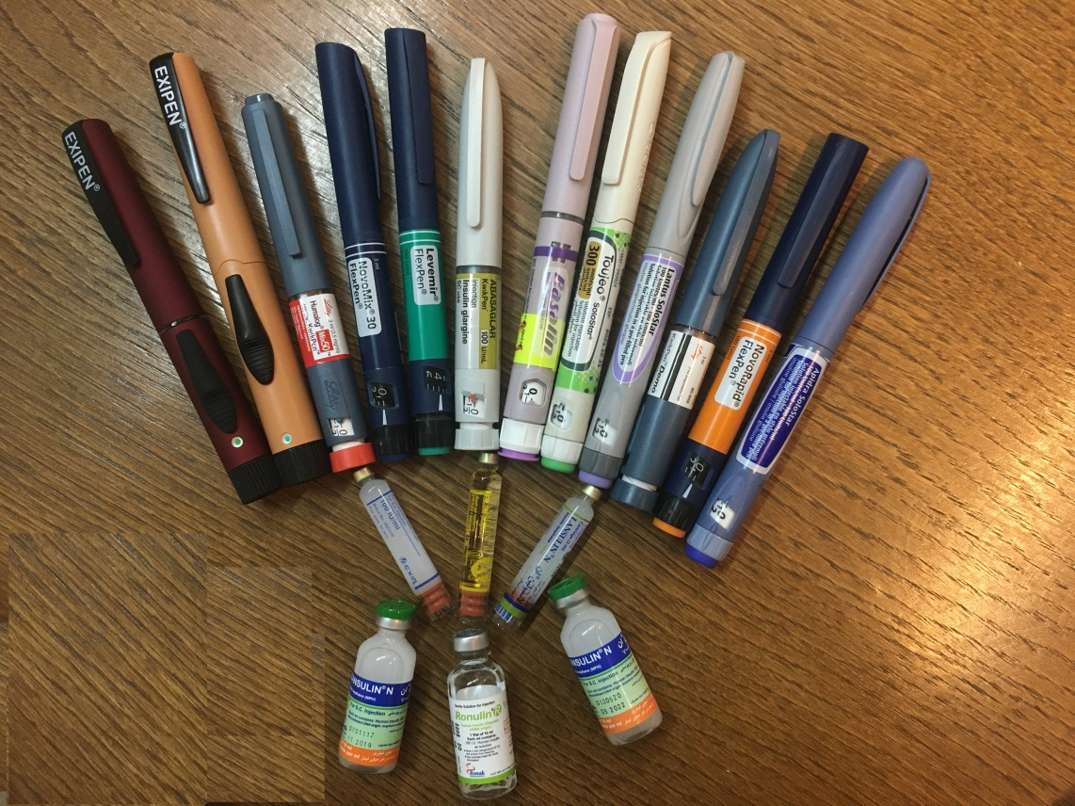
Disclaimer slide
I have participated in multiple physician and patient education programs sponsored by different pharmaceutical companies.

Slide 5

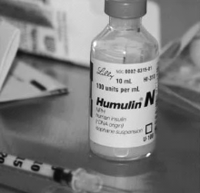
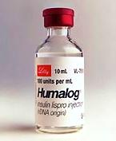
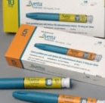
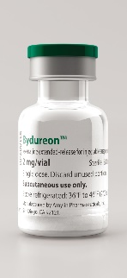
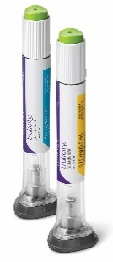
Lilly Diabetes: 90 Years of Milestones
1923
1982
1996
2005
2011
2014
Lilly* is the first company to make insulin commercially available.
Humulin is the
first human drug produced through recombinant
DNA technology.
Humalog is the first rapid-acting human insulin analogue.
Byetta® (exenatide BID injection) is the first GLP-1 RA (developed by Lilly and Amylin‡).
Bydureon® (exenatide
2 mg powder and solvent for prolong release suspension for injection) is the first weekly GLP-1 RA, developed by Lilly, Alkermes,‡ and Amylin.
Trajenta, BI/Lilly’s once-daily linagliptin tablet is approved for the treatment of type 2 diabetes.
Trulicity (dulaglutide once-weekly injection) is in a ready-to-use pen with no reconstitution and a hidden, pre-attached needle.
Basaglar®, BI/Lilly’s new insulin glargine product, is the first biosimilar product approved by the EMA.
Jardiance,
BI/Lilly’s once-daily empagliflozin tablet, is approved.
1999
Actos®, pioglitazone Lilly’s first OAD, is approved (jointly marketed by Lilly and Takeda†).
*Eli Lilly and Company; †Takeda Pharmaceutical Company Ltd.; ‡Amylin Pharmaceuticals, Inc.; §Alkermes, Inc.
EMA = European Medicines Agency; OAD = oral antidiabetic drug.
http://www.lilly.com/about/heritage/Pages/heritage.aspx.
Notes:
Additional products:
Jentadueto®: linagliptin/metformin hydrochloride tablets, distributed by Boehringer Ingelheim and marketed by Boehringer Ingelheim and Eli Lilly
Glyxambi: empagliflozin/linagliptin tablets from Boehringer Ingelheim and Eli Lilly
Additional points:
In April 2006, Takeda and Eli Lilly ended their joint marketing agreement for Actos® in the US. Eli Lilly retained the rights to market the drug in Canada, Mexico, and parts of Asia and Europe. In April 2009, Takeda bought the rights to Actos from Eli Lilly in 7 additional countries, including Canada, Sweden, and Norway
In November 2011, Eli Lilly and Amylin mutually agreed to end their diabetes alliance and transition exenatide responsibility to Amylin

Slide 6
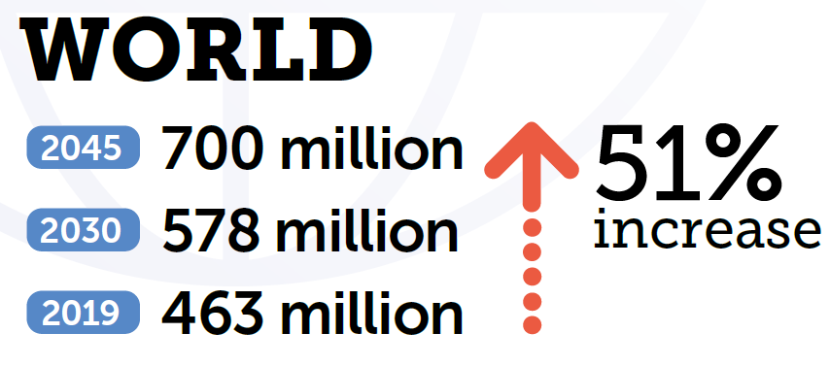
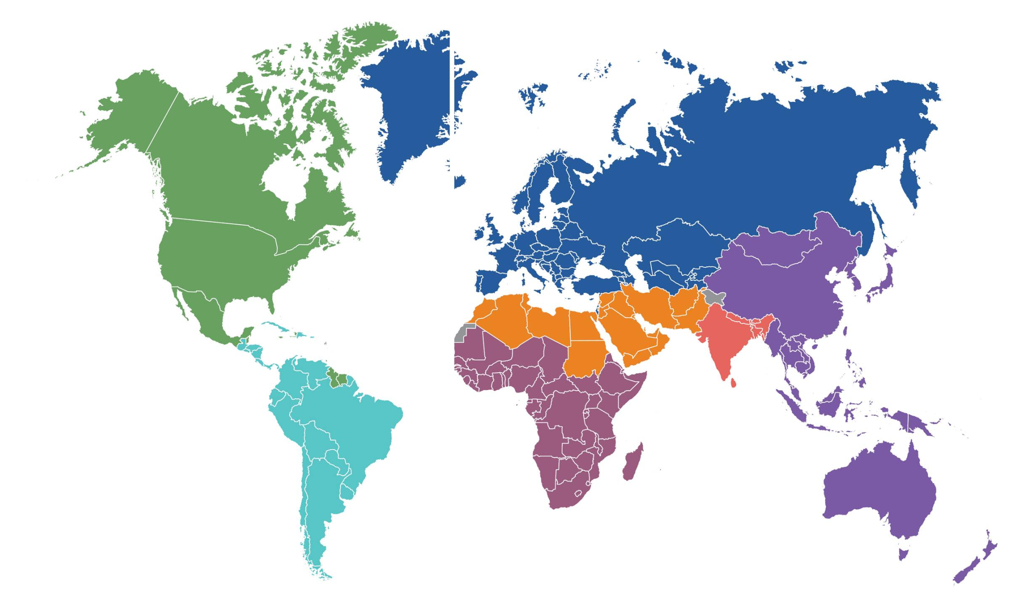
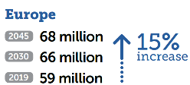
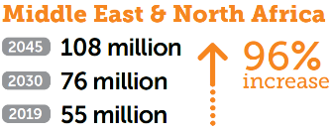
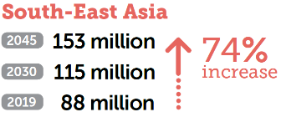
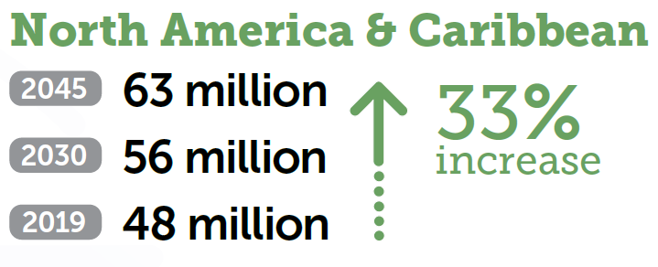
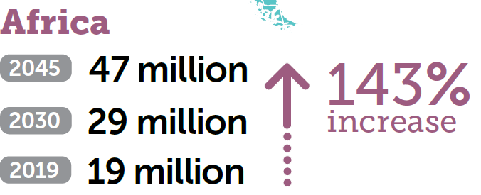
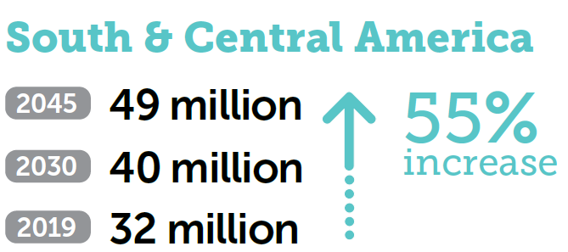
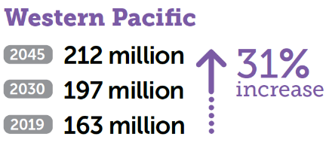
Number of people with diabetes worldwide and per IDF Region in 2019, 2030 and 2045 (20–79 years)
IDF 2019

Slide 7
Number of people with diabetes worldwide and per IDF Region in 2019, 2030 and 2045 (20–79 years)
IDF 2019

Slide 8
Number of people with diabetes worldwide and per IDF Region in 2019, 2030 and 2045 (20–79 years)
IDF 2019
WORLD
2045 700 million
2030 578 million
2019 463 million
51%
increase

Slide 9
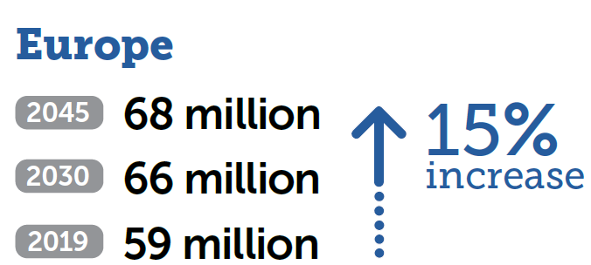
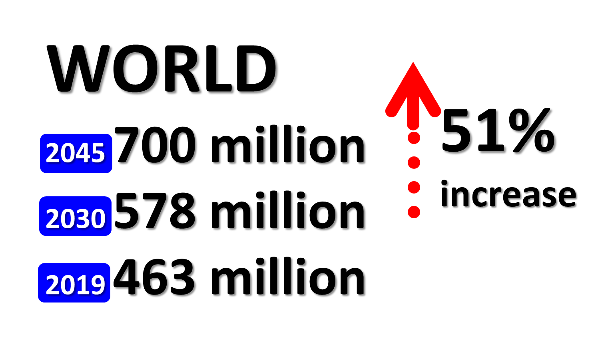

Number of people with diabetes worldwide and per IDF Region in 2019, 2030 and 2045 (20–79 years)
IDF 2019

Slide 10
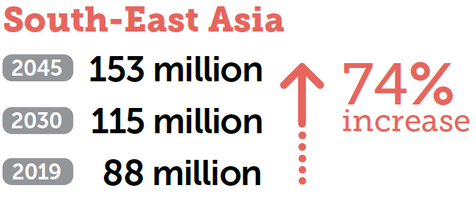
Number of people with diabetes worldwide and per IDF Region in 2019, 2030 and 2045 (20–79 years)
IDF 2019

Slide 11

Number of people with diabetes worldwide and per IDF Region in 2019, 2030 and 2045 (20–79 years)
IDF 2019

Slide 12
Number of people with diabetes worldwide and per IDF Region in 2019, 2030 and 2045 (20–79 years)
IDF 2019

Slide 13
Global diabetes estimates and projections IDF
At a glance | 2019 | 2030 | 2045
Total world population | 7.7 billion | 8.6 billion | 9.5 billion
Adult population (20–79 years) | 5.0 billion | 5.7 billion | 6.4 billion
Diabetes (20–79 years)
Global Prevalence | 9.3% | 10.2% | 10.9%
Number of people with diabetes | 463.0 million | 578.4 million | 700.2 million
Number of deaths due to diabetes | 4.2 million | - | -
Total health expenditures for diabetes | USD 760.3 billion | USD 824.7 Billion | USD 845.0 billion
Hyperglycemia in pregnancy (20–49 years)
Proportion of live births affected | 15.8% | 14.0%ii | 13.3%ii
Number of live births affected | 20.4 million | 18.3 million | 18.0 million
Impaired glucose tolerance (20–79 years)
Global prevalence | 7.5% | 8.0% | 8.6%
Number of people with impaired glucose tolerance | 373.9 million | 453.8 million | 548.4 million
Type 1 diabetes (0–19 years)
Number of children and adolescents with type 1 diabetes | 1,110,100 | - | -
Number of newly diagnosed cases each year | 128,900 | - | -
At a glance
2019
2030
2045

Slide 14
Global diabetes estimates and projections IDF
At a glance | 2019 | 2030 | 2045
Total world population | 7.7 billion | 8.6 billion | 9.5 billion
Adult population (20–79 years) | 5.0 billion | 5.7 billion | 6.4 billion
Diabetes (20–79 years)
Global Prevalence | 9.3% | 10.2% | 10.9%
Number of people with diabetes | 463.0 million | 578.4 million | 700.2 million
Number of deaths due to diabetes | 4.2 million | - | -
Total health expenditures for diabetes | USD 760.3 billion | USD 824.7 Billion | USD 845.0 billion
Hyperglycemia in pregnancy (20–49 years)
Proportion of live births affected | 15.8% | 14.0%ii | 13.3%ii
Number of live births affected | 20.4 million | 18.3 million | 18.0 million
Impaired glucose tolerance (20–79 years)
Global prevalence | 7.5% | 8.0% | 8.6%
Number of people with impaired glucose tolerance | 373.9 million | 453.8 million | 548.4 million
Type 1 diabetes (0–19 years)
Number of children and adolescents with type 1 diabetes | 1,110,100 | - | -
Number of newly diagnosed cases each year | 128,900 | - | -
At a glance
2019
2030
2045

Slide 15
Global diabetes estimates and projections IDF
At a glance | 2019 | 2030 | 2045
Total world population | 7.7 billion | 8.6 billion | 9.5 billion
Adult population (20–79 years) | 5.0 billion | 5.7 billion | 6.4 billion
Diabetes (20–79 years)
Global Prevalence | 9.3% | 10.2% | 10.9%
Number of people with diabetes | 463.0 million | 578.4 million | 700.2 million
Number of deaths due to diabetes | 4.2 million | - | -
Total health expenditures for diabetes | USD 760.3 billion | USD 824.7 Billion | USD 845.0 billion
Hyperglycemia in pregnancy (20–49 years)
Proportion of live births affected | 15.8% | 14.0%ii | 13.3%ii
Number of live births affected | 20.4 million | 18.3 million | 18.0 million
Impaired glucose tolerance (20–79 years)
Global prevalence | 7.5% | 8.0% | 8.6%
Number of people with impaired glucose tolerance | 373.9 million | 453.8 million | 548.4 million
Type 1 diabetes (0–19 years)
Number of children and adolescents with type 1 diabetes | 1,110,100 | - | -
Number of newly diagnosed cases each year | 128,900 | - | -
At a glance
2019
2030
2045

Slide 16
Country summary table for 2019 (IDF Atlas)
Country or territory | Number of adults 20–79 years with diabetes in 1,000s (95% confidence interval) | Diabetes national prevalence (%) in adults 20–79 years (95% confidence interval) | Diabetes age-adjusted comparative prevalence (%) in adults 20–79 years (95% confidence interval) | Number of adults 20–79 years with undiagnosed diabetes in 1,000s (95% confidence interval) | Mean diabetes-related expenditure (USD) per person with diabetes (20–79 years) | Mean diabetes-related expenditure (ID) per person with diabetes (20–79 years) | Diabetes-related deaths in adults 20–79 years (95% confidence interval) | Number of children and adolescents 0–19 years with type 1 diabetes
World | 462,969.9 (368,714.4–600,603.8) | 9.3 (7.4–12.1) | 8.3 (6.2-11.8) | 231,874.0 (186,350.2–300,301.7) | 1,673.1 | 2,480.5 | 4,211,276.9 | 1,110,100
Middle East and North Africa | 54,777.1 (30,711–75,131.4) | 12.9 (7.2–17.6) | 12.2 (8.3–16.1) | 24,461.2 (13,715.0–33,350.3) | 475.3 | 1,469.6 | 418,865.8 | 149,400
Egypt | 8,850.4 (4,754.1–10,086.5) | 15.2 (8.2–17.4) | 17.2 (9.2–19.6) | 4,815.5 (2,586.7–5,488.1) | 279.1 | 1,099.4 | 76,262.7 (44,911.6–85,183.2) | 11,755
Iran (Islamic Republic of) | 5,387.2 (4,226.3–7,052.3) | 9.4 (7.4–12.3) | 9.6 (7.6–12.4) | 1,876.7 (1,472.4–2,457.0) | 1,141.1 | 4,300.4 | 33,036.7 (24,729.8–42,220.2) | 7,808
United States of America | 30,987.9 (26,702.4–35,791.8)) | 13.3 (11.4–15.3) | 10.8 (9.3–12.5 | 11,816.5 (10,181.6–13,647.4) | 9,505.6 | 9,505.6 | 188,968.8 (167,714.5–211,520.8) | 175,866
Notes:
Age-adjusted comparative prevalence
Also called comparative prevalence, is the prevalence calculated by
adjusting to a standard population age-structure. This reduces the effect
of the differences in prevalence that age structures between countries
and regions create. This makes this estimate appropriate for making
comparisons between countries.
Age-adjusted comparative
estimates
To compare diabetes prevalence between countries,
age-adjusted comparative estimates were
calculated. These were produced by standardising
each country’s 2019 prevalence estimate to the age
structure of the world population.11 This removed
the effect of differences in age structure between
countries, making this a suitable measure for
comparisons. The age-adjusted comparative
diabetes prevalence in 2030 and 2045 was
calculated using the UN projected global age
structures for 2030 and 2045, respectively.

Slide 17





Country summary table for 2019 (IDF Atlas)
Country or territory | Diabetes national prevalence (%) in adults 20–79 years (95% confidence interval) | Number of adults 20–79 years with undiagnosed diabetes in 1,000s (95% confidence interval) | Mean diabetes-related expenditure (USD) per person with diabetes (20–79 years) | Diabetes-related deaths in adults 20–79 years (95% confidence interval) | Number of children and adolescents 0–19 years with type 1 diabetes
World | 9.3 (7.4–12.1) | 231,874.0 (186,350.2–300,301.7) | 1,673.1 | 4,211,276.9 | 1,110,100
Middle East and North Africa | 12.9 (7.2–17.6) | 24,461.2 (13,715.0–33,350.3) | 475.3 | 418,865.8 | 149,400
Egypt | 15.2 (8.2–17.4) | 4,815.5 (2,586.7–5,488.1) | 279.1 | 76,262.7 (44,911.6–85,183.2) | 11,755
Iran (Islamic Republic of) | 9.4 (7.4–12.3) | 1,876.7 (1,472.4–2,457.0) | 1,141.1 | 33,036.7 (24,729.8–42,220.2) | 7,808
United States of America | 13.3 (11.4–15.3) | 11,816.5 (10,181.6–13,647.4) | 9,505.6 | 188,968.8 (167,714.5–211,520.8) | 175,866
Notes:
Age-adjusted comparative prevalence
Also called comparative prevalence, is the prevalence calculated by
adjusting to a standard population age-structure. This reduces the effect
of the differences in prevalence that age structures between countries
and regions create. This makes this estimate appropriate for making
comparisons between countries.
Age-adjusted comparative
estimates
To compare diabetes prevalence between countries,
age-adjusted comparative estimates were
calculated. These were produced by standardising
each country’s 2019 prevalence estimate to the age
structure of the world population.11 This removed
the effect of differences in age structure between
countries, making this a suitable measure for
comparisons. The age-adjusted comparative
diabetes prevalence in 2030 and 2045 was
calculated using the UN projected global age
structures for 2030 and 2045, respectively.

Slide 18
Content Overview
Progression of T2DM
Insulin Initiation in T2DM
Introduction to Premix Insulins
Premix vs. Basal Insulin Regimens
Premix vs. Basal-Bolus Regimens
Comparison of Premix, Basal-Bolus, and Basal Insulin Regimens
Guidelines and Treatment Algorithms
Conclusions
Copyright © 2016 Eli Lilly and Company
Notes:
Diab-00070768
Abbreviation:
T2DM=Type 2 diabetes mellitus

Slide 19
Diabetes is a progressive disease
In patients with type 2 diabetes, disease management generally requires stepwise intensification of therapy as beta cell function declines¹:
Reference
1. Inzucchi SE, Bergenstal RM, Buse JB, et al. Management of hyperglycemia in type 2 diabetes: a patient-centered approach. Position statement of the American Diabetes Association (ADA) and the European Association for the Study of Diabetes (EASD) [published correction appears in Diabetologia. 2013;56:680]. Diabetologia. 2012;55:1577-1596.
Notes:
Because diabetes is a progressive disease, therapeutic interventions for patients with type 2 diabetes tend to follow a stepwise progression.¹
Basal insulin therapy has its limitations.
Reference
1. Inzucchi SE, Bergenstal RM, Buse JB, et al. Management of hyperglycemia in type 2 diabetes: a patient-centered approach. Position statement of the American Diabetes Association (ADA) and the European Association for the Study of Diabetes (EASD) [published correction appears in Diabetologia. 2013;56:680]. Diabetologia. 2012;55:1577-1596.

Slide 20
Diabetes is a progressive disease
In patients with type 2 diabetes, disease management generally requires stepwise intensification of therapy as beta cell function declines¹:
Lifestyle changes and OADs
Reference
1. Inzucchi SE, Bergenstal RM, Buse JB, et al. Management of hyperglycemia in type 2 diabetes: a patient-centered approach. Position statement of the American Diabetes Association (ADA) and the European Association for the Study of Diabetes (EASD) [published correction appears in Diabetologia. 2013;56:680]. Diabetologia. 2012;55:1577-1596.
Notes:
Because diabetes is a progressive disease, therapeutic interventions for patients with type 2 diabetes tend to follow a stepwise progression.¹
Basal insulin therapy has its limitations.
Reference
1. Inzucchi SE, Bergenstal RM, Buse JB, et al. Management of hyperglycemia in type 2 diabetes: a patient-centered approach. Position statement of the American Diabetes Association (ADA) and the European Association for the Study of Diabetes (EASD) [published correction appears in Diabetologia. 2013;56:680]. Diabetologia. 2012;55:1577-1596.

Slide 21
Diabetes is a progressive disease
In patients with type 2 diabetes, disease management generally requires stepwise intensification of therapy as beta cell function declines¹:
Non-insulin
injectable antidiabetic agent
Lifestyle changes and OADs
Reference
1. Inzucchi SE, Bergenstal RM, Buse JB, et al. Management of hyperglycemia in type 2 diabetes: a patient-centered approach. Position statement of the American Diabetes Association (ADA) and the European Association for the Study of Diabetes (EASD) [published correction appears in Diabetologia. 2013;56:680]. Diabetologia. 2012;55:1577-1596.
Notes:
Because diabetes is a progressive disease, therapeutic interventions for patients with type 2 diabetes tend to follow a stepwise progression.¹
Basal insulin therapy has its limitations.
Reference
1. Inzucchi SE, Bergenstal RM, Buse JB, et al. Management of hyperglycemia in type 2 diabetes: a patient-centered approach. Position statement of the American Diabetes Association (ADA) and the European Association for the Study of Diabetes (EASD) [published correction appears in Diabetologia. 2013;56:680]. Diabetologia. 2012;55:1577-1596.

Slide 22
Diabetes is a progressive disease
In patients with type 2 diabetes, disease management generally requires stepwise intensification of therapy as beta cell function declines¹:
Insulin
Non-insulin
injectable antidiabetic agent
Lifestyle changes and OADs
Achieving and maintaining glycaemic goals is critical in the management of type 2 diabetes
Reference
1. Inzucchi SE, Bergenstal RM, Buse JB, et al. Management of hyperglycemia in type 2 diabetes: a patient-centered approach. Position statement of the American Diabetes Association (ADA) and the European Association for the Study of Diabetes (EASD) [published correction appears in Diabetologia. 2013;56:680]. Diabetologia. 2012;55:1577-1596.
Notes:
Because diabetes is a progressive disease, therapeutic interventions for patients with type 2 diabetes tend to follow a stepwise progression.¹
Basal insulin therapy has its limitations.
Reference
1. Inzucchi SE, Bergenstal RM, Buse JB, et al. Management of hyperglycemia in type 2 diabetes: a patient-centered approach. Position statement of the American Diabetes Association (ADA) and the European Association for the Study of Diabetes (EASD) [published correction appears in Diabetologia. 2013;56:680]. Diabetologia. 2012;55:1577-1596.

Slide 23
Natural History of
Type 2 Diabetes Mellitus
350
Prediabetes
Metabolic syndrome
Diabetes
diagnosis
Postmeal glucose
300
250
Glucose (mg/dL)
Fasting glucose
200
150
100
50
250
200
Insulin resistance
150
Relative Function
Incretin effect
100
Insulin level
50
β-cell function
0
-15
-10
-5
0
5
10
15
20
25
30
Years
Data from Kendall DM et al. Am J Med 2009;122:S37-50
Copyright © 2016 Eli Lilly and Company
Notes:
Diab-00070768
Copyright Disclosure: Figure has been recreated for Eli Lilly and Company with data from Kendall DM et al. Am J Med 2009;122(Suppl 6):S37-50.
Key Points:
Type 2 diabetes mellitus results from the combination of resistance to insulin action and inadequate insulin secretion.²
It is a progressive disease in which ß-cell function continually declines after diagnosis.³
Many patients eventually need insulin because of advanced insufficiency in insulin secretion.⁴
Treatment requires gradual intensification to compensate for increasing loss of insulin production.⁴
References:
Kendall DM, Cuddihy RM, Bernenstal RM. Clinical application of incretin-based therapy: therapeutic potential, patient selection and clinical use. Am J Med 2009;122(Suppl 6):S37-50.
Khardori R. Type 2 diabetes mellitus. 2015. http://emedicine.medscape.com/article/117853-overview. Last accessed: November 25, 2015.
U.K. prospective diabetes study 16. Overview of 6 years' therapy of type II diabetes: a progressive disease. U.K. Prospective Diabetes Study Group. Diabetes 1995;44(11):1249-58 (updated 45:1655).
Christiansen JS, Liebl A, Davidson JA, Ligthelm RJ, Halimi S. Mid- and high-ratio premix insulin analogues: potential treatment options for patients with type 2 diabetes in need of greater postprandial blood glucose control. Diabetes Obes Metab 2010;12(2):105-14.

Slide 24
Natural History of
Type 2 Diabetes Mellitus
350
Prediabetes
Metabolic syndrome
Diabetes
diagnosis
Postmeal glucose
300
250
Glucose (mg/dL)
Fasting glucose
200
150
100
50
250
200
Insulin resistance
150
Relative Function
Incretin effect
100
Insulin level
50
β-cell function
0
-15
-10
-5
0
5
10
15
20
25
30
Onset of
diabetes
Years
Data from Kendall DM et al. Am J Med 2009;122:S37-50
Copyright © 2016 Eli Lilly and Company
Notes:
Diab-00070768
Copyright Disclosure: Figure has been recreated for Eli Lilly and Company with data from Kendall DM et al. Am J Med 2009;122(Suppl 6):S37-50.
Key Points:
Type 2 diabetes mellitus results from the combination of resistance to insulin action and inadequate insulin secretion.²
It is a progressive disease in which ß-cell function continually declines after diagnosis.³
Many patients eventually need insulin because of advanced insufficiency in insulin secretion.⁴
Treatment requires gradual intensification to compensate for increasing loss of insulin production.⁴
References:
Kendall DM, Cuddihy RM, Bernenstal RM. Clinical application of incretin-based therapy: therapeutic potential, patient selection and clinical use. Am J Med 2009;122(Suppl 6):S37-50.
Khardori R. Type 2 diabetes mellitus. 2015. http://emedicine.medscape.com/article/117853-overview. Last accessed: November 25, 2015.
U.K. prospective diabetes study 16. Overview of 6 years' therapy of type II diabetes: a progressive disease. U.K. Prospective Diabetes Study Group. Diabetes 1995;44(11):1249-58 (updated 45:1655).
Christiansen JS, Liebl A, Davidson JA, Ligthelm RJ, Halimi S. Mid- and high-ratio premix insulin analogues: potential treatment options for patients with type 2 diabetes in need of greater postprandial blood glucose control. Diabetes Obes Metab 2010;12(2):105-14.

Slide 25
Natural History of
Type 2 Diabetes Mellitus
350
Prediabetes
Metabolic syndrome
Diabetes
diagnosis
Postmeal glucose
300
250
Glucose (mg/dL)
Fasting glucose
200
150
100
50
250
200
Insulin resistance
150
Relative Function
Incretin effect
100
Insulin level
50
β-cell function
0
-15
-10
-5
0
5
10
15
20
25
30
Onset of
diabetes
Years
Data from Kendall DM et al. Am J Med 2009;122:S37-50
Copyright © 2016 Eli Lilly and Company
Notes:
Diab-00070768
Copyright Disclosure: Figure has been recreated for Eli Lilly and Company with data from Kendall DM et al. Am J Med 2009;122(Suppl 6):S37-50.
Key Points:
Type 2 diabetes mellitus results from the combination of resistance to insulin action and inadequate insulin secretion.²
It is a progressive disease in which ß-cell function continually declines after diagnosis.³
Many patients eventually need insulin because of advanced insufficiency in insulin secretion.⁴
Treatment requires gradual intensification to compensate for increasing loss of insulin production.⁴
References:
Kendall DM, Cuddihy RM, Bernenstal RM. Clinical application of incretin-based therapy: therapeutic potential, patient selection and clinical use. Am J Med 2009;122(Suppl 6):S37-50.
Khardori R. Type 2 diabetes mellitus. 2015. http://emedicine.medscape.com/article/117853-overview. Last accessed: November 25, 2015.
U.K. prospective diabetes study 16. Overview of 6 years' therapy of type II diabetes: a progressive disease. U.K. Prospective Diabetes Study Group. Diabetes 1995;44(11):1249-58 (updated 45:1655).
Christiansen JS, Liebl A, Davidson JA, Ligthelm RJ, Halimi S. Mid- and high-ratio premix insulin analogues: potential treatment options for patients with type 2 diabetes in need of greater postprandial blood glucose control. Diabetes Obes Metab 2010;12(2):105-14.

Slide 26
Pathophysiological Defects in Type 2 Diabetes: The ‘Ominous Octet’
Hyperglycemia
Copyright © 2016 Eli Lilly and Company
Notes:
Diab-00076618
Copyright Disclosure: Figure has been recreated for Eli Lilly and Company with Data from DeFronzo RA. Diabetes 2009;58:773-95.
Key Points:
There are a number of mechanisms that feed into the hyperglycemia of type 2 diabetes.
The ‘traditional’ defects are in the liver and muscle uptake of glucose, and the decreased insulin secretion by the pancreas.
There are a number of others that have emerged from more recent research:
Decreased incretin effect leads to a failure of the tight coupling of insulin release with meals.
Increased lipolysis increases the breakdown of fats, leading to higher levels of free fatty acids.
The pancreatic α-cells overwork, increasing the glucagon level and hence driving up blood glucose.
The kidney reabsorbs glucose and so prevents its elimination via the urine; in diabetes, it appears to (maladaptively) increase its reuptake.
The brain drives our behavior, and our propensity to eat when full, despite high insulin levels or obesity.
Effective treatment of type 2 diabetes mellitus (T2DM) will require multiple drugs used in combination to correct the multiple pathophysiologic defects, and should be started early in the natural history of T2DM if progressive β-cell failure is to be prevented.
Reference:
DeFronzo RA. Banting Lecture. From the triumvirate to the ominous octet: a new paradigm for the treatment of type 2 diabetes mellitus. Diabetes 2009;58(4):773-95.

Slide 27
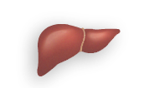
Pathophysiological Defects in Type 2 Diabetes: The ‘Ominous Octet’
Increased hepatic
glucose production
Hyperglycemia
Copyright © 2016 Eli Lilly and Company
Notes:
Diab-00076618
Copyright Disclosure: Figure has been recreated for Eli Lilly and Company with Data from DeFronzo RA. Diabetes 2009;58:773-95.
Key Points:
There are a number of mechanisms that feed into the hyperglycemia of type 2 diabetes.
The ‘traditional’ defects are in the liver and muscle uptake of glucose, and the decreased insulin secretion by the pancreas.
There are a number of others that have emerged from more recent research:
Decreased incretin effect leads to a failure of the tight coupling of insulin release with meals.
Increased lipolysis increases the breakdown of fats, leading to higher levels of free fatty acids.
The pancreatic α-cells overwork, increasing the glucagon level and hence driving up blood glucose.
The kidney reabsorbs glucose and so prevents its elimination via the urine; in diabetes, it appears to (maladaptively) increase its reuptake.
The brain drives our behavior, and our propensity to eat when full, despite high insulin levels or obesity.
Effective treatment of type 2 diabetes mellitus (T2DM) will require multiple drugs used in combination to correct the multiple pathophysiologic defects, and should be started early in the natural history of T2DM if progressive β-cell failure is to be prevented.
Reference:
DeFronzo RA. Banting Lecture. From the triumvirate to the ominous octet: a new paradigm for the treatment of type 2 diabetes mellitus. Diabetes 2009;58(4):773-95.

Slide 28

Pathophysiological Defects in Type 2 Diabetes: The ‘Ominous Octet’
Increased hepatic
glucose production
Hyperglycemia
Decreased glucose
uptake
Copyright © 2016 Eli Lilly and Company
Notes:
Diab-00076618
Copyright Disclosure: Figure has been recreated for Eli Lilly and Company with Data from DeFronzo RA. Diabetes 2009;58:773-95.
Key Points:
There are a number of mechanisms that feed into the hyperglycemia of type 2 diabetes.
The ‘traditional’ defects are in the liver and muscle uptake of glucose, and the decreased insulin secretion by the pancreas.
There are a number of others that have emerged from more recent research:
Decreased incretin effect leads to a failure of the tight coupling of insulin release with meals.
Increased lipolysis increases the breakdown of fats, leading to higher levels of free fatty acids.
The pancreatic α-cells overwork, increasing the glucagon level and hence driving up blood glucose.
The kidney reabsorbs glucose and so prevents its elimination via the urine; in diabetes, it appears to (maladaptively) increase its reuptake.
The brain drives our behavior, and our propensity to eat when full, despite high insulin levels or obesity.
Effective treatment of type 2 diabetes mellitus (T2DM) will require multiple drugs used in combination to correct the multiple pathophysiologic defects, and should be started early in the natural history of T2DM if progressive β-cell failure is to be prevented.
Reference:
DeFronzo RA. Banting Lecture. From the triumvirate to the ominous octet: a new paradigm for the treatment of type 2 diabetes mellitus. Diabetes 2009;58(4):773-95.

Slide 29
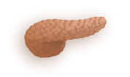
Pathophysiological Defects in Type 2 Diabetes: The ‘Ominous Octet’
Increased hepatic
glucose production
Hyperglycemia
Decreased insulin
secretion
Decreased glucose
uptake
Copyright © 2016 Eli Lilly and Company
Notes:
Diab-00076618
Copyright Disclosure: Figure has been recreated for Eli Lilly and Company with Data from DeFronzo RA. Diabetes 2009;58:773-95.
Key Points:
There are a number of mechanisms that feed into the hyperglycemia of type 2 diabetes.
The ‘traditional’ defects are in the liver and muscle uptake of glucose, and the decreased insulin secretion by the pancreas.
There are a number of others that have emerged from more recent research:
Decreased incretin effect leads to a failure of the tight coupling of insulin release with meals.
Increased lipolysis increases the breakdown of fats, leading to higher levels of free fatty acids.
The pancreatic α-cells overwork, increasing the glucagon level and hence driving up blood glucose.
The kidney reabsorbs glucose and so prevents its elimination via the urine; in diabetes, it appears to (maladaptively) increase its reuptake.
The brain drives our behavior, and our propensity to eat when full, despite high insulin levels or obesity.
Effective treatment of type 2 diabetes mellitus (T2DM) will require multiple drugs used in combination to correct the multiple pathophysiologic defects, and should be started early in the natural history of T2DM if progressive β-cell failure is to be prevented.
Reference:
DeFronzo RA. Banting Lecture. From the triumvirate to the ominous octet: a new paradigm for the treatment of type 2 diabetes mellitus. Diabetes 2009;58(4):773-95.

Slide 30

Pathophysiological Defects in Type 2 Diabetes: The ‘Ominous Octet’
Increased hepatic
glucose production
Increased glucagon
secretion
Hyperglycemia
Decreased insulin
secretion
Decreased glucose
uptake
Copyright © 2016 Eli Lilly and Company
Notes:
Diab-00076618
Copyright Disclosure: Figure has been recreated for Eli Lilly and Company with Data from DeFronzo RA. Diabetes 2009;58:773-95.
Key Points:
There are a number of mechanisms that feed into the hyperglycemia of type 2 diabetes.
The ‘traditional’ defects are in the liver and muscle uptake of glucose, and the decreased insulin secretion by the pancreas.
There are a number of others that have emerged from more recent research:
Decreased incretin effect leads to a failure of the tight coupling of insulin release with meals.
Increased lipolysis increases the breakdown of fats, leading to higher levels of free fatty acids.
The pancreatic α-cells overwork, increasing the glucagon level and hence driving up blood glucose.
The kidney reabsorbs glucose and so prevents its elimination via the urine; in diabetes, it appears to (maladaptively) increase its reuptake.
The brain drives our behavior, and our propensity to eat when full, despite high insulin levels or obesity.
Effective treatment of type 2 diabetes mellitus (T2DM) will require multiple drugs used in combination to correct the multiple pathophysiologic defects, and should be started early in the natural history of T2DM if progressive β-cell failure is to be prevented.
Reference:
DeFronzo RA. Banting Lecture. From the triumvirate to the ominous octet: a new paradigm for the treatment of type 2 diabetes mellitus. Diabetes 2009;58(4):773-95.

Slide 31
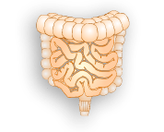
Pathophysiological Defects in Type 2 Diabetes: The ‘Ominous Octet’
Increased hepatic
glucose production
Decreased
incretin effect
Increased glucagon
secretion
Hyperglycemia
Decreased insulin
secretion
Decreased glucose
uptake
Copyright © 2016 Eli Lilly and Company
Notes:
Diab-00076618
Copyright Disclosure: Figure has been recreated for Eli Lilly and Company with Data from DeFronzo RA. Diabetes 2009;58:773-95.
Key Points:
There are a number of mechanisms that feed into the hyperglycemia of type 2 diabetes.
The ‘traditional’ defects are in the liver and muscle uptake of glucose, and the decreased insulin secretion by the pancreas.
There are a number of others that have emerged from more recent research:
Decreased incretin effect leads to a failure of the tight coupling of insulin release with meals.
Increased lipolysis increases the breakdown of fats, leading to higher levels of free fatty acids.
The pancreatic α-cells overwork, increasing the glucagon level and hence driving up blood glucose.
The kidney reabsorbs glucose and so prevents its elimination via the urine; in diabetes, it appears to (maladaptively) increase its reuptake.
The brain drives our behavior, and our propensity to eat when full, despite high insulin levels or obesity.
Effective treatment of type 2 diabetes mellitus (T2DM) will require multiple drugs used in combination to correct the multiple pathophysiologic defects, and should be started early in the natural history of T2DM if progressive β-cell failure is to be prevented.
Reference:
DeFronzo RA. Banting Lecture. From the triumvirate to the ominous octet: a new paradigm for the treatment of type 2 diabetes mellitus. Diabetes 2009;58(4):773-95.

Slide 32
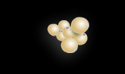
Pathophysiological Defects in Type 2 Diabetes: The ‘Ominous Octet’
Increased hepatic
glucose production
Decreased
incretin effect
Increased glucagon
secretion
Hyperglycemia
Increased
lipolysis
Decreased insulin
secretion
Decreased glucose
uptake
Copyright © 2016 Eli Lilly and Company
Notes:
Diab-00076618
Copyright Disclosure: Figure has been recreated for Eli Lilly and Company with Data from DeFronzo RA. Diabetes 2009;58:773-95.
Key Points:
There are a number of mechanisms that feed into the hyperglycemia of type 2 diabetes.
The ‘traditional’ defects are in the liver and muscle uptake of glucose, and the decreased insulin secretion by the pancreas.
There are a number of others that have emerged from more recent research:
Decreased incretin effect leads to a failure of the tight coupling of insulin release with meals.
Increased lipolysis increases the breakdown of fats, leading to higher levels of free fatty acids.
The pancreatic α-cells overwork, increasing the glucagon level and hence driving up blood glucose.
The kidney reabsorbs glucose and so prevents its elimination via the urine; in diabetes, it appears to (maladaptively) increase its reuptake.
The brain drives our behavior, and our propensity to eat when full, despite high insulin levels or obesity.
Effective treatment of type 2 diabetes mellitus (T2DM) will require multiple drugs used in combination to correct the multiple pathophysiologic defects, and should be started early in the natural history of T2DM if progressive β-cell failure is to be prevented.
Reference:
DeFronzo RA. Banting Lecture. From the triumvirate to the ominous octet: a new paradigm for the treatment of type 2 diabetes mellitus. Diabetes 2009;58(4):773-95.

Slide 33
Pathophysiological Defects in Type 2 Diabetes: The ‘Ominous Octet’
Increased hepatic
glucose production
Decreased
incretin effect
Increased glucagon
secretion
Hyperglycemia
Increased
lipolysis
Decreased insulin
secretion
Decreased glucose
uptake
Copyright © 2016 Eli Lilly and Company
Notes:
Diab-00076618
Copyright Disclosure: Figure has been recreated for Eli Lilly and Company with Data from DeFronzo RA. Diabetes 2009;58:773-95.
Key Points:
There are a number of mechanisms that feed into the hyperglycemia of type 2 diabetes.
The ‘traditional’ defects are in the liver and muscle uptake of glucose, and the decreased insulin secretion by the pancreas.
There are a number of others that have emerged from more recent research:
Decreased incretin effect leads to a failure of the tight coupling of insulin release with meals.
Increased lipolysis increases the breakdown of fats, leading to higher levels of free fatty acids.
The pancreatic α-cells overwork, increasing the glucagon level and hence driving up blood glucose.
The kidney reabsorbs glucose and so prevents its elimination via the urine; in diabetes, it appears to (maladaptively) increase its reuptake.
The brain drives our behavior, and our propensity to eat when full, despite high insulin levels or obesity.
Effective treatment of type 2 diabetes mellitus (T2DM) will require multiple drugs used in combination to correct the multiple pathophysiologic defects, and should be started early in the natural history of T2DM if progressive β-cell failure is to be prevented.
Reference:
DeFronzo RA. Banting Lecture. From the triumvirate to the ominous octet: a new paradigm for the treatment of type 2 diabetes mellitus. Diabetes 2009;58(4):773-95.

Slide 34

Pathophysiological Defects in Type 2 Diabetes: The ‘Ominous Octet’
Increased hepatic
glucose production
Decreased
incretin effect
Increased glucagon
secretion
Increased
glucose
reabsorption
Hyperglycemia
Increased
lipolysis
Decreased insulin
secretion
Decreased glucose
uptake
Copyright © 2016 Eli Lilly and Company
Notes:
Diab-00076618
Copyright Disclosure: Figure has been recreated for Eli Lilly and Company with Data from DeFronzo RA. Diabetes 2009;58:773-95.
Key Points:
There are a number of mechanisms that feed into the hyperglycemia of type 2 diabetes.
The ‘traditional’ defects are in the liver and muscle uptake of glucose, and the decreased insulin secretion by the pancreas.
There are a number of others that have emerged from more recent research:
Decreased incretin effect leads to a failure of the tight coupling of insulin release with meals.
Increased lipolysis increases the breakdown of fats, leading to higher levels of free fatty acids.
The pancreatic α-cells overwork, increasing the glucagon level and hence driving up blood glucose.
The kidney reabsorbs glucose and so prevents its elimination via the urine; in diabetes, it appears to (maladaptively) increase its reuptake.
The brain drives our behavior, and our propensity to eat when full, despite high insulin levels or obesity.
Effective treatment of type 2 diabetes mellitus (T2DM) will require multiple drugs used in combination to correct the multiple pathophysiologic defects, and should be started early in the natural history of T2DM if progressive β-cell failure is to be prevented.
Reference:
DeFronzo RA. Banting Lecture. From the triumvirate to the ominous octet: a new paradigm for the treatment of type 2 diabetes mellitus. Diabetes 2009;58(4):773-95.

Slide 35

Pathophysiological Defects in Type 2 Diabetes: The ‘Ominous Octet’
Neurotransmitter
dysfunction
Increased hepatic
glucose production
Decreased
incretin effect
Increased glucagon
secretion
Increased
glucose
reabsorption
Hyperglycemia
Increased
lipolysis
Decreased insulin
secretion
Decreased glucose
uptake
Copyright © 2016 Eli Lilly and Company
Notes:
Diab-00076618
Copyright Disclosure: Figure has been recreated for Eli Lilly and Company with Data from DeFronzo RA. Diabetes 2009;58:773-95.
Key Points:
There are a number of mechanisms that feed into the hyperglycemia of type 2 diabetes.
The ‘traditional’ defects are in the liver and muscle uptake of glucose, and the decreased insulin secretion by the pancreas.
There are a number of others that have emerged from more recent research:
Decreased incretin effect leads to a failure of the tight coupling of insulin release with meals.
Increased lipolysis increases the breakdown of fats, leading to higher levels of free fatty acids.
The pancreatic α-cells overwork, increasing the glucagon level and hence driving up blood glucose.
The kidney reabsorbs glucose and so prevents its elimination via the urine; in diabetes, it appears to (maladaptively) increase its reuptake.
The brain drives our behavior, and our propensity to eat when full, despite high insulin levels or obesity.
Effective treatment of type 2 diabetes mellitus (T2DM) will require multiple drugs used in combination to correct the multiple pathophysiologic defects, and should be started early in the natural history of T2DM if progressive β-cell failure is to be prevented.
Reference:
DeFronzo RA. Banting Lecture. From the triumvirate to the ominous octet: a new paradigm for the treatment of type 2 diabetes mellitus. Diabetes 2009;58(4):773-95.

Slide 36

Factors Contributing to Progressive Alteration of β-cell Function and Therapeutic Intervention
β-cell function
ACEi=angiotensin converting enzyme inhibitors; ARB=angiotensin receptor blocker; MET=metformin; SU=sulphonylurea; TZD=thiazolidindione
Cernea S and Dobreanu M. Biochemia Medica 2013;23:266-80
Copyright © 2016 Eli Lilly and Company
Notes:
Diab-00076618
Abbreviations:
ACEi=angiotensin converting enzyme inhibitors; ARB=angiotensin receptor blocker; MET=metformin; SU=sulphonylurea; TZD=thiazolidindione
Key Points:
Several factors contribute to the progressive loss of pancreatic beta-cell function/mass in diabetics, including:
Hyperglycemia/glucotoxicity: prolonged exposure to high blood glucose levels results is detrimental, toxic effects on insulin synthesis/secretion, cell survival and insulin sensitivity, which in turn lead to hyperglycemia and to the continuous deterioration of beta-cell function
Therapeutic intervention includes improvement of peripheral glucose uptake with metformin or TZD, reduction of hepatic glucose production with metformin, TZD, or incretins, improvement of insulin secretion with SU or incretins, or with exogenous administration of insulin²
Lipotoxicity: prolonged exposure to increased free fatty acid levels leads to an accumulation of toxic fatty acid metabolites in the islet cells
Therapeutic intervention include suppression of lipolysis with TZDs and insulin, reduction of free fatty acids in the blood and removing the fat from beta-cells, liver and muscle with TZDs² and reduction of glucose and free fatty acid levels with incretins³
Autoimmunity: approximately 10% of T2D patients have diabetes-specific autoantibodies. The incidence is higher in younger, leaner groups⁴
Data on the effects of immune modulators in T2D patients is limited; however, a recent study found that when combined with metformin, an interleukin-1β antibody resulted in a numerical reduction in HbA1c vs. placebo, potentially by improving beta-cell function⁵
Inflammation: increased blood glucose and free fatty acid levels induce an inflammatory response in pancreatic islet cells, which increases the production of cytokines and chemokines⁶. Pro-inflammatory adipokines have local and systemic effects on metabolism, which contribute to the chronic inflammatory process^{7,8}
Anti-inflammatory effects have been demonstrated with insulin, TZDs and metformin. Similar effects have been demonstrated with nonhypoglycemic drugs commonly used by diabetics, including statins, fibrates, angiotensin converting enzyme inhibitors, angiotensin, receptor blockers and even high-dose aspirin^{9,10}
Islet amyloid: while not yet fully understood, evidence suggests a relationship between amyloid formation and beta-cell dysfunction and death¹¹
The available literature regarding agents that would improve islet amyloid deposition and its toxic effects on beta cells is limited; however recent reports, suggest that a TZD and a GLP-1 receptor agonist may have protective effects via PI-3K/AKT pathway¹²
Incretins: in T2D there is an impairment of insulin release and resistance to their action, contributing to beta-cell dysfunction¹³
The positive effects of incretins on beta-cell function is well known^{2,14,15}
Insulin resistance: While the role of insulin resistance in T2D is well known, the mechanisms by which insulin resistance contributes to beta-cell failure are not fully understood. Hypotheses include exhaustion of the beta-cell as a result of insulin hyper-secretion or that factors that contribute to insulin resistance also cause beta-cell dysfunction²
Metformin and TZD have demonstrated positive effects on insulin resistance, due to their potent insulin sensitizing effects as well as their effects on reducing hyperglycemia²
References:
Cernea S, Dobreanu M. Diabetes and beta cell function: from mechanisms to evaluation and clinical implications. Biochemia Medica 2013;23(3):266-80.
DeFronzo RA. Banting Lecture. From the triumvirate to the ominous octet: a new paradigm for the treatment of type 2 diabetes mellitus. Diabetes 2009;58(4):773-95.
Buteau J, El-Assaad W, et al. Glucagon-like peptide-1 prevents beta cell glucolipotoxicity. Diabetologia 2004;47:806-15.
Genovese S, Bazzigaluppi E, et al. Clinical phenotype and beta-cell autoimmunity in Italian patients with adult-onset diabetes. Eur J Endocrinol 2006;154:441-7.
Hensen J, Howard CP, et al. Impact of interleukin-1β antibody (canakinumab) on glycaemic indicators in patients with type 2 diabetes mellitus: results of secondary endpoints from a randomized, placebo-controlled trial. Diabetes Metab 2013;39(6):524-31.
Donath MY, Böni-Schnetzler M, Ellingsgaard H, Ehses JA. Islet inflammation impairs the pancreatic beta-cell in type 2 diabetes. Physiology (Bethesda) 2009;24:325-31.
Goldberg RB. Cytokine and cytokine-like inflammation markers, endothelial dysfunction, and imbalanced coagulation in development of diabetes and its complications. J Clin Endocrinol Metab 2009;94:3171-82.
Dunmore SJ, Brown JE. The role of adipokines in β-cell failure of type 2 diabetes. J Endocrinol 2013;216:T37-45.
Molavi B, Rassouli N, et al. A review of thiazolidinediones and metformin in the treatment of type 2 diabetes with focus on cardiovascular complications. Vasc Health Risk Manag 2007;3:967-73.
Deans KA, Sattar N. “Anti-inflammatory” drugs and their effects on type 2 diabetes. Diabetes Technol Ther 2006;8:18-27.
Jurgens CA, Toukatly MN, et al. β-cell loss and β-cell apoptosis in human type 2 diabetes are related to islet amyloid deposition. Am J Pathol 2011;178:2632-40.
Aston-Mourney K, Hull RL, et al. Exendin-4 increases islet amyloid deposition but offsets the resultant beta cell toxicity in human islet amyloid polypeptide transgenic mouse islets. Diabetologia 2011;54:1756-65.
Meier JJ, Nauck MA. Is the diminished incretin effect in type 2 diabetes just an epi-phenomenon of impaired beta-cell function? Diabetes 2010;59:1117-25.
Cernea S, Raz I. Therapy in the early stage: incretins. Diabetes Care 2011;34 Suppl 2:S264-71.
Cernea S. The role of incretin therapy at different stages of diabetes. Rev Diabet Stud 2011;8:323-38.

Slide 37
Factors Contributing to Progressive Alteration of β-cell Function and Therapeutic Intervention
Autoimmunity
(Immune modulators)
β-cell function
ACEi=angiotensin converting enzyme inhibitors; ARB=angiotensin receptor blocker; MET=metformin; SU=sulphonylurea; TZD=thiazolidindione
Cernea S and Dobreanu M. Biochemia Medica 2013;23:266-80
Copyright © 2016 Eli Lilly and Company
Notes:
Diab-00076618
Abbreviations:
ACEi=angiotensin converting enzyme inhibitors; ARB=angiotensin receptor blocker; MET=metformin; SU=sulphonylurea; TZD=thiazolidindione
Key Points:
Several factors contribute to the progressive loss of pancreatic beta-cell function/mass in diabetics, including:
Hyperglycemia/glucotoxicity: prolonged exposure to high blood glucose levels results is detrimental, toxic effects on insulin synthesis/secretion, cell survival and insulin sensitivity, which in turn lead to hyperglycemia and to the continuous deterioration of beta-cell function
Therapeutic intervention includes improvement of peripheral glucose uptake with metformin or TZD, reduction of hepatic glucose production with metformin, TZD, or incretins, improvement of insulin secretion with SU or incretins, or with exogenous administration of insulin²
Lipotoxicity: prolonged exposure to increased free fatty acid levels leads to an accumulation of toxic fatty acid metabolites in the islet cells
Therapeutic intervention include suppression of lipolysis with TZDs and insulin, reduction of free fatty acids in the blood and removing the fat from beta-cells, liver and muscle with TZDs² and reduction of glucose and free fatty acid levels with incretins³
Autoimmunity: approximately 10% of T2D patients have diabetes-specific autoantibodies. The incidence is higher in younger, leaner groups⁴
Data on the effects of immune modulators in T2D patients is limited; however, a recent study found that when combined with metformin, an interleukin-1β antibody resulted in a numerical reduction in HbA1c vs. placebo, potentially by improving beta-cell function⁵
Inflammation: increased blood glucose and free fatty acid levels induce an inflammatory response in pancreatic islet cells, which increases the production of cytokines and chemokines⁶. Pro-inflammatory adipokines have local and systemic effects on metabolism, which contribute to the chronic inflammatory process^{7,8}
Anti-inflammatory effects have been demonstrated with insulin, TZDs and metformin. Similar effects have been demonstrated with nonhypoglycemic drugs commonly used by diabetics, including statins, fibrates, angiotensin converting enzyme inhibitors, angiotensin, receptor blockers and even high-dose aspirin^{9,10}
Islet amyloid: while not yet fully understood, evidence suggests a relationship between amyloid formation and beta-cell dysfunction and death¹¹
The available literature regarding agents that would improve islet amyloid deposition and its toxic effects on beta cells is limited; however recent reports, suggest that a TZD and a GLP-1 receptor agonist may have protective effects via PI-3K/AKT pathway¹²
Incretins: in T2D there is an impairment of insulin release and resistance to their action, contributing to beta-cell dysfunction¹³
The positive effects of incretins on beta-cell function is well known^{2,14,15}
Insulin resistance: While the role of insulin resistance in T2D is well known, the mechanisms by which insulin resistance contributes to beta-cell failure are not fully understood. Hypotheses include exhaustion of the beta-cell as a result of insulin hyper-secretion or that factors that contribute to insulin resistance also cause beta-cell dysfunction²
Metformin and TZD have demonstrated positive effects on insulin resistance, due to their potent insulin sensitizing effects as well as their effects on reducing hyperglycemia²
References:
Cernea S, Dobreanu M. Diabetes and beta cell function: from mechanisms to evaluation and clinical implications. Biochemia Medica 2013;23(3):266-80.
DeFronzo RA. Banting Lecture. From the triumvirate to the ominous octet: a new paradigm for the treatment of type 2 diabetes mellitus. Diabetes 2009;58(4):773-95.
Buteau J, El-Assaad W, et al. Glucagon-like peptide-1 prevents beta cell glucolipotoxicity. Diabetologia 2004;47:806-15.
Genovese S, Bazzigaluppi E, et al. Clinical phenotype and beta-cell autoimmunity in Italian patients with adult-onset diabetes. Eur J Endocrinol 2006;154:441-7.
Hensen J, Howard CP, et al. Impact of interleukin-1β antibody (canakinumab) on glycaemic indicators in patients with type 2 diabetes mellitus: results of secondary endpoints from a randomized, placebo-controlled trial. Diabetes Metab 2013;39(6):524-31.
Donath MY, Böni-Schnetzler M, Ellingsgaard H, Ehses JA. Islet inflammation impairs the pancreatic beta-cell in type 2 diabetes. Physiology (Bethesda) 2009;24:325-31.
Goldberg RB. Cytokine and cytokine-like inflammation markers, endothelial dysfunction, and imbalanced coagulation in development of diabetes and its complications. J Clin Endocrinol Metab 2009;94:3171-82.
Dunmore SJ, Brown JE. The role of adipokines in β-cell failure of type 2 diabetes. J Endocrinol 2013;216:T37-45.
Molavi B, Rassouli N, et al. A review of thiazolidinediones and metformin in the treatment of type 2 diabetes with focus on cardiovascular complications. Vasc Health Risk Manag 2007;3:967-73.
Deans KA, Sattar N. “Anti-inflammatory” drugs and their effects on type 2 diabetes. Diabetes Technol Ther 2006;8:18-27.
Jurgens CA, Toukatly MN, et al. β-cell loss and β-cell apoptosis in human type 2 diabetes are related to islet amyloid deposition. Am J Pathol 2011;178:2632-40.
Aston-Mourney K, Hull RL, et al. Exendin-4 increases islet amyloid deposition but offsets the resultant beta cell toxicity in human islet amyloid polypeptide transgenic mouse islets. Diabetologia 2011;54:1756-65.
Meier JJ, Nauck MA. Is the diminished incretin effect in type 2 diabetes just an epi-phenomenon of impaired beta-cell function? Diabetes 2010;59:1117-25.
Cernea S, Raz I. Therapy in the early stage: incretins. Diabetes Care 2011;34 Suppl 2:S264-71.
Cernea S. The role of incretin therapy at different stages of diabetes. Rev Diabet Stud 2011;8:323-38.

Slide 38
Factors Contributing to Progressive Alteration of β-cell Function and Therapeutic Intervention
Autoimmunity
(Immune modulators)
β-cell function
Insulin resistance
(MET, TZD)
ACEi=angiotensin converting enzyme inhibitors; ARB=angiotensin receptor blocker; MET=metformin; SU=sulphonylurea; TZD=thiazolidindione
Cernea S and Dobreanu M. Biochemia Medica 2013;23:266-80
Copyright © 2016 Eli Lilly and Company
Notes:
Diab-00076618
Abbreviations:
ACEi=angiotensin converting enzyme inhibitors; ARB=angiotensin receptor blocker; MET=metformin; SU=sulphonylurea; TZD=thiazolidindione
Key Points:
Several factors contribute to the progressive loss of pancreatic beta-cell function/mass in diabetics, including:
Hyperglycemia/glucotoxicity: prolonged exposure to high blood glucose levels results is detrimental, toxic effects on insulin synthesis/secretion, cell survival and insulin sensitivity, which in turn lead to hyperglycemia and to the continuous deterioration of beta-cell function
Therapeutic intervention includes improvement of peripheral glucose uptake with metformin or TZD, reduction of hepatic glucose production with metformin, TZD, or incretins, improvement of insulin secretion with SU or incretins, or with exogenous administration of insulin²
Lipotoxicity: prolonged exposure to increased free fatty acid levels leads to an accumulation of toxic fatty acid metabolites in the islet cells
Therapeutic intervention include suppression of lipolysis with TZDs and insulin, reduction of free fatty acids in the blood and removing the fat from beta-cells, liver and muscle with TZDs² and reduction of glucose and free fatty acid levels with incretins³
Autoimmunity: approximately 10% of T2D patients have diabetes-specific autoantibodies. The incidence is higher in younger, leaner groups⁴
Data on the effects of immune modulators in T2D patients is limited; however, a recent study found that when combined with metformin, an interleukin-1β antibody resulted in a numerical reduction in HbA1c vs. placebo, potentially by improving beta-cell function⁵
Inflammation: increased blood glucose and free fatty acid levels induce an inflammatory response in pancreatic islet cells, which increases the production of cytokines and chemokines⁶. Pro-inflammatory adipokines have local and systemic effects on metabolism, which contribute to the chronic inflammatory process^{7,8}
Anti-inflammatory effects have been demonstrated with insulin, TZDs and metformin. Similar effects have been demonstrated with nonhypoglycemic drugs commonly used by diabetics, including statins, fibrates, angiotensin converting enzyme inhibitors, angiotensin, receptor blockers and even high-dose aspirin^{9,10}
Islet amyloid: while not yet fully understood, evidence suggests a relationship between amyloid formation and beta-cell dysfunction and death¹¹
The available literature regarding agents that would improve islet amyloid deposition and its toxic effects on beta cells is limited; however recent reports, suggest that a TZD and a GLP-1 receptor agonist may have protective effects via PI-3K/AKT pathway¹²
Incretins: in T2D there is an impairment of insulin release and resistance to their action, contributing to beta-cell dysfunction¹³
The positive effects of incretins on beta-cell function is well known^{2,14,15}
Insulin resistance: While the role of insulin resistance in T2D is well known, the mechanisms by which insulin resistance contributes to beta-cell failure are not fully understood. Hypotheses include exhaustion of the beta-cell as a result of insulin hyper-secretion or that factors that contribute to insulin resistance also cause beta-cell dysfunction²
Metformin and TZD have demonstrated positive effects on insulin resistance, due to their potent insulin sensitizing effects as well as their effects on reducing hyperglycemia²
References:
Cernea S, Dobreanu M. Diabetes and beta cell function: from mechanisms to evaluation and clinical implications. Biochemia Medica 2013;23(3):266-80.
DeFronzo RA. Banting Lecture. From the triumvirate to the ominous octet: a new paradigm for the treatment of type 2 diabetes mellitus. Diabetes 2009;58(4):773-95.
Buteau J, El-Assaad W, et al. Glucagon-like peptide-1 prevents beta cell glucolipotoxicity. Diabetologia 2004;47:806-15.
Genovese S, Bazzigaluppi E, et al. Clinical phenotype and beta-cell autoimmunity in Italian patients with adult-onset diabetes. Eur J Endocrinol 2006;154:441-7.
Hensen J, Howard CP, et al. Impact of interleukin-1β antibody (canakinumab) on glycaemic indicators in patients with type 2 diabetes mellitus: results of secondary endpoints from a randomized, placebo-controlled trial. Diabetes Metab 2013;39(6):524-31.
Donath MY, Böni-Schnetzler M, Ellingsgaard H, Ehses JA. Islet inflammation impairs the pancreatic beta-cell in type 2 diabetes. Physiology (Bethesda) 2009;24:325-31.
Goldberg RB. Cytokine and cytokine-like inflammation markers, endothelial dysfunction, and imbalanced coagulation in development of diabetes and its complications. J Clin Endocrinol Metab 2009;94:3171-82.
Dunmore SJ, Brown JE. The role of adipokines in β-cell failure of type 2 diabetes. J Endocrinol 2013;216:T37-45.
Molavi B, Rassouli N, et al. A review of thiazolidinediones and metformin in the treatment of type 2 diabetes with focus on cardiovascular complications. Vasc Health Risk Manag 2007;3:967-73.
Deans KA, Sattar N. “Anti-inflammatory” drugs and their effects on type 2 diabetes. Diabetes Technol Ther 2006;8:18-27.
Jurgens CA, Toukatly MN, et al. β-cell loss and β-cell apoptosis in human type 2 diabetes are related to islet amyloid deposition. Am J Pathol 2011;178:2632-40.
Aston-Mourney K, Hull RL, et al. Exendin-4 increases islet amyloid deposition but offsets the resultant beta cell toxicity in human islet amyloid polypeptide transgenic mouse islets. Diabetologia 2011;54:1756-65.
Meier JJ, Nauck MA. Is the diminished incretin effect in type 2 diabetes just an epi-phenomenon of impaired beta-cell function? Diabetes 2010;59:1117-25.
Cernea S, Raz I. Therapy in the early stage: incretins. Diabetes Care 2011;34 Suppl 2:S264-71.
Cernea S. The role of incretin therapy at different stages of diabetes. Rev Diabet Stud 2011;8:323-38.

Slide 39
Factors Contributing to Progressive Alteration of β-cell Function and Therapeutic Intervention
Autoimmunity
(Immune modulators)
Hyperglycemia/glucotoxicity
(Insulin, Incretins, SU, MET, TZD)
β-cell function
Insulin resistance
(MET, TZD)
ACEi=angiotensin converting enzyme inhibitors; ARB=angiotensin receptor blocker; MET=metformin; SU=sulphonylurea; TZD=thiazolidindione
Cernea S and Dobreanu M. Biochemia Medica 2013;23:266-80
Copyright © 2016 Eli Lilly and Company
Notes:
Diab-00076618
Abbreviations:
ACEi=angiotensin converting enzyme inhibitors; ARB=angiotensin receptor blocker; MET=metformin; SU=sulphonylurea; TZD=thiazolidindione
Key Points:
Several factors contribute to the progressive loss of pancreatic beta-cell function/mass in diabetics, including:
Hyperglycemia/glucotoxicity: prolonged exposure to high blood glucose levels results is detrimental, toxic effects on insulin synthesis/secretion, cell survival and insulin sensitivity, which in turn lead to hyperglycemia and to the continuous deterioration of beta-cell function
Therapeutic intervention includes improvement of peripheral glucose uptake with metformin or TZD, reduction of hepatic glucose production with metformin, TZD, or incretins, improvement of insulin secretion with SU or incretins, or with exogenous administration of insulin²
Lipotoxicity: prolonged exposure to increased free fatty acid levels leads to an accumulation of toxic fatty acid metabolites in the islet cells
Therapeutic intervention include suppression of lipolysis with TZDs and insulin, reduction of free fatty acids in the blood and removing the fat from beta-cells, liver and muscle with TZDs² and reduction of glucose and free fatty acid levels with incretins³
Autoimmunity: approximately 10% of T2D patients have diabetes-specific autoantibodies. The incidence is higher in younger, leaner groups⁴
Data on the effects of immune modulators in T2D patients is limited; however, a recent study found that when combined with metformin, an interleukin-1β antibody resulted in a numerical reduction in HbA1c vs. placebo, potentially by improving beta-cell function⁵
Inflammation: increased blood glucose and free fatty acid levels induce an inflammatory response in pancreatic islet cells, which increases the production of cytokines and chemokines⁶. Pro-inflammatory adipokines have local and systemic effects on metabolism, which contribute to the chronic inflammatory process^{7,8}
Anti-inflammatory effects have been demonstrated with insulin, TZDs and metformin. Similar effects have been demonstrated with nonhypoglycemic drugs commonly used by diabetics, including statins, fibrates, angiotensin converting enzyme inhibitors, angiotensin, receptor blockers and even high-dose aspirin^{9,10}
Islet amyloid: while not yet fully understood, evidence suggests a relationship between amyloid formation and beta-cell dysfunction and death¹¹
The available literature regarding agents that would improve islet amyloid deposition and its toxic effects on beta cells is limited; however recent reports, suggest that a TZD and a GLP-1 receptor agonist may have protective effects via PI-3K/AKT pathway¹²
Incretins: in T2D there is an impairment of insulin release and resistance to their action, contributing to beta-cell dysfunction¹³
The positive effects of incretins on beta-cell function is well known^{2,14,15}
Insulin resistance: While the role of insulin resistance in T2D is well known, the mechanisms by which insulin resistance contributes to beta-cell failure are not fully understood. Hypotheses include exhaustion of the beta-cell as a result of insulin hyper-secretion or that factors that contribute to insulin resistance also cause beta-cell dysfunction²
Metformin and TZD have demonstrated positive effects on insulin resistance, due to their potent insulin sensitizing effects as well as their effects on reducing hyperglycemia²
References:
Cernea S, Dobreanu M. Diabetes and beta cell function: from mechanisms to evaluation and clinical implications. Biochemia Medica 2013;23(3):266-80.
DeFronzo RA. Banting Lecture. From the triumvirate to the ominous octet: a new paradigm for the treatment of type 2 diabetes mellitus. Diabetes 2009;58(4):773-95.
Buteau J, El-Assaad W, et al. Glucagon-like peptide-1 prevents beta cell glucolipotoxicity. Diabetologia 2004;47:806-15.
Genovese S, Bazzigaluppi E, et al. Clinical phenotype and beta-cell autoimmunity in Italian patients with adult-onset diabetes. Eur J Endocrinol 2006;154:441-7.
Hensen J, Howard CP, et al. Impact of interleukin-1β antibody (canakinumab) on glycaemic indicators in patients with type 2 diabetes mellitus: results of secondary endpoints from a randomized, placebo-controlled trial. Diabetes Metab 2013;39(6):524-31.
Donath MY, Böni-Schnetzler M, Ellingsgaard H, Ehses JA. Islet inflammation impairs the pancreatic beta-cell in type 2 diabetes. Physiology (Bethesda) 2009;24:325-31.
Goldberg RB. Cytokine and cytokine-like inflammation markers, endothelial dysfunction, and imbalanced coagulation in development of diabetes and its complications. J Clin Endocrinol Metab 2009;94:3171-82.
Dunmore SJ, Brown JE. The role of adipokines in β-cell failure of type 2 diabetes. J Endocrinol 2013;216:T37-45.
Molavi B, Rassouli N, et al. A review of thiazolidinediones and metformin in the treatment of type 2 diabetes with focus on cardiovascular complications. Vasc Health Risk Manag 2007;3:967-73.
Deans KA, Sattar N. “Anti-inflammatory” drugs and their effects on type 2 diabetes. Diabetes Technol Ther 2006;8:18-27.
Jurgens CA, Toukatly MN, et al. β-cell loss and β-cell apoptosis in human type 2 diabetes are related to islet amyloid deposition. Am J Pathol 2011;178:2632-40.
Aston-Mourney K, Hull RL, et al. Exendin-4 increases islet amyloid deposition but offsets the resultant beta cell toxicity in human islet amyloid polypeptide transgenic mouse islets. Diabetologia 2011;54:1756-65.
Meier JJ, Nauck MA. Is the diminished incretin effect in type 2 diabetes just an epi-phenomenon of impaired beta-cell function? Diabetes 2010;59:1117-25.
Cernea S, Raz I. Therapy in the early stage: incretins. Diabetes Care 2011;34 Suppl 2:S264-71.
Cernea S. The role of incretin therapy at different stages of diabetes. Rev Diabet Stud 2011;8:323-38.

Slide 40
Factors Contributing to Progressive Alteration of β-cell Function and Therapeutic Intervention
Autoimmunity
(Immune modulators)
Hyperglycemia/glucotoxicity
(Insulin, Incretins, SU, MET, TZD)
β-cell function
Insulin resistance
(MET, TZD)
ACEi=angiotensin converting enzyme inhibitors; ARB=angiotensin receptor blocker; MET=metformin; SU=sulphonylurea; TZD=thiazolidindione
Cernea S and Dobreanu M. Biochemia Medica 2013;23:266-80
Copyright © 2016 Eli Lilly and Company
Notes:
Diab-00076618
Abbreviations:
ACEi=angiotensin converting enzyme inhibitors; ARB=angiotensin receptor blocker; MET=metformin; SU=sulphonylurea; TZD=thiazolidindione
Key Points:
Several factors contribute to the progressive loss of pancreatic beta-cell function/mass in diabetics, including:
Hyperglycemia/glucotoxicity: prolonged exposure to high blood glucose levels results is detrimental, toxic effects on insulin synthesis/secretion, cell survival and insulin sensitivity, which in turn lead to hyperglycemia and to the continuous deterioration of beta-cell function
Therapeutic intervention includes improvement of peripheral glucose uptake with metformin or TZD, reduction of hepatic glucose production with metformin, TZD, or incretins, improvement of insulin secretion with SU or incretins, or with exogenous administration of insulin²
Lipotoxicity: prolonged exposure to increased free fatty acid levels leads to an accumulation of toxic fatty acid metabolites in the islet cells
Therapeutic intervention include suppression of lipolysis with TZDs and insulin, reduction of free fatty acids in the blood and removing the fat from beta-cells, liver and muscle with TZDs² and reduction of glucose and free fatty acid levels with incretins³
Autoimmunity: approximately 10% of T2D patients have diabetes-specific autoantibodies. The incidence is higher in younger, leaner groups⁴
Data on the effects of immune modulators in T2D patients is limited; however, a recent study found that when combined with metformin, an interleukin-1β antibody resulted in a numerical reduction in HbA1c vs. placebo, potentially by improving beta-cell function⁵
Inflammation: increased blood glucose and free fatty acid levels induce an inflammatory response in pancreatic islet cells, which increases the production of cytokines and chemokines⁶. Pro-inflammatory adipokines have local and systemic effects on metabolism, which contribute to the chronic inflammatory process^{7,8}
Anti-inflammatory effects have been demonstrated with insulin, TZDs and metformin. Similar effects have been demonstrated with nonhypoglycemic drugs commonly used by diabetics, including statins, fibrates, angiotensin converting enzyme inhibitors, angiotensin, receptor blockers and even high-dose aspirin^{9,10}
Islet amyloid: while not yet fully understood, evidence suggests a relationship between amyloid formation and beta-cell dysfunction and death¹¹
The available literature regarding agents that would improve islet amyloid deposition and its toxic effects on beta cells is limited; however recent reports, suggest that a TZD and a GLP-1 receptor agonist may have protective effects via PI-3K/AKT pathway¹²
Incretins: in T2D there is an impairment of insulin release and resistance to their action, contributing to beta-cell dysfunction¹³
The positive effects of incretins on beta-cell function is well known^{2,14,15}
Insulin resistance: While the role of insulin resistance in T2D is well known, the mechanisms by which insulin resistance contributes to beta-cell failure are not fully understood. Hypotheses include exhaustion of the beta-cell as a result of insulin hyper-secretion or that factors that contribute to insulin resistance also cause beta-cell dysfunction²
Metformin and TZD have demonstrated positive effects on insulin resistance, due to their potent insulin sensitizing effects as well as their effects on reducing hyperglycemia²
References:
Cernea S, Dobreanu M. Diabetes and beta cell function: from mechanisms to evaluation and clinical implications. Biochemia Medica 2013;23(3):266-80.
DeFronzo RA. Banting Lecture. From the triumvirate to the ominous octet: a new paradigm for the treatment of type 2 diabetes mellitus. Diabetes 2009;58(4):773-95.
Buteau J, El-Assaad W, et al. Glucagon-like peptide-1 prevents beta cell glucolipotoxicity. Diabetologia 2004;47:806-15.
Genovese S, Bazzigaluppi E, et al. Clinical phenotype and beta-cell autoimmunity in Italian patients with adult-onset diabetes. Eur J Endocrinol 2006;154:441-7.
Hensen J, Howard CP, et al. Impact of interleukin-1β antibody (canakinumab) on glycaemic indicators in patients with type 2 diabetes mellitus: results of secondary endpoints from a randomized, placebo-controlled trial. Diabetes Metab 2013;39(6):524-31.
Donath MY, Böni-Schnetzler M, Ellingsgaard H, Ehses JA. Islet inflammation impairs the pancreatic beta-cell in type 2 diabetes. Physiology (Bethesda) 2009;24:325-31.
Goldberg RB. Cytokine and cytokine-like inflammation markers, endothelial dysfunction, and imbalanced coagulation in development of diabetes and its complications. J Clin Endocrinol Metab 2009;94:3171-82.
Dunmore SJ, Brown JE. The role of adipokines in β-cell failure of type 2 diabetes. J Endocrinol 2013;216:T37-45.
Molavi B, Rassouli N, et al. A review of thiazolidinediones and metformin in the treatment of type 2 diabetes with focus on cardiovascular complications. Vasc Health Risk Manag 2007;3:967-73.
Deans KA, Sattar N. “Anti-inflammatory” drugs and their effects on type 2 diabetes. Diabetes Technol Ther 2006;8:18-27.
Jurgens CA, Toukatly MN, et al. β-cell loss and β-cell apoptosis in human type 2 diabetes are related to islet amyloid deposition. Am J Pathol 2011;178:2632-40.
Aston-Mourney K, Hull RL, et al. Exendin-4 increases islet amyloid deposition but offsets the resultant beta cell toxicity in human islet amyloid polypeptide transgenic mouse islets. Diabetologia 2011;54:1756-65.
Meier JJ, Nauck MA. Is the diminished incretin effect in type 2 diabetes just an epi-phenomenon of impaired beta-cell function? Diabetes 2010;59:1117-25.
Cernea S, Raz I. Therapy in the early stage: incretins. Diabetes Care 2011;34 Suppl 2:S264-71.
Cernea S. The role of incretin therapy at different stages of diabetes. Rev Diabet Stud 2011;8:323-38.

Slide 41
Factors Contributing to Progressive Alteration of β-cell Function and Therapeutic Intervention
Lipotoxicity
(Insulin, Incretins, TZD)
Autoimmunity
(Immune modulators)
Hyperglycemia/glucotoxicity
(Insulin, Incretins, SU, MET, TZD)
β-cell function
Insulin resistance
(MET, TZD)
ACEi=angiotensin converting enzyme inhibitors; ARB=angiotensin receptor blocker; MET=metformin; SU=sulphonylurea; TZD=thiazolidindione
Cernea S and Dobreanu M. Biochemia Medica 2013;23:266-80
Copyright © 2016 Eli Lilly and Company
Notes:
Diab-00076618
Abbreviations:
ACEi=angiotensin converting enzyme inhibitors; ARB=angiotensin receptor blocker; MET=metformin; SU=sulphonylurea; TZD=thiazolidindione
Key Points:
Several factors contribute to the progressive loss of pancreatic beta-cell function/mass in diabetics, including:
Hyperglycemia/glucotoxicity: prolonged exposure to high blood glucose levels results is detrimental, toxic effects on insulin synthesis/secretion, cell survival and insulin sensitivity, which in turn lead to hyperglycemia and to the continuous deterioration of beta-cell function
Therapeutic intervention includes improvement of peripheral glucose uptake with metformin or TZD, reduction of hepatic glucose production with metformin, TZD, or incretins, improvement of insulin secretion with SU or incretins, or with exogenous administration of insulin²
Lipotoxicity: prolonged exposure to increased free fatty acid levels leads to an accumulation of toxic fatty acid metabolites in the islet cells
Therapeutic intervention include suppression of lipolysis with TZDs and insulin, reduction of free fatty acids in the blood and removing the fat from beta-cells, liver and muscle with TZDs² and reduction of glucose and free fatty acid levels with incretins³
Autoimmunity: approximately 10% of T2D patients have diabetes-specific autoantibodies. The incidence is higher in younger, leaner groups⁴
Data on the effects of immune modulators in T2D patients is limited; however, a recent study found that when combined with metformin, an interleukin-1β antibody resulted in a numerical reduction in HbA1c vs. placebo, potentially by improving beta-cell function⁵
Inflammation: increased blood glucose and free fatty acid levels induce an inflammatory response in pancreatic islet cells, which increases the production of cytokines and chemokines⁶. Pro-inflammatory adipokines have local and systemic effects on metabolism, which contribute to the chronic inflammatory process^{7,8}
Anti-inflammatory effects have been demonstrated with insulin, TZDs and metformin. Similar effects have been demonstrated with nonhypoglycemic drugs commonly used by diabetics, including statins, fibrates, angiotensin converting enzyme inhibitors, angiotensin, receptor blockers and even high-dose aspirin^{9,10}
Islet amyloid: while not yet fully understood, evidence suggests a relationship between amyloid formation and beta-cell dysfunction and death¹¹
The available literature regarding agents that would improve islet amyloid deposition and its toxic effects on beta cells is limited; however recent reports, suggest that a TZD and a GLP-1 receptor agonist may have protective effects via PI-3K/AKT pathway¹²
Incretins: in T2D there is an impairment of insulin release and resistance to their action, contributing to beta-cell dysfunction¹³
The positive effects of incretins on beta-cell function is well known^{2,14,15}
Insulin resistance: While the role of insulin resistance in T2D is well known, the mechanisms by which insulin resistance contributes to beta-cell failure are not fully understood. Hypotheses include exhaustion of the beta-cell as a result of insulin hyper-secretion or that factors that contribute to insulin resistance also cause beta-cell dysfunction²
Metformin and TZD have demonstrated positive effects on insulin resistance, due to their potent insulin sensitizing effects as well as their effects on reducing hyperglycemia²
References:
Cernea S, Dobreanu M. Diabetes and beta cell function: from mechanisms to evaluation and clinical implications. Biochemia Medica 2013;23(3):266-80.
DeFronzo RA. Banting Lecture. From the triumvirate to the ominous octet: a new paradigm for the treatment of type 2 diabetes mellitus. Diabetes 2009;58(4):773-95.
Buteau J, El-Assaad W, et al. Glucagon-like peptide-1 prevents beta cell glucolipotoxicity. Diabetologia 2004;47:806-15.
Genovese S, Bazzigaluppi E, et al. Clinical phenotype and beta-cell autoimmunity in Italian patients with adult-onset diabetes. Eur J Endocrinol 2006;154:441-7.
Hensen J, Howard CP, et al. Impact of interleukin-1β antibody (canakinumab) on glycaemic indicators in patients with type 2 diabetes mellitus: results of secondary endpoints from a randomized, placebo-controlled trial. Diabetes Metab 2013;39(6):524-31.
Donath MY, Böni-Schnetzler M, Ellingsgaard H, Ehses JA. Islet inflammation impairs the pancreatic beta-cell in type 2 diabetes. Physiology (Bethesda) 2009;24:325-31.
Goldberg RB. Cytokine and cytokine-like inflammation markers, endothelial dysfunction, and imbalanced coagulation in development of diabetes and its complications. J Clin Endocrinol Metab 2009;94:3171-82.
Dunmore SJ, Brown JE. The role of adipokines in β-cell failure of type 2 diabetes. J Endocrinol 2013;216:T37-45.
Molavi B, Rassouli N, et al. A review of thiazolidinediones and metformin in the treatment of type 2 diabetes with focus on cardiovascular complications. Vasc Health Risk Manag 2007;3:967-73.
Deans KA, Sattar N. “Anti-inflammatory” drugs and their effects on type 2 diabetes. Diabetes Technol Ther 2006;8:18-27.
Jurgens CA, Toukatly MN, et al. β-cell loss and β-cell apoptosis in human type 2 diabetes are related to islet amyloid deposition. Am J Pathol 2011;178:2632-40.
Aston-Mourney K, Hull RL, et al. Exendin-4 increases islet amyloid deposition but offsets the resultant beta cell toxicity in human islet amyloid polypeptide transgenic mouse islets. Diabetologia 2011;54:1756-65.
Meier JJ, Nauck MA. Is the diminished incretin effect in type 2 diabetes just an epi-phenomenon of impaired beta-cell function? Diabetes 2010;59:1117-25.
Cernea S, Raz I. Therapy in the early stage: incretins. Diabetes Care 2011;34 Suppl 2:S264-71.
Cernea S. The role of incretin therapy at different stages of diabetes. Rev Diabet Stud 2011;8:323-38.

Slide 42
Factors Contributing to Progressive Alteration of β-cell Function and Therapeutic Intervention
Lipotoxicity
(Insulin, Incretins, TZD)
Autoimmunity
(Immune modulators)
Hyperglycemia/glucotoxicity
(Insulin, Incretins, SU, MET, TZD)
β-cell function
Insulin resistance
(MET, TZD)
Incretins
(Incretins)
ACEi=angiotensin converting enzyme inhibitors; ARB=angiotensin receptor blocker; MET=metformin; SU=sulphonylurea; TZD=thiazolidindione
Cernea S and Dobreanu M. Biochemia Medica 2013;23:266-80
Copyright © 2016 Eli Lilly and Company
Notes:
Diab-00076618
Abbreviations:
ACEi=angiotensin converting enzyme inhibitors; ARB=angiotensin receptor blocker; MET=metformin; SU=sulphonylurea; TZD=thiazolidindione
Key Points:
Several factors contribute to the progressive loss of pancreatic beta-cell function/mass in diabetics, including:
Hyperglycemia/glucotoxicity: prolonged exposure to high blood glucose levels results is detrimental, toxic effects on insulin synthesis/secretion, cell survival and insulin sensitivity, which in turn lead to hyperglycemia and to the continuous deterioration of beta-cell function
Therapeutic intervention includes improvement of peripheral glucose uptake with metformin or TZD, reduction of hepatic glucose production with metformin, TZD, or incretins, improvement of insulin secretion with SU or incretins, or with exogenous administration of insulin²
Lipotoxicity: prolonged exposure to increased free fatty acid levels leads to an accumulation of toxic fatty acid metabolites in the islet cells
Therapeutic intervention include suppression of lipolysis with TZDs and insulin, reduction of free fatty acids in the blood and removing the fat from beta-cells, liver and muscle with TZDs² and reduction of glucose and free fatty acid levels with incretins³
Autoimmunity: approximately 10% of T2D patients have diabetes-specific autoantibodies. The incidence is higher in younger, leaner groups⁴
Data on the effects of immune modulators in T2D patients is limited; however, a recent study found that when combined with metformin, an interleukin-1β antibody resulted in a numerical reduction in HbA1c vs. placebo, potentially by improving beta-cell function⁵
Inflammation: increased blood glucose and free fatty acid levels induce an inflammatory response in pancreatic islet cells, which increases the production of cytokines and chemokines⁶. Pro-inflammatory adipokines have local and systemic effects on metabolism, which contribute to the chronic inflammatory process^{7,8}
Anti-inflammatory effects have been demonstrated with insulin, TZDs and metformin. Similar effects have been demonstrated with nonhypoglycemic drugs commonly used by diabetics, including statins, fibrates, angiotensin converting enzyme inhibitors, angiotensin, receptor blockers and even high-dose aspirin^{9,10}
Islet amyloid: while not yet fully understood, evidence suggests a relationship between amyloid formation and beta-cell dysfunction and death¹¹
The available literature regarding agents that would improve islet amyloid deposition and its toxic effects on beta cells is limited; however recent reports, suggest that a TZD and a GLP-1 receptor agonist may have protective effects via PI-3K/AKT pathway¹²
Incretins: in T2D there is an impairment of insulin release and resistance to their action, contributing to beta-cell dysfunction¹³
The positive effects of incretins on beta-cell function is well known^{2,14,15}
Insulin resistance: While the role of insulin resistance in T2D is well known, the mechanisms by which insulin resistance contributes to beta-cell failure are not fully understood. Hypotheses include exhaustion of the beta-cell as a result of insulin hyper-secretion or that factors that contribute to insulin resistance also cause beta-cell dysfunction²
Metformin and TZD have demonstrated positive effects on insulin resistance, due to their potent insulin sensitizing effects as well as their effects on reducing hyperglycemia²
References:
Cernea S, Dobreanu M. Diabetes and beta cell function: from mechanisms to evaluation and clinical implications. Biochemia Medica 2013;23(3):266-80.
DeFronzo RA. Banting Lecture. From the triumvirate to the ominous octet: a new paradigm for the treatment of type 2 diabetes mellitus. Diabetes 2009;58(4):773-95.
Buteau J, El-Assaad W, et al. Glucagon-like peptide-1 prevents beta cell glucolipotoxicity. Diabetologia 2004;47:806-15.
Genovese S, Bazzigaluppi E, et al. Clinical phenotype and beta-cell autoimmunity in Italian patients with adult-onset diabetes. Eur J Endocrinol 2006;154:441-7.
Hensen J, Howard CP, et al. Impact of interleukin-1β antibody (canakinumab) on glycaemic indicators in patients with type 2 diabetes mellitus: results of secondary endpoints from a randomized, placebo-controlled trial. Diabetes Metab 2013;39(6):524-31.
Donath MY, Böni-Schnetzler M, Ellingsgaard H, Ehses JA. Islet inflammation impairs the pancreatic beta-cell in type 2 diabetes. Physiology (Bethesda) 2009;24:325-31.
Goldberg RB. Cytokine and cytokine-like inflammation markers, endothelial dysfunction, and imbalanced coagulation in development of diabetes and its complications. J Clin Endocrinol Metab 2009;94:3171-82.
Dunmore SJ, Brown JE. The role of adipokines in β-cell failure of type 2 diabetes. J Endocrinol 2013;216:T37-45.
Molavi B, Rassouli N, et al. A review of thiazolidinediones and metformin in the treatment of type 2 diabetes with focus on cardiovascular complications. Vasc Health Risk Manag 2007;3:967-73.
Deans KA, Sattar N. “Anti-inflammatory” drugs and their effects on type 2 diabetes. Diabetes Technol Ther 2006;8:18-27.
Jurgens CA, Toukatly MN, et al. β-cell loss and β-cell apoptosis in human type 2 diabetes are related to islet amyloid deposition. Am J Pathol 2011;178:2632-40.
Aston-Mourney K, Hull RL, et al. Exendin-4 increases islet amyloid deposition but offsets the resultant beta cell toxicity in human islet amyloid polypeptide transgenic mouse islets. Diabetologia 2011;54:1756-65.
Meier JJ, Nauck MA. Is the diminished incretin effect in type 2 diabetes just an epi-phenomenon of impaired beta-cell function? Diabetes 2010;59:1117-25.
Cernea S, Raz I. Therapy in the early stage: incretins. Diabetes Care 2011;34 Suppl 2:S264-71.
Cernea S. The role of incretin therapy at different stages of diabetes. Rev Diabet Stud 2011;8:323-38.

Slide 43
Factors Contributing to Progressive Alteration of β-cell Function and Therapeutic Intervention
Lipotoxicity
(Insulin, Incretins, TZD)
Autoimmunity
(Immune modulators)
Hyperglycemia/glucotoxicity
(Insulin, Incretins, SU, MET, TZD)
β-cell function
Insulin resistance
(MET, TZD)
Islet amyloid
(Incretins, TZD)
Incretins
(Incretins)
ACEi=angiotensin converting enzyme inhibitors; ARB=angiotensin receptor blocker; MET=metformin; SU=sulphonylurea; TZD=thiazolidindione
Cernea S and Dobreanu M. Biochemia Medica 2013;23:266-80
Copyright © 2016 Eli Lilly and Company
Notes:
Diab-00076618
Abbreviations:
ACEi=angiotensin converting enzyme inhibitors; ARB=angiotensin receptor blocker; MET=metformin; SU=sulphonylurea; TZD=thiazolidindione
Key Points:
Several factors contribute to the progressive loss of pancreatic beta-cell function/mass in diabetics, including:
Hyperglycemia/glucotoxicity: prolonged exposure to high blood glucose levels results is detrimental, toxic effects on insulin synthesis/secretion, cell survival and insulin sensitivity, which in turn lead to hyperglycemia and to the continuous deterioration of beta-cell function
Therapeutic intervention includes improvement of peripheral glucose uptake with metformin or TZD, reduction of hepatic glucose production with metformin, TZD, or incretins, improvement of insulin secretion with SU or incretins, or with exogenous administration of insulin²
Lipotoxicity: prolonged exposure to increased free fatty acid levels leads to an accumulation of toxic fatty acid metabolites in the islet cells
Therapeutic intervention include suppression of lipolysis with TZDs and insulin, reduction of free fatty acids in the blood and removing the fat from beta-cells, liver and muscle with TZDs² and reduction of glucose and free fatty acid levels with incretins³
Autoimmunity: approximately 10% of T2D patients have diabetes-specific autoantibodies. The incidence is higher in younger, leaner groups⁴
Data on the effects of immune modulators in T2D patients is limited; however, a recent study found that when combined with metformin, an interleukin-1β antibody resulted in a numerical reduction in HbA1c vs. placebo, potentially by improving beta-cell function⁵
Inflammation: increased blood glucose and free fatty acid levels induce an inflammatory response in pancreatic islet cells, which increases the production of cytokines and chemokines⁶. Pro-inflammatory adipokines have local and systemic effects on metabolism, which contribute to the chronic inflammatory process^{7,8}
Anti-inflammatory effects have been demonstrated with insulin, TZDs and metformin. Similar effects have been demonstrated with nonhypoglycemic drugs commonly used by diabetics, including statins, fibrates, angiotensin converting enzyme inhibitors, angiotensin, receptor blockers and even high-dose aspirin^{9,10}
Islet amyloid: while not yet fully understood, evidence suggests a relationship between amyloid formation and beta-cell dysfunction and death¹¹
The available literature regarding agents that would improve islet amyloid deposition and its toxic effects on beta cells is limited; however recent reports, suggest that a TZD and a GLP-1 receptor agonist may have protective effects via PI-3K/AKT pathway¹²
Incretins: in T2D there is an impairment of insulin release and resistance to their action, contributing to beta-cell dysfunction¹³
The positive effects of incretins on beta-cell function is well known^{2,14,15}
Insulin resistance: While the role of insulin resistance in T2D is well known, the mechanisms by which insulin resistance contributes to beta-cell failure are not fully understood. Hypotheses include exhaustion of the beta-cell as a result of insulin hyper-secretion or that factors that contribute to insulin resistance also cause beta-cell dysfunction²
Metformin and TZD have demonstrated positive effects on insulin resistance, due to their potent insulin sensitizing effects as well as their effects on reducing hyperglycemia²
References:
Cernea S, Dobreanu M. Diabetes and beta cell function: from mechanisms to evaluation and clinical implications. Biochemia Medica 2013;23(3):266-80.
DeFronzo RA. Banting Lecture. From the triumvirate to the ominous octet: a new paradigm for the treatment of type 2 diabetes mellitus. Diabetes 2009;58(4):773-95.
Buteau J, El-Assaad W, et al. Glucagon-like peptide-1 prevents beta cell glucolipotoxicity. Diabetologia 2004;47:806-15.
Genovese S, Bazzigaluppi E, et al. Clinical phenotype and beta-cell autoimmunity in Italian patients with adult-onset diabetes. Eur J Endocrinol 2006;154:441-7.
Hensen J, Howard CP, et al. Impact of interleukin-1β antibody (canakinumab) on glycaemic indicators in patients with type 2 diabetes mellitus: results of secondary endpoints from a randomized, placebo-controlled trial. Diabetes Metab 2013;39(6):524-31.
Donath MY, Böni-Schnetzler M, Ellingsgaard H, Ehses JA. Islet inflammation impairs the pancreatic beta-cell in type 2 diabetes. Physiology (Bethesda) 2009;24:325-31.
Goldberg RB. Cytokine and cytokine-like inflammation markers, endothelial dysfunction, and imbalanced coagulation in development of diabetes and its complications. J Clin Endocrinol Metab 2009;94:3171-82.
Dunmore SJ, Brown JE. The role of adipokines in β-cell failure of type 2 diabetes. J Endocrinol 2013;216:T37-45.
Molavi B, Rassouli N, et al. A review of thiazolidinediones and metformin in the treatment of type 2 diabetes with focus on cardiovascular complications. Vasc Health Risk Manag 2007;3:967-73.
Deans KA, Sattar N. “Anti-inflammatory” drugs and their effects on type 2 diabetes. Diabetes Technol Ther 2006;8:18-27.
Jurgens CA, Toukatly MN, et al. β-cell loss and β-cell apoptosis in human type 2 diabetes are related to islet amyloid deposition. Am J Pathol 2011;178:2632-40.
Aston-Mourney K, Hull RL, et al. Exendin-4 increases islet amyloid deposition but offsets the resultant beta cell toxicity in human islet amyloid polypeptide transgenic mouse islets. Diabetologia 2011;54:1756-65.
Meier JJ, Nauck MA. Is the diminished incretin effect in type 2 diabetes just an epi-phenomenon of impaired beta-cell function? Diabetes 2010;59:1117-25.
Cernea S, Raz I. Therapy in the early stage: incretins. Diabetes Care 2011;34 Suppl 2:S264-71.
Cernea S. The role of incretin therapy at different stages of diabetes. Rev Diabet Stud 2011;8:323-38.

Slide 44
Factors Contributing to Progressive Alteration of β-cell Function and Therapeutic Intervention
Lipotoxicity
(Insulin, Incretins, TZD)
Autoimmunity
(Immune modulators)
Hyperglycemia/glucotoxicity
(Insulin, Incretins, SU, MET, TZD)
Inflammation
(Insulin, MET, TZD; statins, fibrates, ACEi, ARB, aspirin)
β-cell function
Insulin resistance
(MET, TZD)
Islet amyloid
(Incretins, TZD)
Incretins
(Incretins)
ACEi=angiotensin converting enzyme inhibitors; ARB=angiotensin receptor blocker; MET=metformin; SU=sulphonylurea; TZD=thiazolidindione
Cernea S and Dobreanu M. Biochemia Medica 2013;23:266-80
Copyright © 2016 Eli Lilly and Company
Notes:
Diab-00076618
Abbreviations:
ACEi=angiotensin converting enzyme inhibitors; ARB=angiotensin receptor blocker; MET=metformin; SU=sulphonylurea; TZD=thiazolidindione
Key Points:
Several factors contribute to the progressive loss of pancreatic beta-cell function/mass in diabetics, including:
Hyperglycemia/glucotoxicity: prolonged exposure to high blood glucose levels results is detrimental, toxic effects on insulin synthesis/secretion, cell survival and insulin sensitivity, which in turn lead to hyperglycemia and to the continuous deterioration of beta-cell function
Therapeutic intervention includes improvement of peripheral glucose uptake with metformin or TZD, reduction of hepatic glucose production with metformin, TZD, or incretins, improvement of insulin secretion with SU or incretins, or with exogenous administration of insulin²
Lipotoxicity: prolonged exposure to increased free fatty acid levels leads to an accumulation of toxic fatty acid metabolites in the islet cells
Therapeutic intervention include suppression of lipolysis with TZDs and insulin, reduction of free fatty acids in the blood and removing the fat from beta-cells, liver and muscle with TZDs² and reduction of glucose and free fatty acid levels with incretins³
Autoimmunity: approximately 10% of T2D patients have diabetes-specific autoantibodies. The incidence is higher in younger, leaner groups⁴
Data on the effects of immune modulators in T2D patients is limited; however, a recent study found that when combined with metformin, an interleukin-1β antibody resulted in a numerical reduction in HbA1c vs. placebo, potentially by improving beta-cell function⁵
Inflammation: increased blood glucose and free fatty acid levels induce an inflammatory response in pancreatic islet cells, which increases the production of cytokines and chemokines⁶. Pro-inflammatory adipokines have local and systemic effects on metabolism, which contribute to the chronic inflammatory process^{7,8}
Anti-inflammatory effects have been demonstrated with insulin, TZDs and metformin. Similar effects have been demonstrated with nonhypoglycemic drugs commonly used by diabetics, including statins, fibrates, angiotensin converting enzyme inhibitors, angiotensin, receptor blockers and even high-dose aspirin^{9,10}
Islet amyloid: while not yet fully understood, evidence suggests a relationship between amyloid formation and beta-cell dysfunction and death¹¹
The available literature regarding agents that would improve islet amyloid deposition and its toxic effects on beta cells is limited; however recent reports, suggest that a TZD and a GLP-1 receptor agonist may have protective effects via PI-3K/AKT pathway¹²
Incretins: in T2D there is an impairment of insulin release and resistance to their action, contributing to beta-cell dysfunction¹³
The positive effects of incretins on beta-cell function is well known^{2,14,15}
Insulin resistance: While the role of insulin resistance in T2D is well known, the mechanisms by which insulin resistance contributes to beta-cell failure are not fully understood. Hypotheses include exhaustion of the beta-cell as a result of insulin hyper-secretion or that factors that contribute to insulin resistance also cause beta-cell dysfunction²
Metformin and TZD have demonstrated positive effects on insulin resistance, due to their potent insulin sensitizing effects as well as their effects on reducing hyperglycemia²
References:
Cernea S, Dobreanu M. Diabetes and beta cell function: from mechanisms to evaluation and clinical implications. Biochemia Medica 2013;23(3):266-80.
DeFronzo RA. Banting Lecture. From the triumvirate to the ominous octet: a new paradigm for the treatment of type 2 diabetes mellitus. Diabetes 2009;58(4):773-95.
Buteau J, El-Assaad W, et al. Glucagon-like peptide-1 prevents beta cell glucolipotoxicity. Diabetologia 2004;47:806-15.
Genovese S, Bazzigaluppi E, et al. Clinical phenotype and beta-cell autoimmunity in Italian patients with adult-onset diabetes. Eur J Endocrinol 2006;154:441-7.
Hensen J, Howard CP, et al. Impact of interleukin-1β antibody (canakinumab) on glycaemic indicators in patients with type 2 diabetes mellitus: results of secondary endpoints from a randomized, placebo-controlled trial. Diabetes Metab 2013;39(6):524-31.
Donath MY, Böni-Schnetzler M, Ellingsgaard H, Ehses JA. Islet inflammation impairs the pancreatic beta-cell in type 2 diabetes. Physiology (Bethesda) 2009;24:325-31.
Goldberg RB. Cytokine and cytokine-like inflammation markers, endothelial dysfunction, and imbalanced coagulation in development of diabetes and its complications. J Clin Endocrinol Metab 2009;94:3171-82.
Dunmore SJ, Brown JE. The role of adipokines in β-cell failure of type 2 diabetes. J Endocrinol 2013;216:T37-45.
Molavi B, Rassouli N, et al. A review of thiazolidinediones and metformin in the treatment of type 2 diabetes with focus on cardiovascular complications. Vasc Health Risk Manag 2007;3:967-73.
Deans KA, Sattar N. “Anti-inflammatory” drugs and their effects on type 2 diabetes. Diabetes Technol Ther 2006;8:18-27.
Jurgens CA, Toukatly MN, et al. β-cell loss and β-cell apoptosis in human type 2 diabetes are related to islet amyloid deposition. Am J Pathol 2011;178:2632-40.
Aston-Mourney K, Hull RL, et al. Exendin-4 increases islet amyloid deposition but offsets the resultant beta cell toxicity in human islet amyloid polypeptide transgenic mouse islets. Diabetologia 2011;54:1756-65.
Meier JJ, Nauck MA. Is the diminished incretin effect in type 2 diabetes just an epi-phenomenon of impaired beta-cell function? Diabetes 2010;59:1117-25.
Cernea S, Raz I. Therapy in the early stage: incretins. Diabetes Care 2011;34 Suppl 2:S264-71.
Cernea S. The role of incretin therapy at different stages of diabetes. Rev Diabet Stud 2011;8:323-38.

Slide 45
Classes of Antihyperglycemic Agents
1. Insulins
2. Sulfonylureas
3. Metformin
4. α-Glucosidase inhibitors
5. Glinides
6. Tiozolidondions
7. Pramlintide
8. GLP-1 receptor agonists
9. Dipeptidyl peptidase-4 inhibitors
10. Colesevelam
11. Bromocriptine
12. SGLT-2 inhibitors
bile acid sequestrant

Slide 46
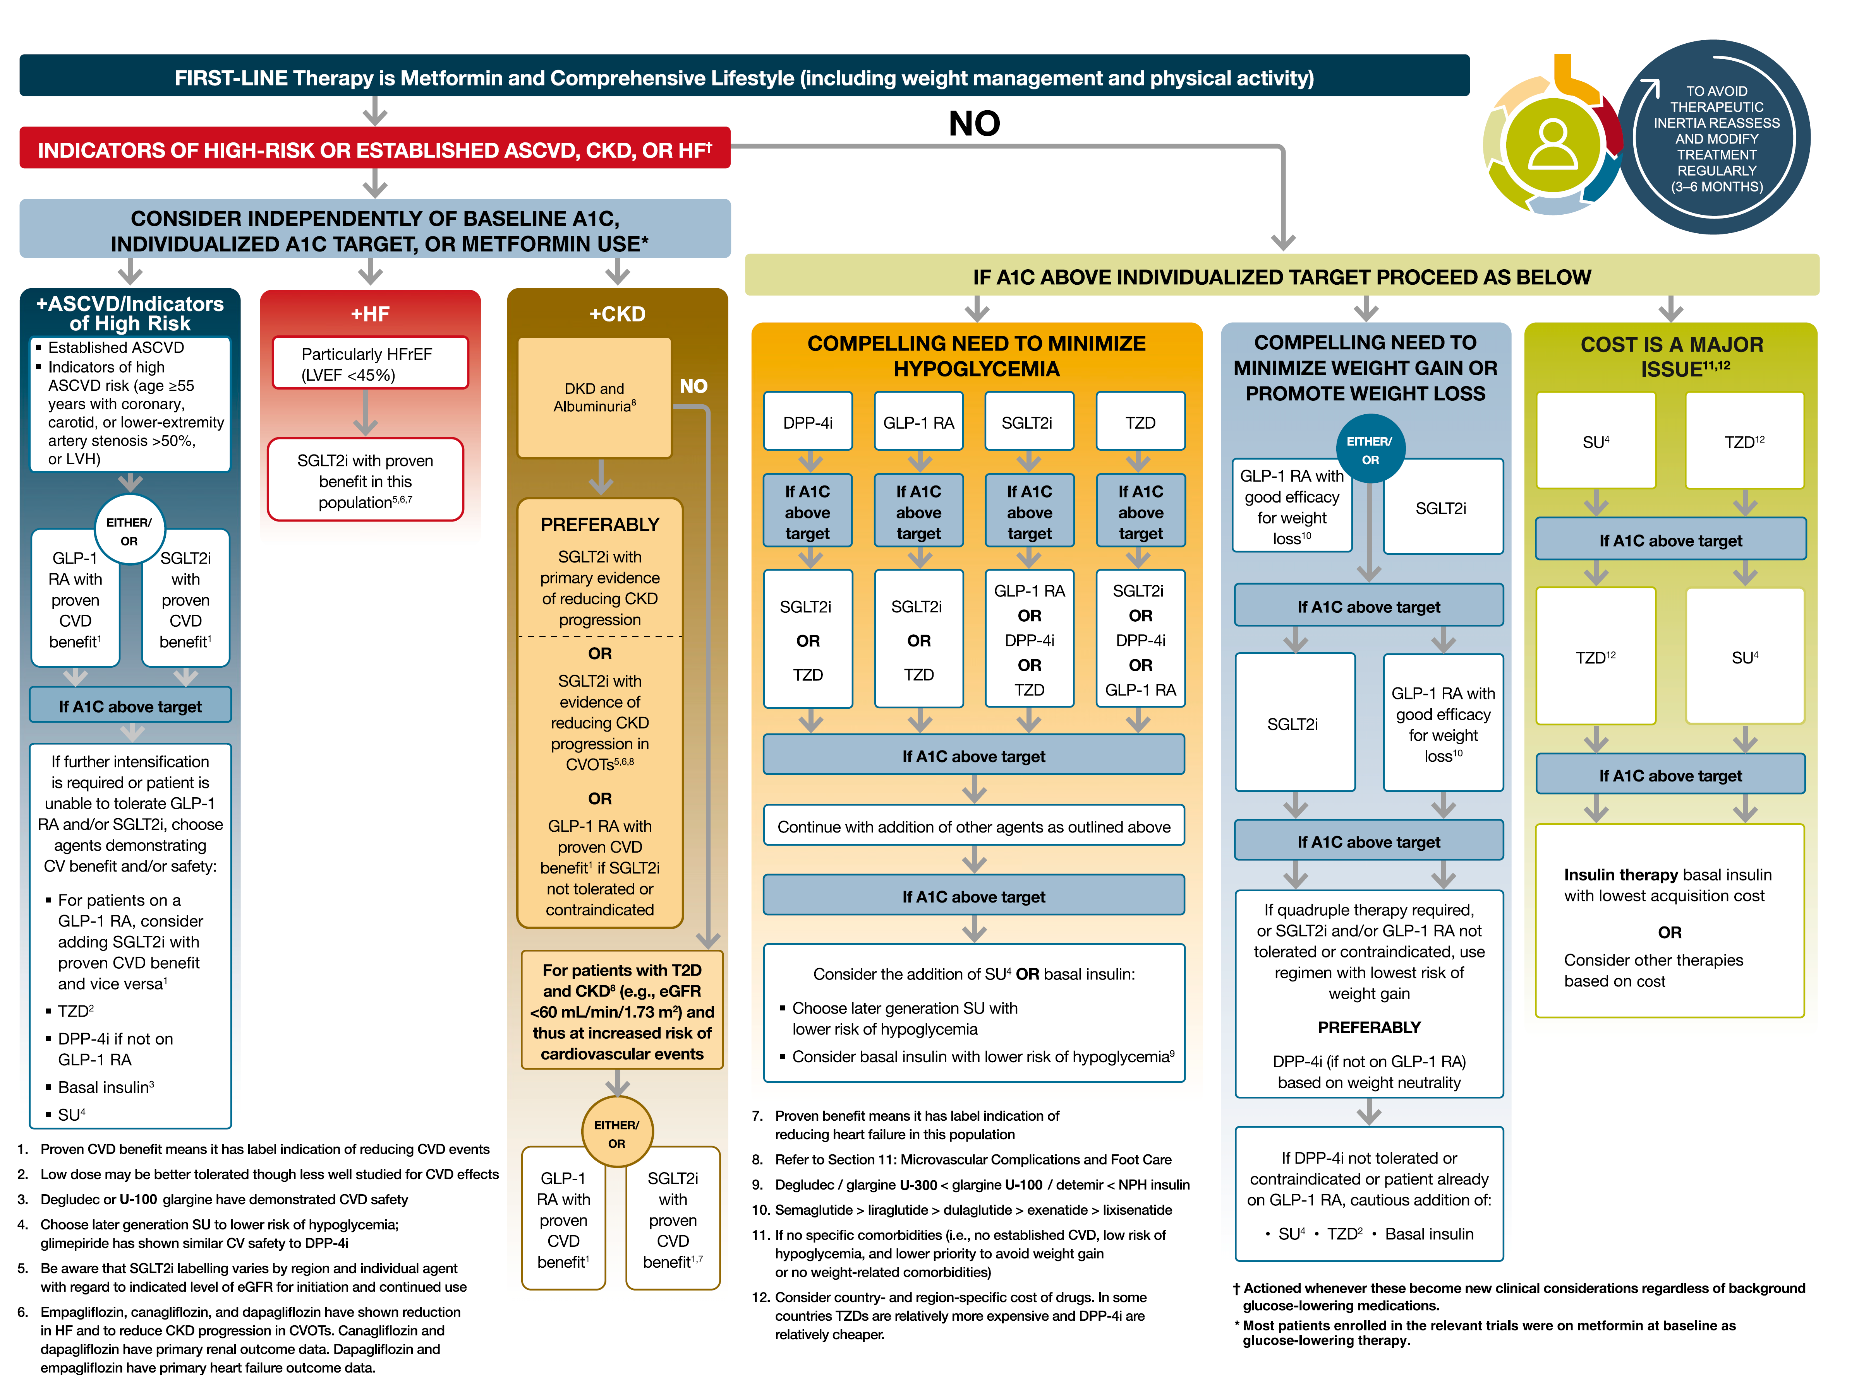
2021

Slide 47

Insulin Resistance in Subjects With Normal β-Cells
Insulin
Level
100
75
β-cell insulin secretion increases to offset the insulin resistance
IGT
β-cell Function (%)
50
Postprandial
Hyperglycemia
25
Type 2 Diabetes
0
Insulin Sensitivity
Sensitive
Resistant
Bergman RN. Diabetes 1989;38:1512-27
Copyright © 2016 Eli Lilly and Company
Notes:
Diab-00076618
Copyright Disclosure: Image of toy truck purchased for Lilly from CanStock Photo Inc in June 2016.
Key Points:
In healthy individuals, there is a balance between secretion and insulin action such that insulin secretion x insulin sensitivity = constant.
Thus, with insulin resistance, it is proposed that a normal β-cell will increase its production appropriately, staving off impairment of glucose tolerance.
This concept is supported by data in healthy pregnant women, in whom the reciprocal relationship is shown to exist and impaired glucose tolerance is not observed despite substantial insulin resistance.
Reference:
Bergman RN. Lilly lecture 1989. Toward physiological understanding of glucose tolerance. Minimal-model approach. Diabetes 1989;38(12):1512-27.

Slide 48
β-cell Function Declines as Type 2 Diabetes Progresses¹⁻⁴
β-cell function declines over time
Insulin
Level
Failure of the β-cell to compensate
100
Diabetes Diagnosis
75
IGT
Insulin
initiation
β-cell Function (%)
50
Postprandial
Hyperglycemia
25
Type 2 Diabetes
0
Insulin Sensitivity
Sensitive
Resistant
DeFronzo RA. Diabetes 2009;58:773-95
Bergman RN. Diabetes 1989;38:1512-27
Data from Holman RR. Diabetes Res Clin Pract 1998;40:S21-25
Data from UKPDS 16. Diabetes 1995;44:1249-58 (updated 45:1655)
Copyright © 2016 Eli Lilly and Company
Notes:
Diab-00076618
Copyright Disclosure: Figure has been recreated for Eli Lilly and Company with data from Holman RR. Diabetes Res Clin Pract 1998;40:S21-25 and UKPDS 16. Diabetes 1995;44:1249-58. Updated 45:1655. Image of toy truck purchased for Lilly from CanStock Photo Inc in June 2016.
Key Points:
Insulin resistance, by placing an increased demand on the β-cell to hypersecrete insulin, also plays an important role in the progressive β-cell failure of type 2 diabetes.¹
As diabetes progresses, β-cell function declines, contributing to glycemic deterioration.²
Type 2 diabetes is characterized by insulin resistance and the progressive loss of islet β-cell function. Although the former is already established at diagnosis and changes little thereafter, β-cell function continues to decline, leading to secondary failure of antihyperglycemic therapies.²
In the UK Prospective Diabetes Study (UKPDS), glycemic deterioration was associated with progressive loss of β-cell function.³⁻⁵
References:
DeFronzo RA. Banting Lecture. From the triumvirate to the ominous octet: a new paradigm for the treatment of type 2 diabetes mellitus. Diabetes 2009;58(4):773-95.
Bergman RN. Lilly lecture 1989. Toward physiological understanding of glucose tolerance. Minimal-model approach. Diabetes 1989;38(12):1512-27.
Holman RR. Assessing the potential for α-glucosidase inhibitors in prediabetic states. Diabetes Res Clin Pract 1998;40(Suppl):S21-5.
UK prospective diabetes study 16. Overview of 6 years' therapy of type II diabetes: a progressive disease. UK Prospective Diabetes Study Group. Diabetes 1995;44(11):1249-58 (updated 45:1655).
Kahn SE, Haffner SM, et al. Glycemic durability of rosiglitazone, metformin, or glyburide monotherapy. N Engl J Med 2006;355(23):2427-43.
Gallwitz B. The fate of Beta-cells in type 2 diabetes and the possible role of pharmacological interventions. Rev Diabet Stud 2006;3(4):208-16.

Slide 49
Progressive β-cell Failure in Type 2 Diabetes
Insulin
Level
100
Diabetes Diagnosis
75
IGT
Insulin
initiation
β-cell Function (%)
50
Postprandial
Hyperglycemia
25
Type 2 Diabetes
0
Insulin Sensitivity
Sensitive
Resistant
DeFronzo RA. Diabetes 2009;58:773-95
Bergman RN. Diabetes 1989;38:1512-27
Data from Holman RR. Diabetes Res Clin Pract 1998;40:S21-25
Data from UKPDS 16. Diabetes 1995;44:1249-58 (updated 45:1655)
Copyright © 2016 Eli Lilly and Company
Notes:
Diab-00076618
Copyright Disclosure: Figure has been recreated for Eli Lilly and Company with data from Holman RR. Diabetes Res Clin Pract 1998;40:S21-25 and UKPDS 16. Diabetes 1995;44:1249-58. Updated 45:1655. Image of toy truck purchased for Lilly from CanStock Photo Inc in June 2016.
Key Points:
Insulin resistance, by placing an increased demand on the β-cell to hypersecrete insulin, also plays an important role in the progressive β-cell failure of type 2 diabetes.¹
As diabetes progresses, β-cell function declines, contributing to glycemic deterioration.²
Type 2 diabetes is characterized by insulin resistance and the progressive loss of islet β-cell function. Although the former is already established at diagnosis and changes little thereafter, β-cell function continues to decline, leading to secondary failure of antihyperglycemic therapies.²
In the UK Prospective Diabetes Study (UKPDS), glycemic deterioration was associated with progressive loss of β-cell function.³⁻⁵
References:
DeFronzo RA. Banting Lecture. From the triumvirate to the ominous octet: a new paradigm for the treatment of type 2 diabetes mellitus. Diabetes 2009;58(4):773-95.
Bergman RN. Lilly lecture 1989. Toward physiological understanding of glucose tolerance. Minimal-model approach. Diabetes 1989;38(12):1512-27.
Holman RR. Assessing the potential for alpha-glucosidase inhibitors in prediabetic states. Diabetes Res Clin Pract 1998;40(Suppl):S21-5.
UK prospective diabetes study 16. Overview of 6 years' therapy of type II diabetes: a progressive disease. UK Prospective Diabetes Study Group. Diabetes 1995;44(11):1249-58 (updated 45:1655).
Kahn SE, Haffner SM, et al. Glycemic durability of rosiglitazone, metformin, or glyburide monotherapy. N Engl J Med 2006;355(23):2427-43.
Gallwitz B. The fate of Beta-cells in type 2 diabetes and the possible role of pharmacological interventions. Rev Diabet Stud 2006;3(4):208-16.

Slide 50
80
Relative contributions of postprandial () and fasting () hyperglycemia (%) to the overall diurnal hyperglycemia over quintiles of HbA1c. a, significant difference was observed between fasting and postprandial plasma glucose (paired t test); b, significantly different from all other quintiles (ANOVA); c, significantly different from quintile 5 (ANOVA).
a,b
60
c
c
40
a
Contribution (%)
b
a
20
2HPPG
FBS
0
1
2
3
4
5
(<7.3)
(7.3 – 8.4)
(8.3– 9.2)
(9.2– 10.2)
(>10.2)
HbA1C Quintiles

Slide 51
80
Relative contributions of postprandial () and fasting () hyperglycemia (%) to the overall diurnal hyperglycemia over quintiles of HbA1c. a, significant difference was observed between fasting and postprandial plasma glucose (paired t test); b, significantly different from all other quintiles (ANOVA); c, significantly different from quintile 5 (ANOVA).
a,b
60
c
a
40
Contribution (%)
b
a
20
2HPPG
c
FBS
0
1
2
3
4
5
(<7.3)
(7.3 – 8.4)
(8.3– 9.2)
(9.2– 10.2)
(>10.2)
HbA1C Quintiles

Slide 52
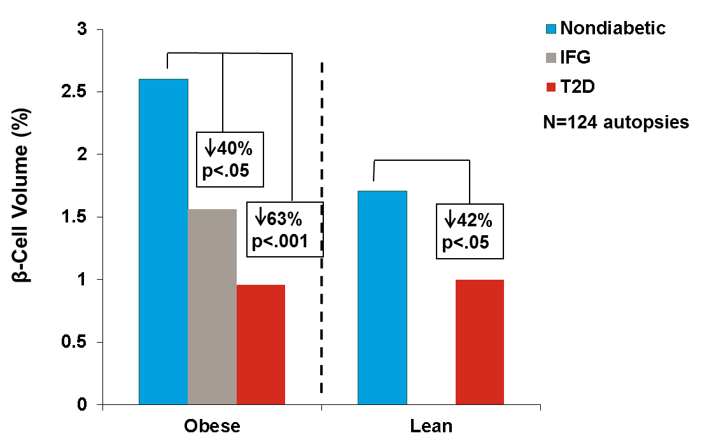
β-Cell Volume in Patients With IFG and Patients With T2D
Butler AE et al. Diabetes 2003;52:102-10
Notes:
Insu-00056817
[Source: Butler et al. Diabetes 2003;52(1):102-10. /p 105 Figure 2B, /p104/col 2/paragraph 3/sentences 1, 3 and 7; N value from Abstract]
Abbreviations: IFG=Impaired fasting glucose; T2D=Type 2 diabetes
Key Point:
This Mayo Clinic study showed that patients with T2D and those with borderline abnormalities (IFG) have severely reduced β-cell mass. [inferred from /p103/col 1/paragraph 4/Sentence 1 and sentence 3; p/104/col 2/paragraph 2 continued to /p105/col 1/paragraph 1; /p106/col 1/paragaraph 2/sentence 1; /p109/col 2/paragraph 3/sentence 1 and 3 ]
Reference:
Butler AE, Janson J, et al. Beta-cell deficit and increased beta-cell apoptosis in humans with type 2 diabetes. Diabetes 2003;52(1):102-10.

Slide 53
Content Overview
Progression of T2DM
Insulin Initiation in T2DM
Introduction to Premix Insulins
Premix vs. Basal Insulin Regimens
Premix vs. Basal-Bolus Regimens
Comparison of Premix, Basal-Bolus, and Basal Insulin Regimens
Guidelines and Treatment Algorithms
Conclusions
Copyright © 2016 Eli Lilly and Company
Notes:
Diab-00070768
Abbreviation:
T2DM=Type 2 diabetes mellitus

Slide 54
2021

Slide 55
2021

Slide 56
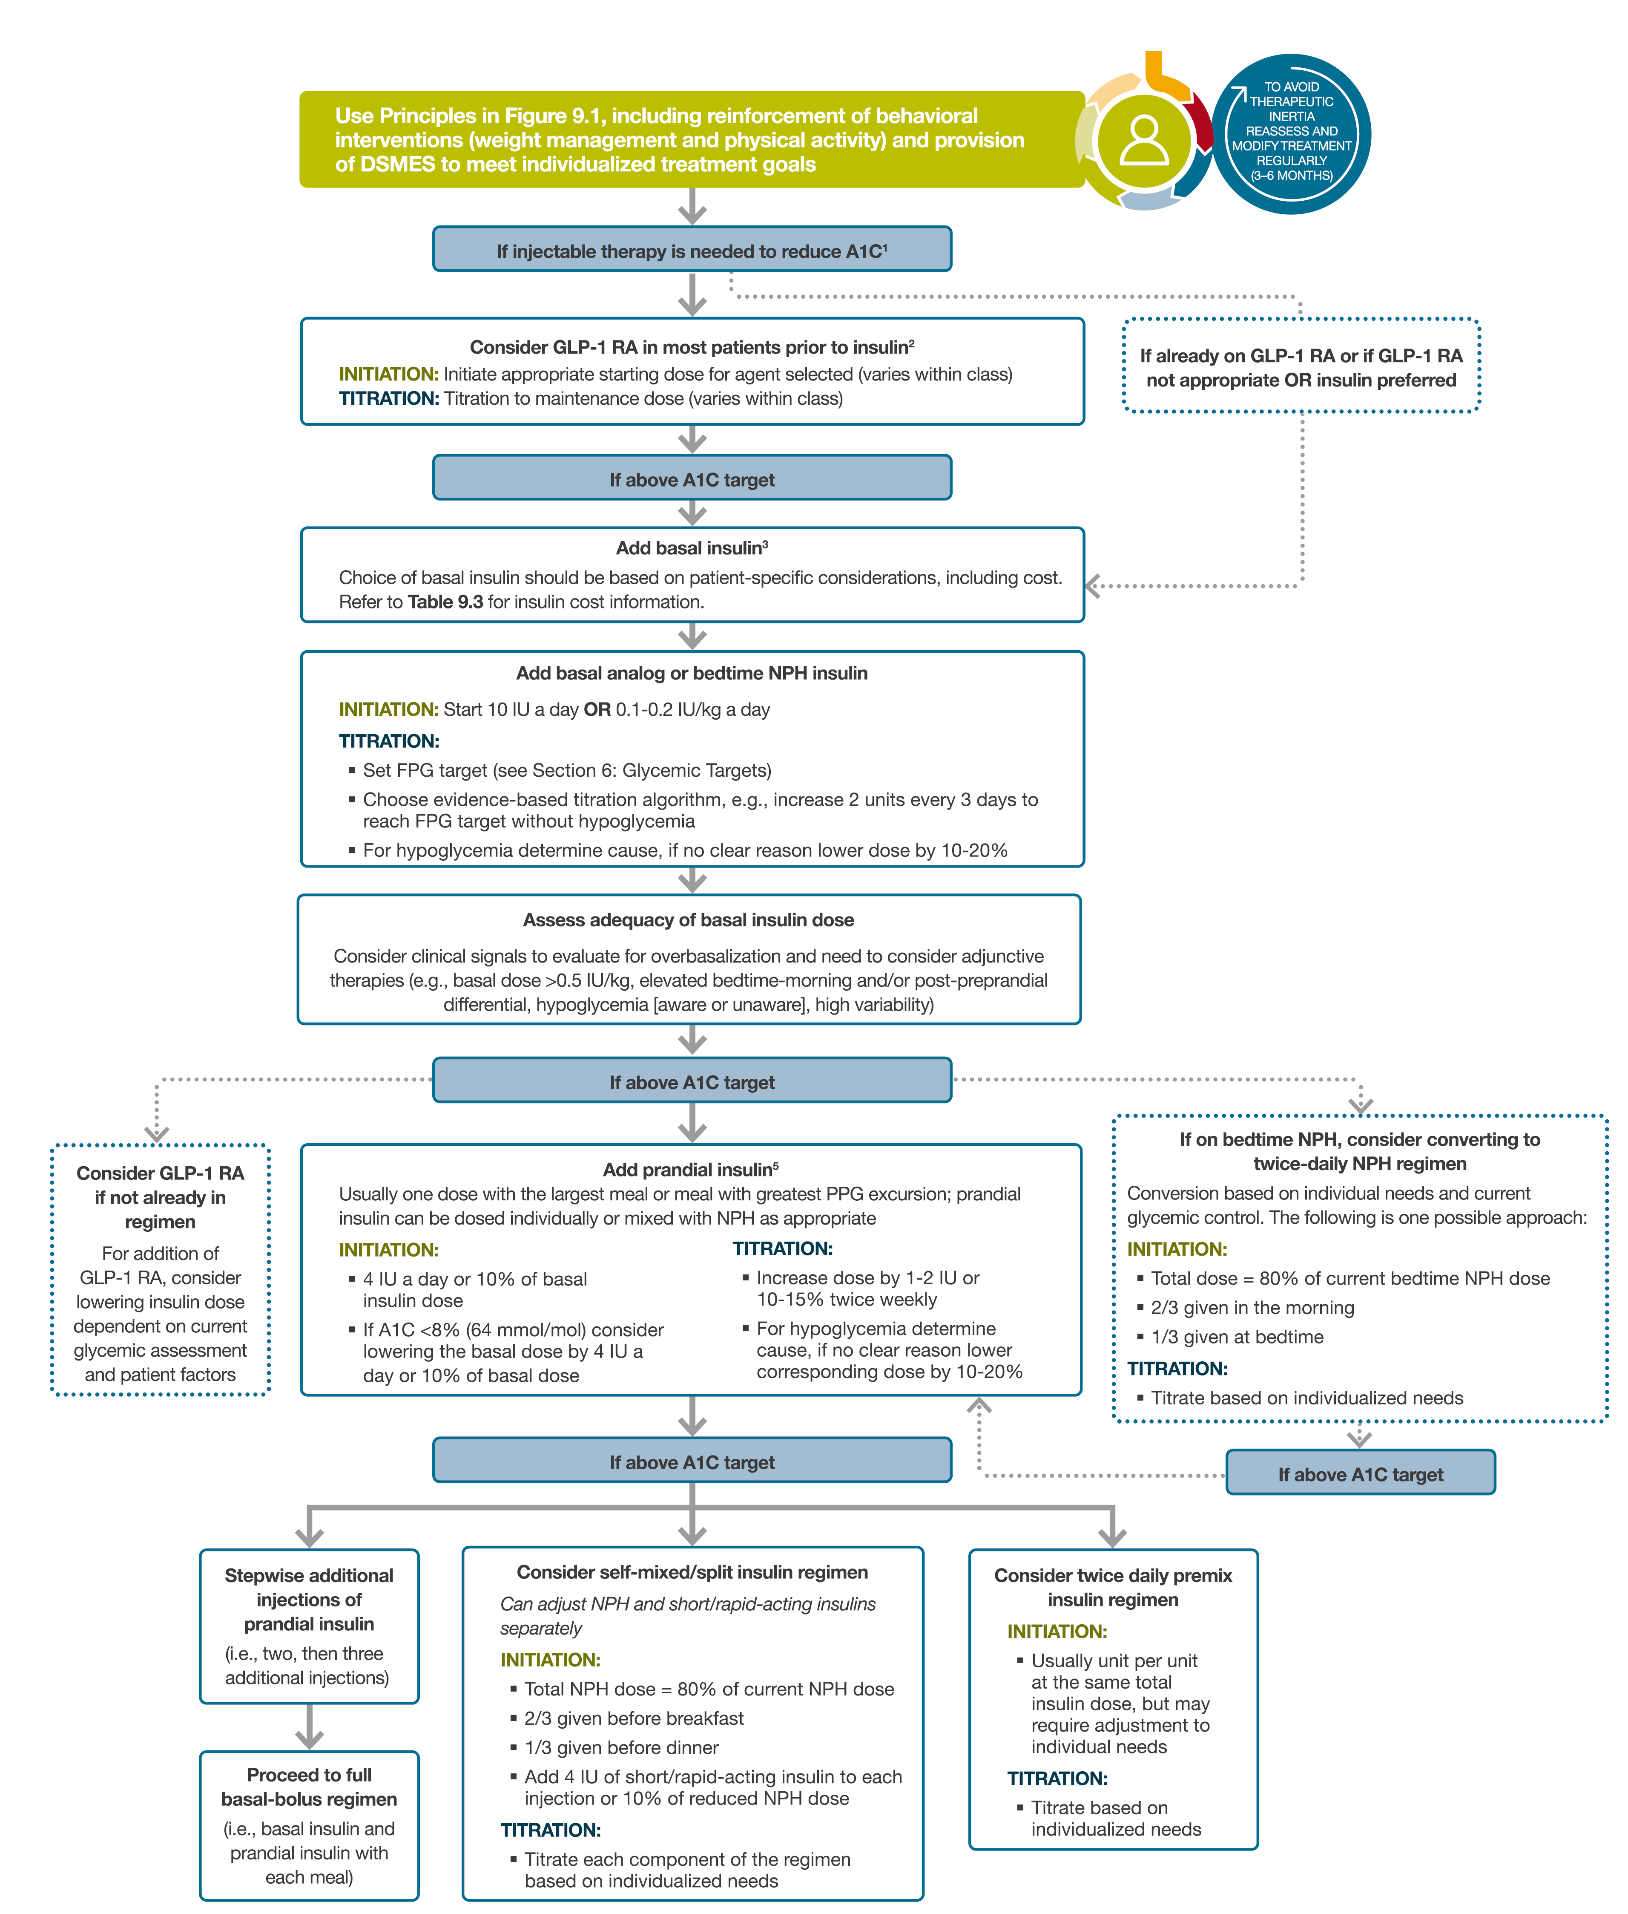
2021

Slide 57
Why Target PPG and FPG?¹
Current type 2 diabetes therapy often takes the following path:
Oral therapy
(target varies based on medication)
Noninsulin injectable therapy
(GLP-1 receptor agonists)²
Prandial insulin
(targets primarily PPG)
Basal insulin
(targets primarily FPG)
Diet and exercise
Years With Diabetes
PPG and FPG control is important to
bring HbA1c levels to target
Inzucchi SE et al. Diabetes Care 2012;35:1364-79 (updated 36:490)
Lund A et al. Expert Opin Emerg Drugs 2011;16:607-18
Notes:
Insu-00056817
[Source: Inzucchi et al. Diabetes Care 2012;35(6):1364-79(Updated 36: p 490), Pg 1366-1373, “Therapeutic Options”; Statement below figure: Pg 1366, Col 1, Para 3; Lund et al. Expert Opin Emerg Drugs 2011;16(4):607-18. Inferred from Abstract and Pg 611, Col 1, Para 1]
Abbreviations: FPG=Fasting plasma glucose; GLP-1=Glucagon-like peptide-1; HbA1c=Hemoglobin A1c; PPG=Postprandial plasma glucose
References:
Inzucchi SE, Bergenstal RM, et al; American Diabetes Association (ADA); European Association for the Study of Diabetes (EASD). Management of hyperglycemia in type 2 diabetes: a patient-centered approach: position statement of the American Diabetes Association (ADA) and the European Association for the Study of Diabetes (EASD). Diabetes Care 2012;35(6):1364-79 (updated 36:490).
Lund A, Knop FK, et al. Emerging GLP-1 receptor agonists. Expert Opin Emerg Drugs 2011;16(4):607-18.

Slide 58
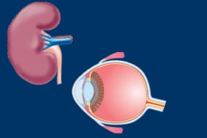

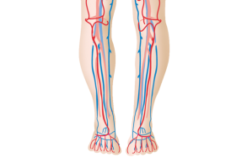

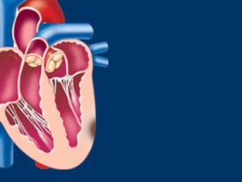

UKPDS
A 1% Decrease in HbA_{1c} Is Associated with a Large Reduction in Complications
Microvascular complications (eg, kidney disease and blindness)
37%
Amputation or fatal peripheral blood vessel disease
43%
HbA_{1c}
1%
21%
Deaths related to diabetes
14%
Heart attack
12%
Stroke
Stratton IM, et al. BMJ. 2000;321(7258):405-412.
Notes:
Main Point: Reducing HbA_{1c} is a key to addressing other potential complications.
Discussion:
Observational data based on UKPDS have demonstrated the association of good blood glucose control with a reduced burden of microvascular and macrovascular complications.
Reference:
Stratton IM, Adler AI, Neil HAW, et al. Association of glycaemia with macrovascular and microvascular complications of type 2 diabetes (UKPDS 35): prospective observational study. BMJ. 2000;321(7258):405-412.

Slide 59
The Benefits of Early Intensive Control
UKPDS 10-year Post-trial Follow-up
Intensive vs
Conventional Treatment^{1*}
10-year Post-trial Follow-up²
(Noninterventional)
1977-1991
Randomization
1
1997
(20 years)
Trial End
2007
(30 years)
12%
9%
16%
15%
25%
24%
Any diabetes-related endpoint
Microvascular disease
Myocardial infarction
*P<.05 for intensive vs conventional treatment.
1. UKPDS Study Group. Lancet. 1998;352(9131):837-853. 2. Holman RR, et al. N Engl J Med. 2008;359(15):1577-1589.
Notes:
Discussion: Long-term follow-up of the population studied in the UKPDS study demonstrated that the patients reaching strict glycaemic control soonest had the lowest incidence of cardiovascular disease (CVD), including myocardial infarction. Notably, patients in the intensive therapy group, those being treated with a sulphonylurea (SU) and insulin, had better glucose levels in the early stages of their therapy and benefits seemed to persist a decade later.^{1,2}
References:
UKPDS Group. Intensive blood-glucose control with sulphonylureas or insulin compare with conventional treatment and risk of complications in patients with type 2 diabetes (UKPDS 33). Lancet. 1998;352(9131):837-853.
Holman RR, Paul SK, Bethel MA, Matthews DR, Neil HAW. 10-year follow-up of intensive glucose control in type 2 diabetes. N Engl J Med. 2008;359(15):1577-1589.

Slide 60
Postprandial Hyperglycemia and Associated Complications
Macrovascular
disease*^{1,2}
Increased risk of
pancreatic cancer⁹
Increased carotid
intima-media thickness³
Postprandial
hyperglycemia
Increased risk
of retinopathy⁸
Decreased myocardial
blood flow/volume⁴
Increased inflammatory
markers⁷
Impaired early
diastolic dysfunction⁵
Increased
oxidative stress⁶
*Controversy on this point exists, as epidemiological studies have shown that postprandial Hyperglycemia is positively correlated with increased risk; however, several interventional trials have shown that a decrease in PPG is not necessarily associated with a decrease in macrovascular events.¹⁰
1. DECODE study group. Arch Intern Med. 2001;161(3):397-405. 2. Hanefeld M, et al. Diabetologia. 1996;39(12):1577-1583. 3. Esposito K, et al. J Clin Endorcrinol Metab. 2008;93(4):1345-1350. 4. Scognamiglio R, et al. Circulation. 2005;112(2):179-184. 5. Bibra H, et al. Horm Metab Res. 2009;41(2):109-115. 6. Monnier L, et al. JAMA. 2006;295(14):1681-1687. 7. Neri S, et al. Eur J Nutr. 2010;49(7):409-416. 8. Shiraiwa T, et al. Diabetes Care. 2005;28(11):2806-2807. 9. Gapstur SM, et al. JAMA. 2000;283(19):2552-2558. 10. Clement S. Curr Diab Rep. 2009;9(5):355-9.
Notes:
Main Point: Postprandial Hyperglycemia is associated with other diabetes-related complications.

Slide 61
Postprandial Hyperglycemia Is Associated with CV Mortality Risk
Hazard Ratios for Death According to Glucose Levels in Nondiabetic Individuals¹
Hazard Ratio
2-hour PPG (mmol/L)
FPG (mmol/L)
Several large epidemiological studies showed independent association between 2-hour PPG and CV risk even in the healthy and borderline glucose ranges.^{1,2}
CV = cardiovascular.
1. DECODE Study Group. Lancet. 1999;354(9179):617-621. 2. Meigs JB, et al. Diabetes Care. 2002;25(10):1845-1850.
Notes:
Main Point: This slide presents results from the DECODE study. This was a large European database analysis that included a number of individual studies from the continent. After adjusting for confounding factors, postchallenge Hyperglycemia remained significantly and independently associated with cardiovascular (CV) risk. Fasting Hyperglycemia was not.
Background: Baseline data was assessed on glucose concentrations at fasting and 2 h after the 75 g oral glucose tolerance test from 13 prospective European cohort studies, which included 18,048 men and 7,316 women aged 30 years or older. Mean follow-up was 7.3 years. We assessed the risk of death according to the different diagnostic glucose categories.
Discussion: Fasting-glucose concentrations alone do not identify individuals at increased risk of death associated with hyperglycaemia. The oral glucose tolerance test provides additional prognostic information and enables detection of individuals with impaired glucose tolerance, who have the
greatest attributable risk of death.
Reference:
DECODE Study Group. Glucose tolerance and mortality: comparison of WHO and American Diabetes Association diagnostic criteria. Lancet. 1999;354(9179):617-621.

Slide 62
Postprandial, Not Fasting, Glucose Is Associated with MI and Mortality Risk
Diabetes Intervention Study: 11-year Follow-up
MI
Mortality
FPG
PPG
300
200
100
0
300
200
100
0
P<.05
P<.05
Incidence Rate per 1000 Patients
4.4-6.1 ≤7.8 >7.8
4.4-8.0 ≤10.0 >10.0
Blood Glucose (mmol/L)
n=994
MI = myocardial infarction.
Hanefeld M, et al. Diabetologia. 1996;39(12):1577-1583.
Notes:
Main Point: This slide shows results from the Diabetes Intervention Study (DIS) by Hanefeld et al. This study included patients with type 2 diabetes (early stage of the disease). The investigators followed patients for 11 years to collect information on mortality and myocardial infarction (MI). The risk correlated significantly and independently with postprandial hyperglycaemia, but not with fasting hyperglycaemia.
Reference:
Hanefeld M, Fischer S, Julius U, et al. Risk factors for myocardial infarction and death in newly detected NIDDM: the Diabetes Intervention Study, 11-year follow-up. Diabetologia. 1996;39(12):1577-1583.

Slide 63
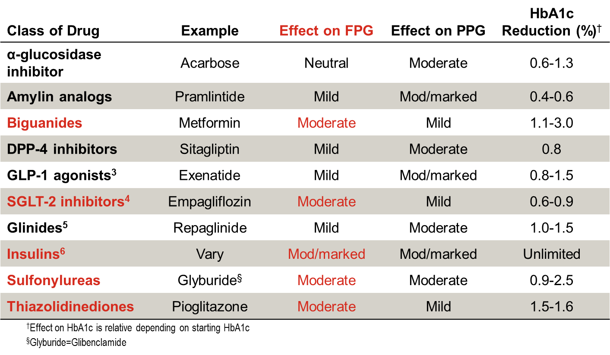
What Classes of Drugs Target FPG?^{1,2}
Rodbard HW et al. Endocr Pract 2009;15:541-59 (updated 15:768)
Rodbard HW et al. Endocr Pract 2007;13(Suppl 1):1-68 (updated 14:802)
Lund A et al. Expert Opin Emerg Drugs 2011;16:607-18
Nauke MA. Drug Des Devel Ther 2014;8:1335-80
Drucker DJ et al. Diabetes Care 2010;33:428-33
Tibaldi J. Am J Med 2008;121(Suppl 6):S20-9
Notes:
Insu-00056817
Note: Pramlintide not approved in all areas: consider removing its row if not approved in your region.
[Source: Class/FPG/PPG from AACE 2009 Position statement: Rodbard et al. Endocr Pract 2009;15(6):541-59. /p548; HbA1c decreases from 2007 AACE Guidelines (except glinides and insulin): Rodbard et al. Endocr Pract 2007;13(Suppl 1):4-68. /p27/Table 4.6; GLP-1 agonists: Lund et al. Expert Opin Emerg Drugs 2011;16(4):607-18. Inferred from Pg 609, Col 1, Para 1 and Col 2, Para 1, and Pg 611, Col 1, Para 2 and Col 2, Para 1; SGLT-2 inhibitors: Nauke. Drug Des Devel Ther 2014;8:1335-80. Inferred from Pg 1340, Col 2, Para 4 cont. to Pg 1341, Col 1, Para 1; Glinides: Drucker et al. Diabetes Care 2010;33(2):428-33. /p429/Figure 1; Insulin: Tibaldi. Am J Med 2008;121(Suppl 6):S20-9. /pS22/paragraph 2; Footnote: Drucker et al. Diabetes Care 2010;33(2):428-33. /p429/Figure 1]
Abbreviations: DPP-4=Dipeptidyl peptidase 4; FPG=Fasting plasma glucose; GLP-1=Glucagon-like peptide-1; HbA1c=Hemoglobin A1c; PPG=Postprandial plasma glucose; SGLT-2=Sodium glucose co-transporter 2
Key Points: [Inferred from table]
There are many classes of drugs currently approved for therapy of type 2 diabetes, with different mechanisms of action and different abilities to target and reduce FPG, PPG, and HbA1c.
Values in the table represent a range of mean reductions obtained after treatment; however, the higher the baseline HbA1c, the greater the reduction affected by medications.
References:
Rodbard HW, Jellinger PS, et al. Statement by an American Association of Clinical Endocrinologists/American College of Endocrinology consensus panel on type 2 diabetes mellitus: an algorithm for glycemic control. Endocr Pract 2009;15(6):541-59 (updated 15:768).
Rodbard HW, Blonde L, et al; AACE Diabetes Mellitus Clinical Practice Guidelines Task Force. American Association of Clinical Endocrinologists medical guidelines for clinical practice for the management of diabetes mellitus. Endocr Pract 2007;13(Suppl 1):1-68 (updated 14:802).
Lund A, Knop FK, et al. Emerging GLP-1 receptor agonists. Expert Opin Emerg Drugs 2011;16(4):607-18.
Nauck MA. Update on developments with SGLT2 inhibitors in the management of type 2 diabetes. Drug Des Devel Ther 2014;8:1335-80.
Drucker DJ, Sherman SI, et al. Incretin-based therapies for the treatment of type 2 diabetes: evaluation of the risks and benefits. Diabetes Care 2010;33(2):428-33.
Tibaldi J. Initiating and intensifying insulin therapy in type 2 diabetes mellitus. Am J Med 2008;121(Suppl 6):S20-9.

Slide 64
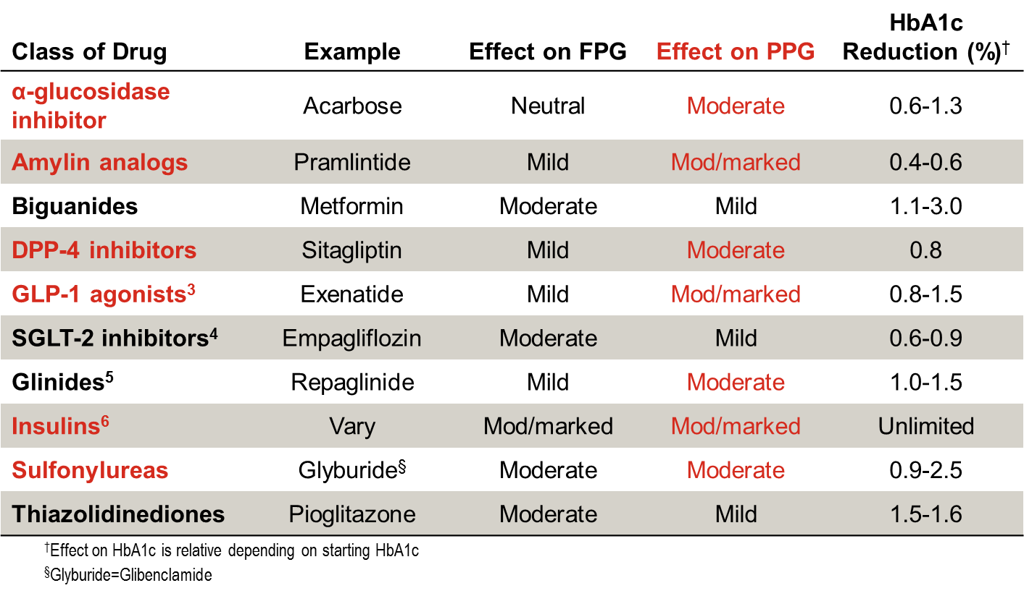
What Classes of Drugs Target PPG?^{1,2}
Rodbard HW et al. Endocr Pract 2009;15:541-59 (updated 15:768)
Rodbard HW et al. Endocr Pract 2007;13(Suppl 1):1-68 (updated 14:802)
Lund A et al. Expert Opin Emerg Drugs 2011;16:607-18
Nauke MA. Drug Des Devel Ther 2014;8:1335-80
Drucker DJ et al. Diabetes Care 2010;33:428-33
Tibaldi J. Am J Med 2008;121(Suppl 6):S20-9
Notes:
Insu-00056817
Note: Pramlintide not approved in all areas: consider removing its row if not approved in your region.
[Source: Class/FPG/PPG from AACE 2009 Position statement: Rodbard et al. Endocr Pract 2009;15(6):541-59. /p548; HbA1c decreases from 2007 AACE Guidelines (except glinides and insulin): Rodbard et al. Endocr Pract 2007;13(Suppl 1):4-68. /p27/Table 4.6; GLP-1 agonists: Lund et al. Expert Opin Emerg Drugs 2011;16(4):607-18. Inferred from Pg 609, Col 1, Para 1 and Col 2, Para 1, and Pg 611, Col 1, Para 2 and Col 2, Para 1; SGLT-2 inhibitors: Nauke. Drug Des Devel Ther 2014;8:1335-80. Inferred from Pg 1340, Col 2, Para 4 cont. to Pg 1341, Col 1, Para 1; Glinides: Drucker et al. Diabetes Care 2010;33(2):428-33. /p429/Figure 1; Insulin: Tibaldi. Am J Med 2008;121(Suppl 6):S20-9. /pS22/paragraph 2; Footnote: Drucker et al. Diabetes Care 2010;33(2):428-33. /p429/Figure 1]
Abbreviations: DPP-4=Dipeptidyl peptidase 4; FPG=Fasting plasma glucose; GLP-1=Glucagon-like peptide-1; HbA1c=Hemoglobin A1c; PPG=Postprandial plasma glucose; SGLT-2=Sodium glucose co-transporter 2
Key Points: [Inferred from table]
There are many classes of drugs currently approved for therapy of type 2 diabetes, with different mechanisms of action and different abilities to target and reduce FPG, PPG, and HbA1c.
Values in the table represent a range of mean reductions obtained after treatment; however, the higher the baseline HbA1c, the greater the reduction affected by medications.
References:
Rodbard HW, Jellinger PS, et al. Statement by an American Association of Clinical Endocrinologists/American College of Endocrinology consensus panel on type 2 diabetes mellitus: an algorithm for glycemic control. Endocr Pract 2009;15(6):541-59 (updated 15:768).
Rodbard HW, Blonde L, et al; AACE Diabetes Mellitus Clinical Practice Guidelines Task Force. American Association of Clinical Endocrinologists medical guidelines for clinical practice for the management of diabetes mellitus. Endocr Pract 2007;13(Suppl 1):1-68 (updated 14:802).
Lund A, Knop FK, et al. Emerging GLP-1 receptor agonists. Expert Opin Emerg Drugs 2011;16(4):607-18.
Nauck MA. Update on developments with SGLT2 inhibitors in the management of type 2 diabetes. Drug Des Devel Ther 2014;8:1335-80.
Drucker DJ, Sherman SI, et al. Incretin-based therapies for the treatment of type 2 diabetes: evaluation of the risks and benefits. Diabetes Care 2010;33(2):428-33.
Tibaldi J. Initiating and intensifying insulin therapy in type 2 diabetes mellitus. Am J Med 2008;121(Suppl 6):S20-9.

Slide 65
Differences exist between patient HbA_{1c} and physician’s target at study entry
Physician goal for patient
Patient laboratory value
9.5
9.0
8.5
8.0
7.5
7.0
6.5
6.0
HbA_{1c} (%)
Overall
China
Germany
India
Mexico
Russia
Saudi
Arabia
US
More or less stringent glycaemic goals may be appropriate for individual patients. Goals should be individualised based on duration of diabetes, age/life expectancy, comorbid conditions, known cardiovascular disease or advanced microvascular complications, hypoglycaemia unawareness, and individual patient considerations. Patients were on insulin treatment for at least 3 months.
Polinski JM, et al. BMC Endocr Disord. 2015;15(46):1-9.
Notes:
Main points:
Differences exist between patient HbA_{1c} and physician’s target at baseline¹
An HbA_{1c} of <7% has been shown to reduce the complications of T2DM²
Additional information:¹
Baseline clinical characteristics of 4,341 patients enrolled in MOSA1c study, as recorded in the patient medical record
MOSA1c was a 2-year longitudinal observational study that followed patients’ real-world diabetes care and health outcomes
MOSA1c involved no additional treatments, visits, or laboratory collections beyond those occurring within the course of normal care
Data collection occurred during an initial baseline visit and during 4 subsequent prospective visit windows (within ±3 months) at 6, 12, 18, and 24 months
References:
Polinski JM, Seoyoung KC, Dingfeng J, et al. Geographic patterns in patient demographics and insulin use in 18 countries, a global perspective from the multinational observational study assessing insulin use: understanding the challenges associated with progression of therapy (MOSA1c). BMC Endocrine Disorders. 2015;15:46.
American Diabetes Association. Glycemic targets. Sec. 5. In: Standards of Medical Care in Diabetes—2016. Diabetes Care. 2016;39(Suppl. 1):S39–S46.

Slide 66
Baseline insulin regimens are different around the world,¹ reflecting local needs
Basal insulin only
Mixed insulin only
Other insulin combinations
100
90
80
70
60
50
40
30
20
10
0
Patients (%)
Overall
China
Germany
India
Mexico
Russia
Saudi
Arabia
US
NPH = neutral protamine Hagedorn.
IDF Global Guideline for Type 2 Diabetes. Begin with a basal insulin once daily such as NPH insulin, insulin glargine, or insulin detemir.²
1. Polinski JM, et al. BMC Endocr Disord. 2015;15(46):1-9. 2. International Diabetes Federation. Clinical Guidelines Task Force. 2012.
Notes:
Main point:
Baseline insulin regimens are different around the world
Additional information:
Characteristics of insulin use among patients, by country
MOSA1c was a 2-year longitudinal observational study that followed patients’ real-world diabetes care and health outcomes
MOSA1c involved no additional treatments, visits, or laboratory collections beyond those occurring within the course of normal care
Data collection occurred during an initial baseline visit and during 4 subsequent prospective visit windows (within ±3 months) at 6, 12, 18, and 24 months
Reference:
Polinski JM, Seoyoung KC, Dingfeng J, et al. Geographic patterns in patient demographics and insulin use in 18 countries, a global perspective from the multinational observational study assessing insulin use: understanding the challenges associated with progression of therapy (MOSA1c). BMC Endocrine Disorders. 2015;15:46.

Slide 67
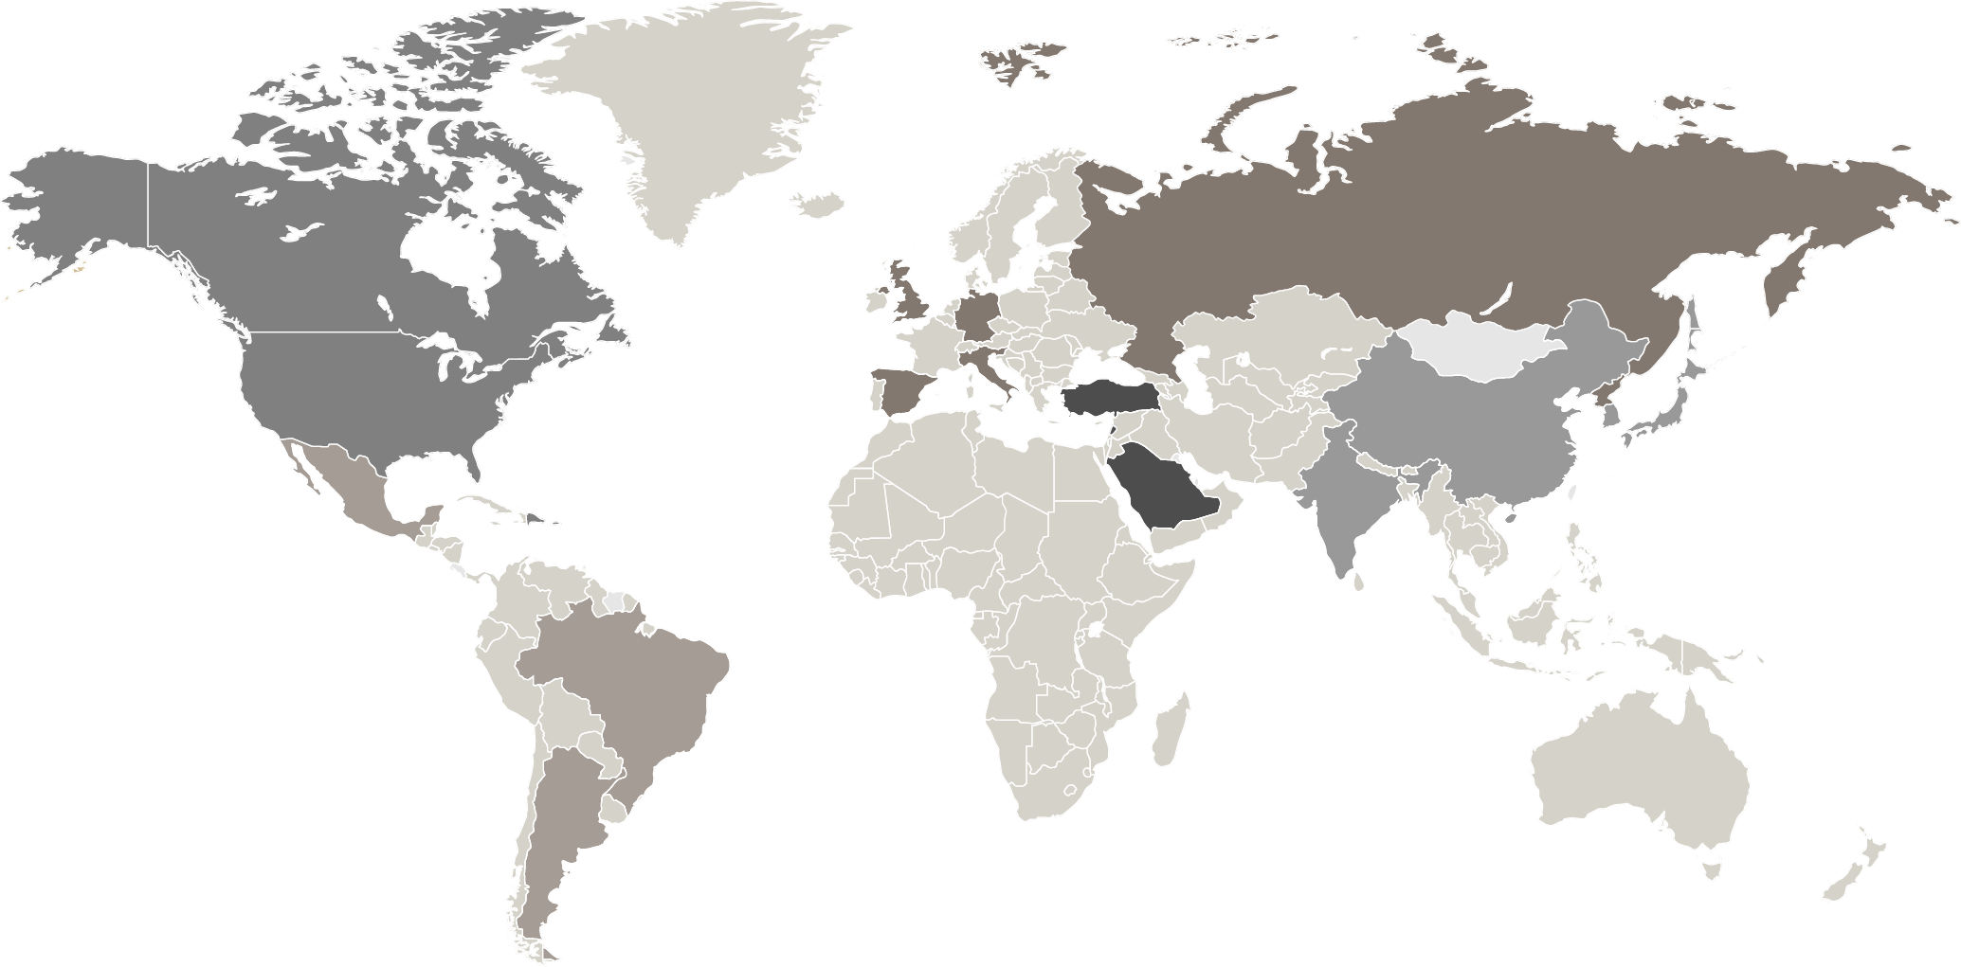
After Starting Insulin Treatment, About 60% of Patients Do not Progress in Their Insulin Treatment Over a 2-Year Period
Percentages of patients who do not progress in insulin treatment
60%
62%
58%
55%
62%
Not progressed
59%
Progressed
Progression defined as (1) additional insulin injections or introduction of another type of insulin, (2) addition of a GLP-1 RA , or (3) additional OAMs.
Rogers JR, et al. Poster presented at American Diabetes Association 76th Scientific Sessions. 10-14 June 2016, New Orleans, LA.
Notes:
Main point:
Over the 2-year study period, approximately 60% of study participants did not progress in their treatment
Additional information:
Patients were taking any commercially available insulin therapy other than intensive basal-bolus insulin therapy (ie, basal +3 prandial injections) from any manufacturer for ≥3months with or without any combination of approved noninsulin antidiabetic medications
MOSA1c was a 2-year longitudinal observational study that followed patients’ real-world diabetes care and health outcomes
MOSA1c involved no additional treatments, visits, or laboratory collections beyond those occurring within the course of normal care
Data collection occurred during an initial baseline visit and during 4 subsequent prospective visit windows (within ±3 months) at 6, 12, 18, and 24 months
Reference:
Rogers JR, Curtis BH, Eddings W, et al. How Diabetes Knowledge affects Diabetes Therapy: the MOSA1c study. Poster presented at American Diabetes Association 76th Scientific Sessions. June 10-14, 2016, New Orleans, LA.

Slide 68
Treatment Strategies: Insulins
Basal insulin: Targets FPG > PPG
  Benefit: Only 1-2 injections per day; physiologic
  Drawback: Patients may require prandial insulin to reach HbA1c targets
Premixed insulin: Targets both FPG and PPG
  Benefit: Fewer injections than prandial
  Drawback: Unable to adjust components separately
Prandial (mealtime) insulin: Targets PPG > FPG
  Benefit: Most physiologic; best at targeting PPG
  Drawback: Most injections; requires addition of basal insulin to target FPG
Lasserson DS et al. Diabetologia 2009;52:1990-2000
Notes:
Insu-00056817
[Source: Differences in FBG/PPG: Lasserson et al. Diabetologia 2009;52(10):1990-2000. /p1995/column 2/ “Fasting glucose” and “PPG”]
Abbreviations: FPG=Fasting plasma glucose; HbA1c=Hemoglobin A1c; PPG=Postprandial plasma glucose
Key Points:
There are different strategies for providing insulin.
Basal is a very popular starter regimen, often just 1 injection per day, but postprandial excursions, although decreased, may still exist. [inferred from /p1995/col 2/last para continued to /p1996/col 2/para 1]
Premix insulin is good because it has components to cover both FPG and PPG and has fewer injections per day than a prandial or basal/bolus regimen, but the components are unable to be adjusted separately. [Inferred]
Prandial (mealtime) insulin is the most physiologic strategy to reduce the increase in glucose after meals: the best insulin for targeting PPG. May require addition of basal insulin to cover FPG, so the downside is the number of injections, particularly for patients. [initial statement of this bullet is inferred from /p1991/col 1/para 3/last sentence]
Reference:
Lasserson DS, Glasziou P, et al. Optimal insulin regimens in type 2 diabetes mellitus: systematic review and meta-analyses. Diabetologia 2009;52(10):1990-2000.

Slide 69
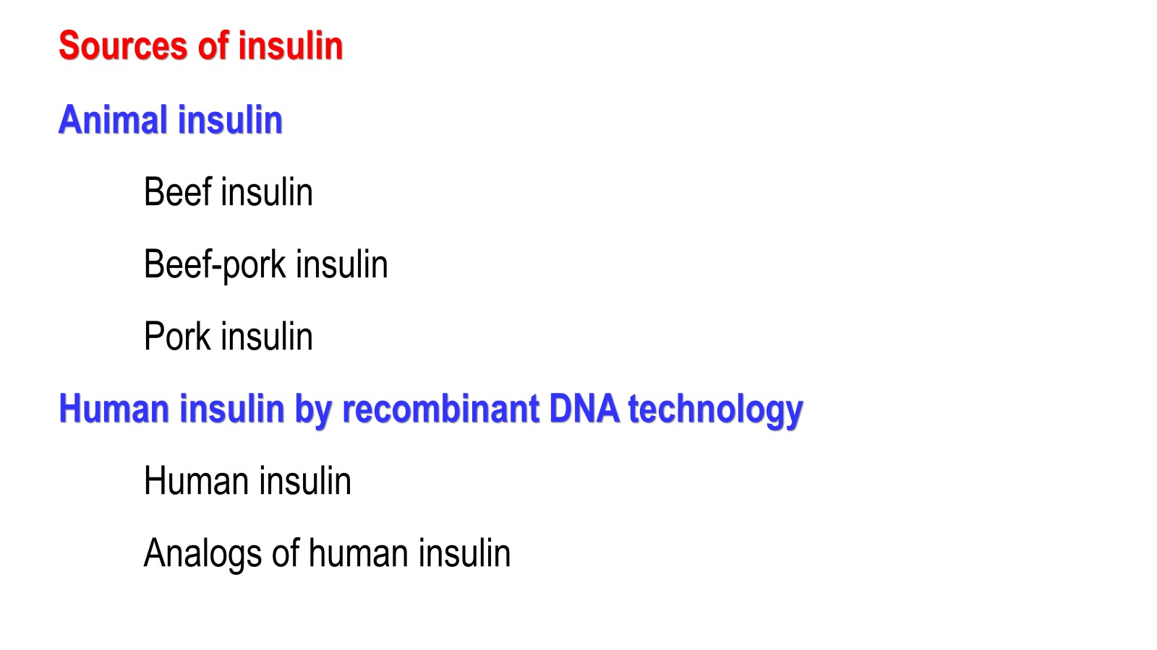

Slide 70
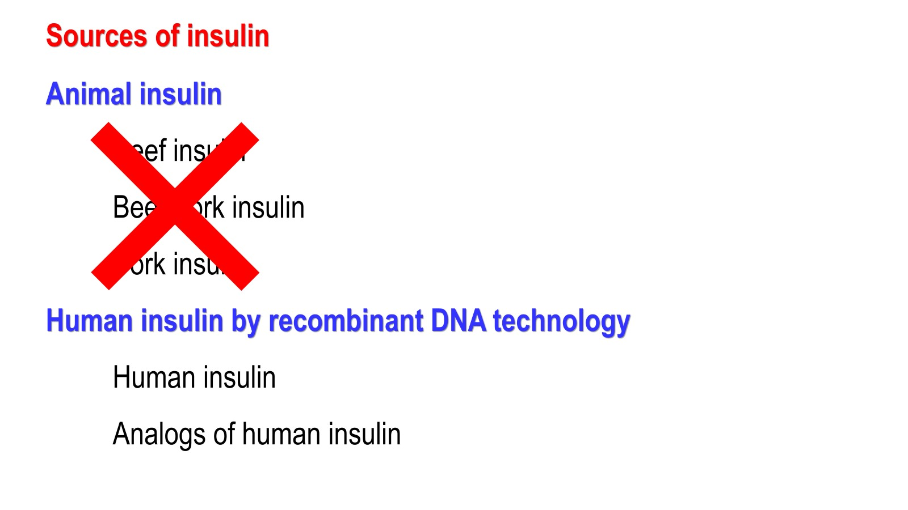

Slide 71
Insulin Analogs
Recombinant DNA technology has allowed for the development and production of analogs to human insulin.
With analogs, the insulin molecule structure is modified slightly to alter the pharmacokinetic properties of insulin, primarily affecting the absorption of the drug from the subcutaneous tissue.
The B26-B30 region of the insulin molecule is not critical for insulin receptor recognition and it is in this region that amino acids are generally substituted. Thus, the insulin analogs are still recognized by and bind to the insulin receptor.
Three rapid-acting insulin analogs (insulin aspart, lispro and glulisine)
Three long-acting insulin analogs (insulin glargine, detemir, and degludec)

Slide 72
Insulin Analogs
Recombinant DNA technology has allowed for the development and production of analogs to human insulin.
With analogs, the insulin molecule structure is modified slightly to alter the pharmacokinetic properties of insulin, primarily affecting the absorption of the drug from the subcutaneous tissue.
The B26-B30 region of the insulin molecule is not critical for insulin receptor recognition and it is in this region that amino acids are generally substituted. Thus, the insulin analogs are still recognized by and bind to the insulin receptor.
Three rapid-acting insulin analogs (insulin aspart, lispro and glulisine)
Three long-acting insulin analogs (insulin glargine, detemir, and degludec)

Slide 73
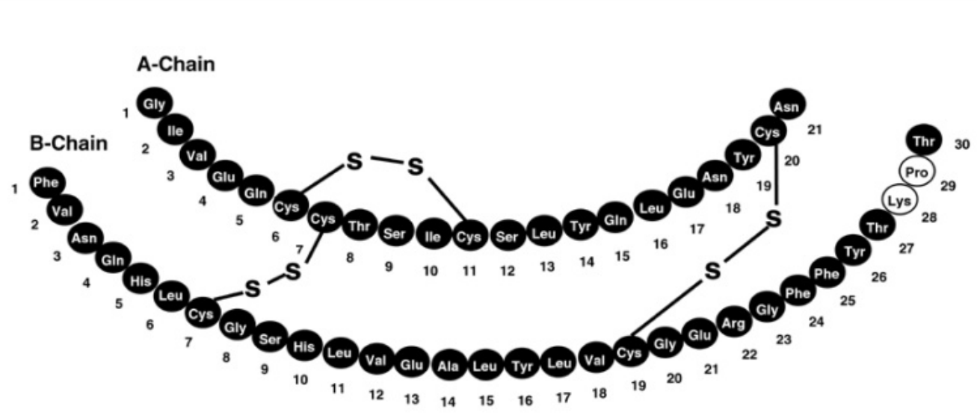
28 Proline 29 Lysine
28 Lysine 29 Proline
PRO LYS
LYS PRO

Slide 74
Content Overview
Progression of T2DM
Insulin Initiation in T2DM
Introduction to Premix Insulins
Premix vs. Basal Insulin Regimens
Premix vs. Basal-Bolus Regimens
Comparison of Premix, Basal-Bolus, and Basal Insulin Regimens
Guidelines and Treatment Algorithms
Conclusions
Copyright © 2016 Eli Lilly and Company
Notes:
Diab-00070768
Abbreviation:
T2DM=Type 2 diabetes mellitus

Slide 75
What are Premix Insulins?
Premix human insulins¹
  Composed of human insulin and NPH (intermediate-acting human insulin)
  Dosing in T2DM: 2-3 injections per day, approximately 30-45 minutes before a meal
Premix insulin analogs¹
  Composed of a rapid acting analog and the same insulin attached to protamine, which prolongs its absorption
  Dosing in T2DM: 2-3 injections per day, up to 15 minutes before or right after meals
Target both FPG and PPG²
Mosenzon O and Raz I. Diabetes Care 2013;36(Suppl 2):S212-8
Wu T et al. Diabetes Ther 2015;6:273-87
Copyright © 2016 Eli Lilly and Company
Notes:
Diab-00070768
Abbreviations:
FPG=fasting plasma glucose; NPH=neutral protamine hagedorn; PPG=postprandial glucose; T2DM=type 2 diabetes mellitus
References:
Mosenzon O, Raz I. Intensification of insulin therapy for type 2 diabetic patients in primary care: basal-bolus regimen versus premix insulin analogs: when and for whom? Diabetes Care 2013;36 (Suppl 2):S212-8.
Wu T, Betty B, Downie M, Khanolkar M, Kilov G, Orr-Walker B, Senator G, Fulcher G. Practical guidance on the use of premix insulin analogs in initiating, intensifying, or switching insulin regimens in type 2 diabetes. Diabetes Ther 2015;6(3):273-87.

Slide 76



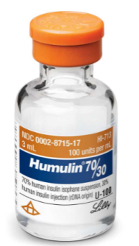
BHI 30
A premixed
suspension of:
Regular
human insulin
Soluble insulin lispro
25%
30%
Protamine-crystallised
insulin Lispro
75%
70%
NPH insulin
(protaminated human insulin)
Humalog Mix75/25
BHI 30
BHI, biphasic human insulin; NPH, neutral protamine Hagedorn

Slide 77

BHI 30
A premixed
suspension of:
Regular
human insulin
Soluble insulin lispro
50%
30%
Protamine-crystallised
insulin Lispro
50%
70%
NPH insulin
(protaminated human insulin)
Humalog Mix50/50
BHI 30
BHI, biphasic human insulin; NPH, neutral protamine Hagedorn

Slide 78
Benefits of Premix Insulins
Desirable Features
Resulting Benefits
“Premix”
No mixing errors
Rapid and Basal Components
“Single Pen”
Convenient dosing schedule
Both FPG and PPG control
Less number of injections and glucose testingª than basal-bolus therapy
ªLess number of glucose testing for premix insulin (QD or BID) vs. basal-bolus insulin with prandial insulin (TID)
Garber AJ. Drugs 2006;66:31-49
Copyright © 2016 Eli Lilly and Company
Notes:
Diab-00070768
Abbreviations:
FPG=fasting plasma glucose; PPG=postprandial glucose
Key Points:
Premixed insulin analogs are usually administered BID with one injection at both breakfast and dinnertime; QD injection at dinnertime can be effective for many patients.
In contrast, basal-bolus therapy usually entails prandial insulin injections TID, which would lead to 3 glucose measurements per day.
Reference:
Garber AJ. Premix insulin analogues for the treatment of diabetes mellitus. Drugs 2006;66(1):31-49.

Slide 79
Time-Action Profile of Premix Insulins
Lispro
7
Lispro NPL
6
14
5
12
10
4
8
Serum Insulin Concentrations (ng/ml)
Mean Glucose Infusion Rate (mg/kg/min)
3
6
2
4
1
2
0
0
0
2
4
6
8
10
12
14
16
18
20
22
24
0
2
4
6
8
10
12
14
16
18
20
22
24
Time (Hours After Dosing)
Time (Hours After Dosing)
N=30. Nondiabetic subjects. 0.3 U/kg dose.
Data from Heise T et al. Diabetes Care 1998;21:800-3
Copyright © 2016 Eli Lilly and Company
Notes:
Diab-00070768
Abbreviations:
LM25=25% insulin lispro, 75% insulin lispro protamine suspension; LM50=50% insulin lispro, 50% insulin lispro protamine suspension; NPL=neutral protamine lispro
Copyright Disclosure: Figure has been recreated for Eli Lilly and Company with Data from Heise T et al. Diabetes Care 1998;21:800-3
Key Points:
The pharmacodynamic and pharmacokinetic properties of insulin lispro are preserved in stable mixtures.
Subcutaneous injection of the individual mixtures was followed by a rapid initial insulin response and a similar t_{max}, independent of the proportion of insulin lispro in the formulation.
In contrast, glucodynamic effect, increased with the fraction of insulin lispro in the mixture.
The results of this study indicate that stable mixtures of a rapid-acting insulin analog and its intermediate-acting formulation combine the advantages of a fixed mixture with the benefits of timely insulin action.
Reference:
Heise T, Weyer C, Serwas A, Heinrichs S, Osinga J, Roach P, Woodworth J, Gudat U, Heinemann L. Time-action profiles of novel premix preparations of insulin lispro and NPL insulin. Diabetes Care 1998;21(5):800-3.

Slide 80

Time-Action Profile of Premix Insulins
Lispro
LM25
7
Lispro NPL
6
14
5
12
10
4
8
Serum Insulin Concentrations (ng/ml)
Mean Glucose Infusion Rate (mg/kg/min)
3
6
2
4
1
2
0
0
0
2
4
6
8
10
12
14
16
18
20
22
24
0
2
4
6
8
10
12
14
16
18
20
22
24
Time (Hours After Dosing)
Time (Hours After Dosing)
N=30. Nondiabetic subjects. 0.3 U/kg dose.
Data from Heise T et al. Diabetes Care 1998;21:800-3
Copyright © 2016 Eli Lilly and Company
Notes:
Diab-00070768
Abbreviations:
LM25=25% insulin lispro, 75% insulin lispro protamine suspension; LM50=50% insulin lispro, 50% insulin lispro protamine suspension; NPL=neutral protamine lispro
Copyright Disclosure: Figure has been recreated for Eli Lilly and Company with Data from Heise T et al. Diabetes Care 1998;21:800-3
Key Points:
The pharmacodynamic and pharmacokinetic properties of insulin lispro are preserved in stable mixtures.
Subcutaneous injection of the individual mixtures was followed by a rapid initial insulin response and a similar t_{max}, independent of the proportion of insulin lispro in the formulation.
In contrast, glucodynamic effect, increased with the fraction of insulin lispro in the mixture.
The results of this study indicate that stable mixtures of a rapid-acting insulin analog and its intermediate-acting formulation combine the advantages of a fixed mixture with the benefits of timely insulin action.
Reference:
Heise T, Weyer C, Serwas A, Heinrichs S, Osinga J, Roach P, Woodworth J, Gudat U, Heinemann L. Time-action profiles of novel premix preparations of insulin lispro and NPL insulin. Diabetes Care 1998;21(5):800-3.

Slide 81
Time-Action Profile of Premix Insulins
Lispro
LM50
LM25
7
Lispro NPL
6
14
5
12
10
4
8
Serum Insulin Concentrations (ng/ml)
Mean Glucose Infusion Rate (mg/kg/min)
3
6
2
4
1
2
0
0
0
2
4
6
8
10
12
14
16
18
20
22
24
0
2
4
6
8
10
12
14
16
18
20
22
24
Time (Hours After Dosing)
Time (Hours After Dosing)
N=30. Nondiabetic subjects. 0.3 U/kg dose.
Data from Heise T et al. Diabetes Care 1998;21:800-3
Copyright © 2016 Eli Lilly and Company
Notes:
Diab-00070768
Abbreviations:
LM25=25% insulin lispro, 75% insulin lispro protamine suspension; LM50=50% insulin lispro, 50% insulin lispro protamine suspension; NPL=neutral protamine lispro
Copyright Disclosure: Figure has been recreated for Eli Lilly and Company with Data from Heise T et al. Diabetes Care 1998;21:800-3
Key Points:
The pharmacodynamic and pharmacokinetic properties of insulin lispro are preserved in stable mixtures.
Subcutaneous injection of the individual mixtures was followed by a rapid initial insulin response and a similar t_{max}, independent of the proportion of insulin lispro in the formulation.
In contrast, glucodynamic effect, increased with the fraction of insulin lispro in the mixture.
The results of this study indicate that stable mixtures of a rapid-acting insulin analog and its intermediate-acting formulation combine the advantages of a fixed mixture with the benefits of timely insulin action.
Reference:
Heise T, Weyer C, Serwas A, Heinrichs S, Osinga J, Roach P, Woodworth J, Gudat U, Heinemann L. Time-action profiles of novel premix preparations of insulin lispro and NPL insulin. Diabetes Care 1998;21(5):800-3.

Slide 82
Premix Insulins Currently Available (US)ª
Insulin Analogs | Human Insulins
Insulin lispro mix 75/25¹ | Human insulin 70/30^{4,5}
Insulin lispro mix 50/50²
Insulin aspart 70/30³
ªInsulin components are stated as basal/prandial
Humalog® Mix75/25™ [Prescribing Information]. 2015
Humalog® Mix50/50™ [Prescribing Information]. 2015
NovoLog Mix 70/30™ [Prescribing Information]. 2015
Humulin® 70/30 [Prescribing Information]. 2015
Novolin® 70/30 [Patient information]. 2010
US=available within the United States of America
Copyright © 2016 Eli Lilly and Company
Notes:
Diab-00070768
References:
Humalog® Mix75/25™[Prescribing Information]. Indianapolis, IN. Lilly USA, LLC. 2015. http://pi.lilly.com/us/humalog7525-pi.pdf. Last accessed: November 6, 2015.
Humalog® Mix50/50™[Prescribing Information]. Indianapolis, IN. Lilly USA, LLC. 2015. http://pi.lilly.com/us/humalog5050-pi.pdf. Last accessed: November 6, 2015.
NovoLog Mix 70/30 [Prescribing Information]. Bagsvaerd, Denmark: Novo Nordisk Limited; 2015. http://www.novo-pi.com/novologmix7030.pdf. Last accessed: November 6, 2015.
Humulin® 70-30 [Prescribing Information]. Indianapolis, IN. Lilly USA, LLC. 2015. http://pi.lilly.com/us/HUMULIN-7030-USPI.pdf. Last accessed: March 6, 2016.
Novolin 70/30 [Patient information]. Bagsvaerd, Denmark: Novo Nordisk Limited; 2010. http://www.novonordiskmedicalinformation.com/file_upload/Novolin%2070_30%20PPI.pdf. Last accessed: March 6, 2016.

Slide 83
Premix Insulins Currently Available (Iran)ª
Insulin Analogs | Human Insulins
Insulin lispro mix 75/25¹ | Human insulin 70/30^{4,5}
Insulin lispro mix 50/50²
Insulin aspart 70/30³
ªInsulin components are stated as basal/prandial
Humalog® Mix75/25™
Humalog® Mix50/50™
NovoLog Mix 70/30™
Lnsulin® 70/30
Npvomix® 30
US=available within the United States of America
Copyright © 2016 Eli Lilly and Company
Notes:
Diab-00070768
References:
Humalog® Mix75/25™[Prescribing Information]. Indianapolis, IN. Lilly USA, LLC. 2015. http://pi.lilly.com/us/humalog7525-pi.pdf. Last accessed: November 6, 2015.
Humalog® Mix50/50™[Prescribing Information]. Indianapolis, IN. Lilly USA, LLC. 2015. http://pi.lilly.com/us/humalog5050-pi.pdf. Last accessed: November 6, 2015.
NovoLog Mix 70/30 [Prescribing Information]. Bagsvaerd, Denmark: Novo Nordisk Limited; 2015. http://www.novo-pi.com/novologmix7030.pdf. Last accessed: November 6, 2015.
Humulin® 70-30 [Prescribing Information]. Indianapolis, IN. Lilly USA, LLC. 2015. http://pi.lilly.com/us/HUMULIN-7030-USPI.pdf. Last accessed: March 6, 2016.
Novolin 70/30 [Patient information]. Bagsvaerd, Denmark: Novo Nordisk Limited; 2010. http://www.novonordiskmedicalinformation.com/file_upload/Novolin%2070_30%20PPI.pdf. Last accessed: March 6, 2016.

Slide 84
Premix Insulins Currently Available(OUS)ª
Insulin Analogs | Human Insulins
Insulin lispro mix 25/75¹ | Human insulin 15/85⁴
Insulin lispro mix 50/50² | Human insulin 25/75⁵
Insulin aspart 30/70³ | Human insulin 30/70⁶
 | Human insulin 40/60⁷
 | Human insulin 50/50⁸
ªInsulin components are stated as prandial/basal
Humalog Mix 25. SPC 2016
Humalog Mix 50. SPC 2016
Novo Mix 30, SPC 2014
Insuman Comb 15, SPC 2013
Insuman Comb 25, SPC 2013
Humulin, SPC 2015
Novolin®ge Penfill® Premixed insulin preparations, 2011
Insuman Comb 50, SPC 2013
OUS=available outside of the United States of America
Copyright © 2016 Eli Lilly and Company
Notes:
Diab-00070768
References:
Humalog Mix25 100U/ml suspension for injection in vial/cartridge/KwikPen. Eli Lilly Nederland B.V. 2016. http://www.medicines.org.uk/emc/medicine/3203. Last accessed: March 2, 2016.
Humalog Mix50 100U/ml suspension for injection in cartridge/KwikPen. Eli Lilly Nederland B.V. 2016. http://www.medicines.org.uk/emc/medicine/3203. Last accessed: March 2, 2016.
NovoRapid 100 units/ml in a vial, NovoRapid Penfill 100 units/ml, NovoRapid FlexPen 100 units/ml, NovoRapid FlexTouch 100 units/ml. West Sussex, UK: Novo Nordisk Limited; 2015. http://www.medicines.org.uk/emc/medicine/25033. Last accessed: March 2, 2016.
Insuman Comb 15 100 IU/ml suspension for injection in a cartridge. Surrey, UK. Sanofi. 2013. http://www.medicines.org.uk/emc/medicine/26470. Last accessed: December 16, 2015.
Insuman Comb 25 100 IU/ml suspension for injection in a cartridge. Surrey, UK. Sanofi. 2013. http://www.medicines.org.uk/emc/medicine/26473. Last accessed: December 16, 2015.
Humulin Vials, Cartridges and KwikPens. Eli Lilly Basingtoke, Hampshire, UK. 2015. http://www.medicines.org.uk/emc/medicine/3425. Last accessed: March 2, 2016.
Novolin®ge Penfill® Premixed insulin preparations. Ontario, Canada. Novo Nordisk Canada Inc. 2011. http://www.novonordisk.ca/content/dam/Canada/AFFILIATE/www-novonordisk-ca/OurProducts/PDF/novolin-premix-consumer-information.pdf. Last accessed: December 23, 2015.
Insuman Comb 50 100 IU/ml suspension for injection in a cartridge. Surrey, UK. Sanofi. 2013. http://www.medicines.org.uk/emc/medicine/26480. Last accessed: December 7, 2015.

Slide 85
Premix Analogs Have Stronger Early Glucose Lowering Activity and Faster Onset Than Human Premixes
Humalog® Mix75/25™ (0.3 U/kg)
Humulin® 70/30 (0.3 U/kg)
10
10
9
9
8
8
7
7
6
6
5
5
GIR (mg/min/kg)
GIR (mg/min/kg)
4
4
3
3
2
2
1
1
0
0
0
2
4
6
8
10
12
0
2
4
6
8
10
12
Time, hours after dosing
Time, hours after dosing
Injection timing:
Peak activity:
0-15 min before meals
1-2 hours after injection²
30-60 min before meals
2-10 hours after injection ²
Insulin activity after injection of Humalog® Mix75/25™ in nondiabetic subjects; N=30³
Insulin activity after injection of Humulin® 70/30 in nondiabetic subjects; N=18⁴
Data from Humalog® Mix75/25 [Package Insert]; 2015
http://courses.washington.edu/pharm504/Insulin%20Chart.pdf
Heise T el al. Diabetes Care 1998;21:800-3
Data from Woodworth JR et al. Diabetes Care 1994;17:366-71
Copyright © 2016 Eli Lilly and Company
Notes:
Diab-00070768
Abbreviation:
GIR=glucose infusion rate
Copyright Disclosure: Figure has been recreated for Eli Lilly and Company with Data from Humalog® Mix75/25 [Package Insert]; 2015 and Woodworth JR et al. Diabetes Care 1994;17:366-71
Key Points:
These graphs show the relative glucose lowering activity of Humalog Mix75/25 vs. Humulin 70/30.
Humalog Mix75/25 has a stronger, faster response in lowering glucose activity, with a peak activity time of 1-2 hours as compared to 2-10 hours for Humulin 70/30.²
This means that Humalog Mix75/25 can be injected 0-15 mins prior to eating as compared to 30-60 mins for Humulin 70/30, this offers greater convenience for the patient.¹
References:
Humalog® Mix75/25TM [Package Insert]; Eli Lilly and Company, 2015. http://pi.lilly.com/us/humalog7525-pi.pdf. Last accessed: December 10, 2015.
Insulin comparison chart. http://courses.washington.edu/pharm504/Insulin%20Chart.pdf. Last accessed: 28 December 2015.
Heise T, Weyer C, Serwas A, Heinrichs S, Osinga J, Roach P, Woodworth J, Gudat U, Heinemann L. Time-action profiles of novel premix preparations of insulin lispro and NPL insulin. Diabetes Care 1998;21(5):800-3.
Woodworth JR, Howey DC, Bowsher RR, Brunelle RL, Rowe HM, Compton J, Cerimele B. Comparative pharmacokinetics and glucodynamics of two human insulin mixtures 70/30 and 50/50 insulin mixtures. Diabetes Care 1994;17(5):366-71.

Slide 86
Premix Analogs vs. Human Premixes^{1,2}
Compared to human premix insulins,
premix analogs showed
  An improved pharmacodynamic/pharmacokinetic profile
  Improved postprandial glycemic control
  Similar rates of hypoglycemia
  Similar mean doses of insulin, changes in body weight, and incidence of adverse events
Copyright © 2016 Eli Lilly and Company
Notes:
Diab-00070768
Abbreviations:
PD=pharmacodynamic; PK=pharmacokinetic
References:
Roach P, Yue L, Arora V. Improved postprandial glycemic control during treatment with Humalog Mix25, a novel protamine-based insulin lispro formulation. Humalog Mix25 Study Group. Diabetes Care 1999;22(8):1258-61.
Malone JK, Yang H, Woodworth JR, Huang J, Campaigne BN, Halle JP, Yale JF, Grossman LD. Humalog Mix25 offers better mealtime glycemic control in patients with type 1 or type 2 diabetes. Diabetes Metab 2000;26(6):481-7.

Slide 87
“Ideal” Patient Characteristics for a Premix Insulin^{1,2}
Organized lifestyle
Regular intake of meals
Less motivated for frequent blood glucose monitoring and insulin dose adaptation
Prefers fewer injections
  Older age, poor cognitive ability, limited manual dexterity, need for caretaker
Mosenzon O and Raz I. Diabetes Care 2013;36(Suppl 2)S212-8
Wu T et al. Diabetes Ther 2015;6:273-87
Copyright © 2016 Eli Lilly and Company
Notes:
Diab-00070768
References:
Mosenzon O, Raz I. Intensification of insulin therapy for type 2 diabetic patients in primary care: basal-bolus regimen versus premix insulin analogs: when and for whom? Diabetes Care 2013;36( Suppl 2):S212-8.
Wu T, Betty B, Downie M, Khanolkar M, Kilov G, Orr-Walker B, Senator G, Fulcher G. Practical guidance on the use of premix insulin analogs in initiating, intensifying, or switching insulin regimens in type 2 diabetes. Diabetes Ther 2015;6(3):273-87.

Slide 88
Who May Benefit From Insulin Mixtures?
Patients:
With inadequate glycemic control (HbA1c above target) on existing therapy
Who are already taking basal insulin and, in the opinion of their physician, may require an insulin formulation change to control glycemia and reduce the risk of hypoglycemia
Who want fewer injections than basal + bolus regimens
Inzucchi SE et al. Diabetes Care 2012;35:1364-79 (updated 36:490)
Notes:
Insu-00056817
[Source: Inferred from Pg 1371, Fig 2]
Abbreviation: HbA1c=Hemoglobin A1c
Reference:
Inzucchi SE, Bergenstal RM, et al; American Diabetes Association (ADA); European Association for the Study of Diabetes (EASD). Management of hyperglycemia in type 2 diabetes: a patient-centered approach: position statement of the American Diabetes Association (ADA) and the European Association for the Study of Diabetes (EASD). Diabetes Care 2012;35(6):1364-79 (updated 36:490).

Slide 89


Higher Proportion of Rapid-Acting Insulin
Results in Lower Mean Incremental Glucose AUC^{1,2}
1400
*
Insulin glargine was associated with the highest mean incremental glucose AUC of the 4 regimens
1200
1000
*
800
*
Mean glucose AUC (mmol x min/L)
600
*
400
*
200
0
Glargine
HM30
LM25
LM50
Control²
(n=13)
(n=22)
(n=22)
(n=23)
(n=10)
*p<.05 vs. all other groups, including nondiabetic controls
Data from Schwartz S et al. Diabetologia 2003;46:A267
Data from Schwartz S et al. Clin Ther 2006;28:1649-57
AUC=area under the curve
Copyright © 2016 Eli Lilly and Company
Notes:
Diab-00070768
Abbreviations:
AUC=area under the curveLM25=25% insulin lispro, 75% insulin lispro protamine suspension; LM50=50% insulin lispro, 50% insulin lispro protamine suspension; HM30=human mix 30/70 (30% regular human insulin, 70% human insulin isophane suspension); T2DM=Type 2 diabetes mellitus
Copyright Disclosure: Figure has been recreated for Eli Lilly and Company with Data from Schwartz S et al. Diabetologia 2003;46:A267 and Schwartz S et al. Clin Ther 2006;28:1649-57
Key Point:
This figure illustrates the incremental AUC values in the different treatment groups following the test meal. Incremental AUC values decreased as the proportion of rapid-acting or regular insulin components of the fixed-mixture preparations increased.
References:
Schwartz S, Zagar AJ, Althouse SK, Pinaire JA, Holcombe JH. Post-challenge glucose responses to fixed mixtures of insulin lispro, human insulin 30/70, and insulin glargine in patients with type 2 diabetes. Diabetologia 2003;46(Suppl 2):A267.
Schwartz S, Zagar AJ, Althouse SK, Pinaire JA, Holcombe JH. A single-center, randomized, double-blind, three-way crossover study examining postchallenge glucose responses to human insulin 70/30 and insulin lispro fixed mixtures 75/25 and 50/50 in patients with type 2 diabetes mellitus. Clin Ther 2006;28(10):1649-57.

Slide 90
2021

Slide 91
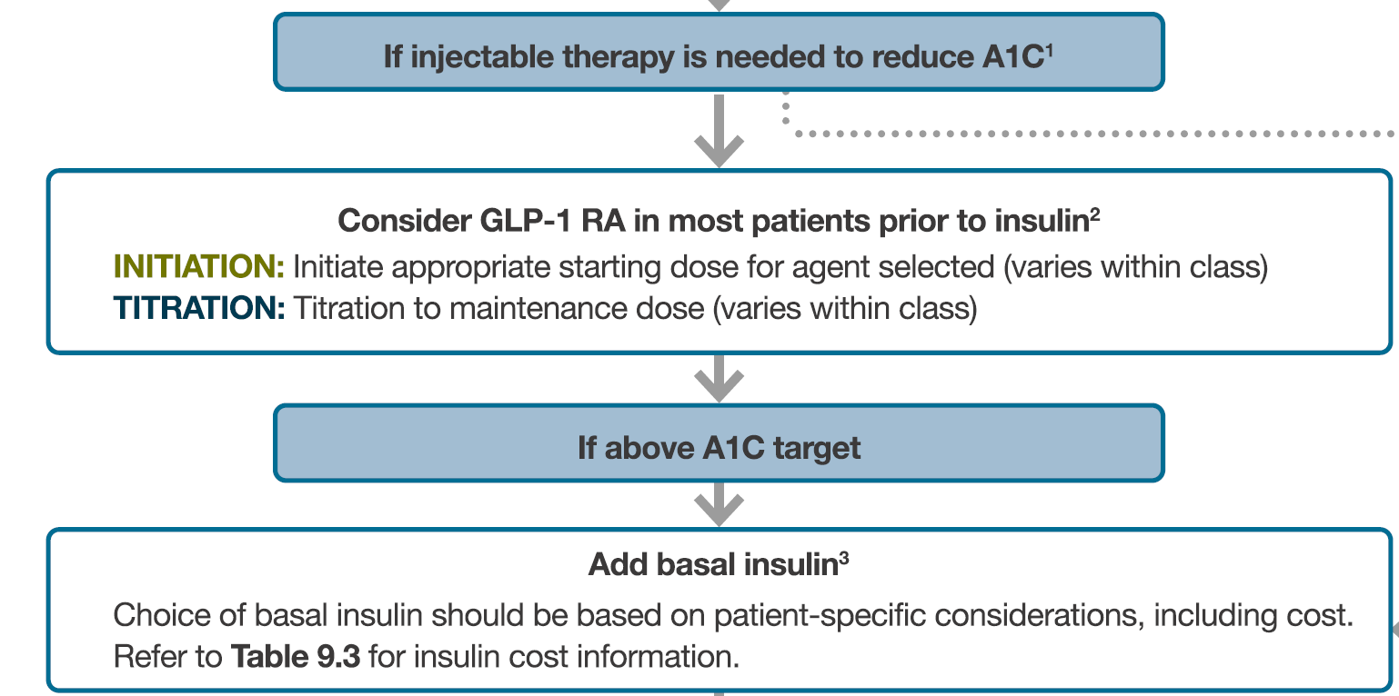
2021

Slide 92
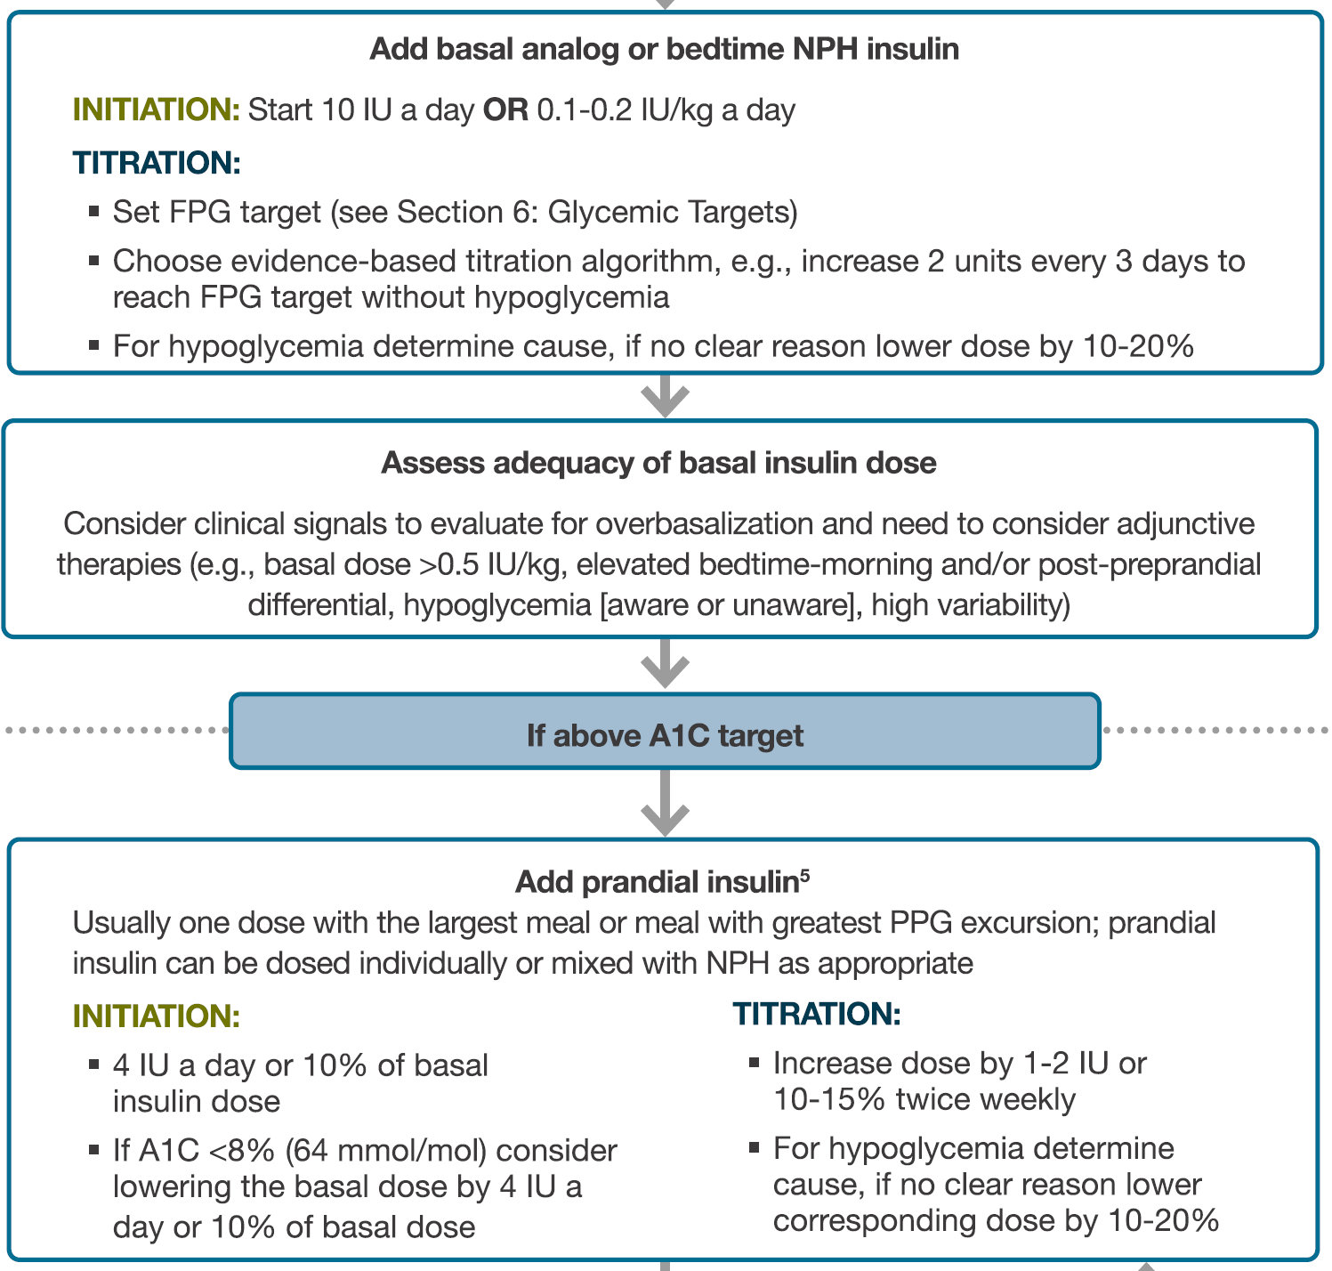
2021

Slide 93
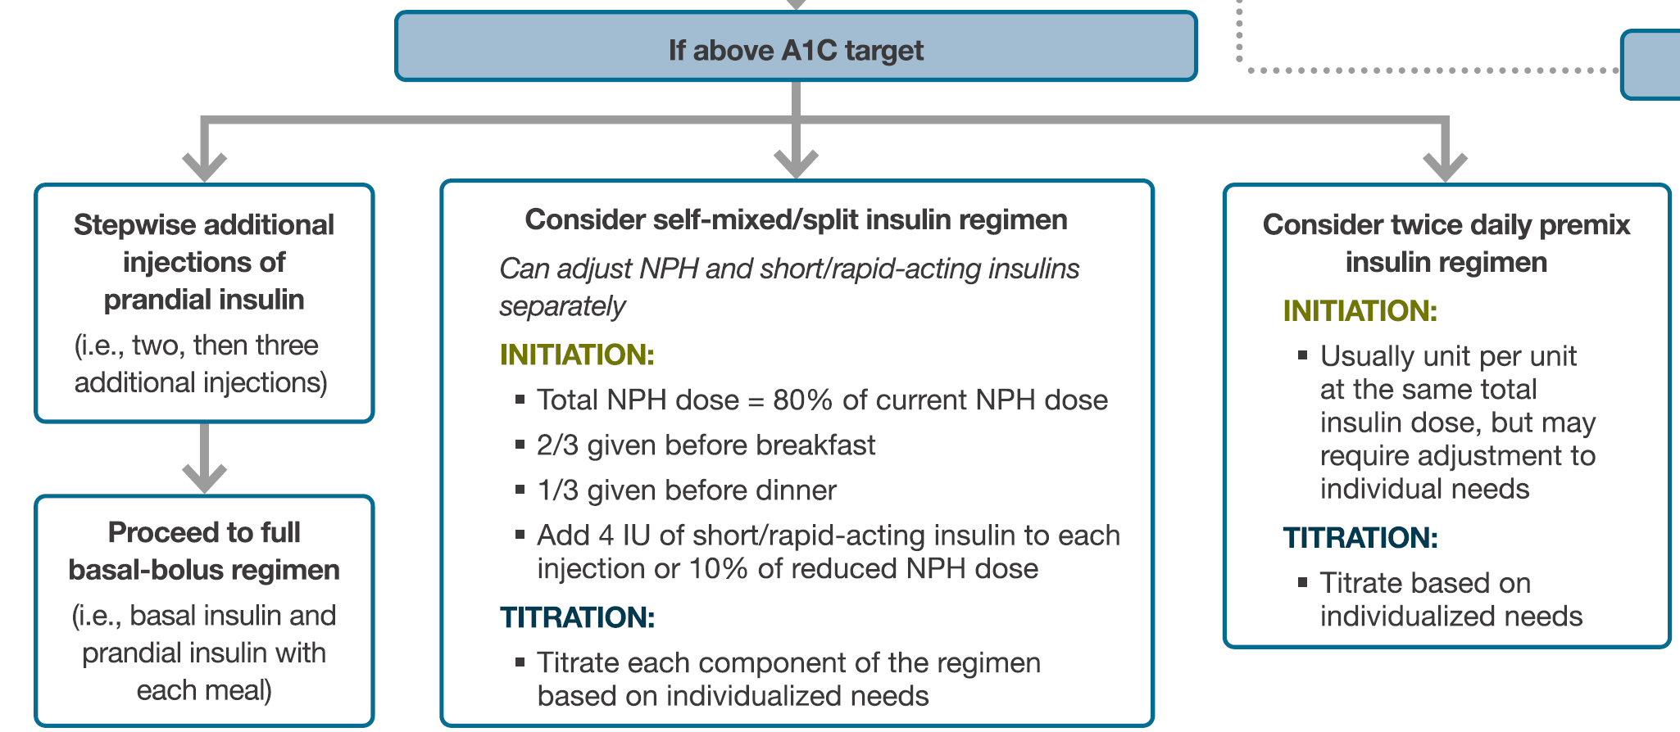
2021

Slide 94
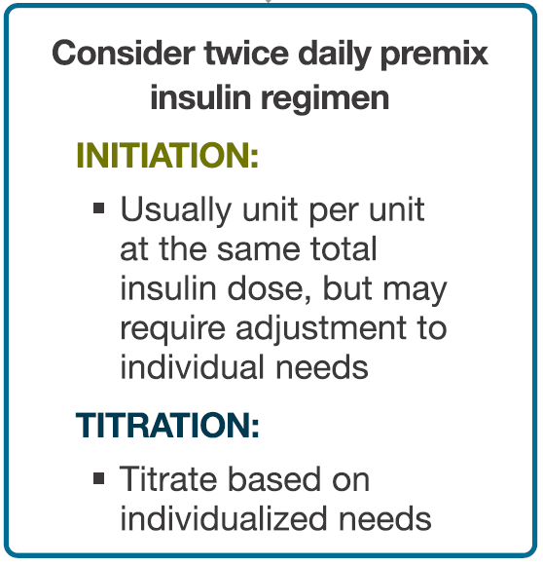
2021

Slide 95
“The Puzzle” of Insulin Therapy
Basal, Prandial, Premix
Most patients with T2DM will eventually need insulin therapy as β-cell function declines over time and diet, exercise, and OAMs will not suffice to maintain adequate glucose control^{1,2}
While guidelines recommend basal insulin as the most convenient initial insulin regimen,³ in reality, several other options are widely used and are based on the concept of personalized care⁴
  Premix insulins are one of the commonly used options⁴
This slide set delineates important characteristics of treatment with premix insulins and compare them with alternative insulin therapies
Holman RR. Diabetes Res Clin Pract 1998;40:S21-25
Elizarova S et al. J Diabetes 2014;6:100-10
American Diabetes Association. Diabetes Care 2016;39:S52-9
Freemantle N et al. Diabetes Obes Metab 2013;15:1120-7
OAM=oral antihyperglycemic medication
Copyright © 2016 Eli Lilly and Company
Notes:
Diab-00070768
Abbreviation:
T2DM=Type 2 diabetes mellitus
References:
Holman RR. Assessing the potential for α-glucosidase inhibitors in prediabetic states. Diabetes Res Clin Pract 1998;40(Suppl):S21-25.
Elizarova S, Galstyan GR, Wolffenbuttel BH. Role of premix insulin analogues in the treatment of patients with type 2 diabetes mellitus: a narrative review. J Diabetes 2014;6(2):100-10.
American Diabetes Association. Approaches to glycemic treatment. Diabetes Care 2016;39(Suppl 1):S52-9.
Freemantle N, Balkau B, Home PD. A propensity score matched comparison of different insulin regimens 1 year after beginning insulin in people with type 2 diabetes. Diabetes Obes Metab 2013;15(12):1120-7.

Slide 96
“The Puzzle” of Insulin Therapy
Basal, Prandial, Premix
Most patients with T2DM will eventually need insulin therapy as β-cell function declines over time and diet, exercise, and OAMs will not suffice to maintain adequate glucose control^{1,2}
While guidelines recommend basal insulin as the most convenient initial insulin regimen,³ in reality, several other options are widely used and are based on the concept of personalized care⁴
  Premix insulins are one of the commonly used options⁴
This slide set delineates important characteristics of treatment with premix insulins and compare them with alternative insulin therapies
Holman RR. Diabetes Res Clin Pract 1998;40:S21-25
Elizarova S et al. J Diabetes 2014;6:100-10
American Diabetes Association. Diabetes Care 2016;39:S52-9
Freemantle N et al. Diabetes Obes Metab 2013;15:1120-7
OAM=oral antihyperglycemic medication
Copyright © 2016 Eli Lilly and Company
Notes:
Diab-00070768
Abbreviation:
T2DM=Type 2 diabetes mellitus
References:
Holman RR. Assessing the potential for α-glucosidase inhibitors in prediabetic states. Diabetes Res Clin Pract 1998;40(Suppl):S21-25.
Elizarova S, Galstyan GR, Wolffenbuttel BH. Role of premix insulin analogues in the treatment of patients with type 2 diabetes mellitus: a narrative review. J Diabetes 2014;6(2):100-10.
American Diabetes Association. Approaches to glycemic treatment. Diabetes Care 2016;39(Suppl 1):S52-9.
Freemantle N, Balkau B, Home PD. A propensity score matched comparison of different insulin regimens 1 year after beginning insulin in people with type 2 diabetes. Diabetes Obes Metab 2013;15(12):1120-7.

Slide 97
“The Puzzle” of Insulin Therapy
Basal, Prandial, Premix
Most patients with T2DM will eventually need insulin therapy as β-cell function declines over time and diet, exercise, and OAMs will not suffice to maintain adequate glucose control^{1,2}
While guidelines recommend basal insulin as the most convenient initial insulin regimen,³ in reality, several other options are widely used and are based on the concept of personalized care⁴
  Premix insulins are one of the commonly used options⁴
This slide set delineates important characteristics of treatment with premix insulins and compare them with alternative insulin therapies
Holman RR. Diabetes Res Clin Pract 1998;40:S21-25
Elizarova S et al. J Diabetes 2014;6:100-10
American Diabetes Association. Diabetes Care 2016;39:S52-9
Freemantle N et al. Diabetes Obes Metab 2013;15:1120-7
OAM=oral antihyperglycemic medication
Copyright © 2016 Eli Lilly and Company
Notes:
Diab-00070768
Abbreviation:
T2DM=Type 2 diabetes mellitus
References:
Holman RR. Assessing the potential for α-glucosidase inhibitors in prediabetic states. Diabetes Res Clin Pract 1998;40(Suppl):S21-25.
Elizarova S, Galstyan GR, Wolffenbuttel BH. Role of premix insulin analogues in the treatment of patients with type 2 diabetes mellitus: a narrative review. J Diabetes 2014;6(2):100-10.
American Diabetes Association. Approaches to glycemic treatment. Diabetes Care 2016;39(Suppl 1):S52-9.
Freemantle N, Balkau B, Home PD. A propensity score matched comparison of different insulin regimens 1 year after beginning insulin in people with type 2 diabetes. Diabetes Obes Metab 2013;15(12):1120-7.

Slide 98
INSTIGATE Observational Study:
Insulins Used at Initiation
ª
Percentage of Patients
ªIncludes both intermediate- and long-acting insulins
Liebl A et al. Curr Med Res Opin 2011;27:887-95
Copyright © 2016 Eli Lilly and Company
Notes:
Diab-00070768
Key Points:
At the time of insulin initiation, long/intermediate acting insulin only was the most common regimen in France (84.2%) and Spain (68.1%).
In the UK and Greece, the most frequently initiated regimens were either premix insulin formulations only (53.6% and 30.1%, respectively) or long/intermediate-acting insulin only (38.7% and 48.4%, respectively).
In Germany, the initial regimen was short-acting insulin only for most patients (50.2%) followed by basal/bolus regimens (23.6%).
Reference:
Liebl A, Jones S, Benroubi M, Castell C, Goday A, Aline Charles M, Smith HT, Nicolay C, Simpson A. Clinical outcomes after insulin initiation in patients with type 2 diabetes: 6-month data from the INSTIGATE observational study in five European countries. Curr Med Res Opin 2011;27(5):887-95.

Slide 99
INSTIGATE Observational Study:
HbA1c 6 Months After Insulin Initiation
12
11
10
9
Most Recent HbA1c (%)
8
7
6
EASD/ADA/IDF Consensus Target (HbA1c <7.0%)
0
Baseline
(N=1037)
6 Months
(N=978)
Baseline
(N=151)
6 Months
(N=145)
Baseline
(N=230)
6 Months
(N=230)
Baseline
(N=255)
6 Months
(N=256)
Baseline
(N=183)
6 Months
(N=175)
Baseline
(N=218)
6 Months
(N=172)
Overall
France
Germany
Greece
Spain
UK
Box plots are lower quartile-median-upper quartile HbA1c; diamonds are mean HbA1c
Data from Liebl A et al. Curr Med Res Opin 2011;27:887-95
Copyright © 2016 Eli Lilly and Company
Notes:
Diab-00070768
Abbreviations:
ADA=American Diabetes Association; EASD=European Association for the Study of Diabetes; HbA1c=hemoglobin A1c; IDF=International Diabetes Federation
Copyright Disclosure: Figure has been recreated for Eli Lilly and Company with Data from Liebl A et al. Curr Med Res Opin 2011;27:887-95.
Key Points:
At baseline, the mean ± standard deviation (SD) HbA1c was 9.6 ± 1.8% in the total population and this decreased to 7.5 ± 1.2% (median 7.3%) at 6 months after insulin initiation.
The mean HbA1c concentration was decreased to within the EASD/ADA target range (<7%) only in Germany (6.9 ± 1.0%, median 6.7%) and both mean and median values remained above target in all other countries examined.
The largest mean decrease was in Germany (-2.3%) and the smallest decrease in the UK (-1.7%).
Reference:
Liebl A, Jones S, Benroubi M, Castell C, Goday A, Aline Charles M, Smith HT, Nicolay C, Simpson A. Clinical outcomes after insulin initiation in patients with type 2 diabetes: 6-month data from the INSTIGATE observational study in five European countries. Curr Med Res Opin 2011;27(5):887-95.

Slide 100
INSTIGATE Observational Study:
HbA1c 6 Months After Insulin Initiation
12
11
10
9
Most Recent HbA1c (%)
8
7
6
EASD/ADA/IDF Consensus Target (HbA1c <7.0%)
0
Baseline
(N=1037)
6 Months
(N=978)
Baseline
(N=151)
6 Months
(N=145)
Baseline
(N=230)
6 Months
(N=230)
Baseline
(N=255)
6 Months
(N=256)
Baseline
(N=183)
6 Months
(N=175)
Baseline
(N=218)
6 Months
(N=172)
Overall
France
Germany
Greece
Spain
UK
Box plots are lower quartile-median-upper quartile HbA1c; diamonds are mean HbA1c
Data from Liebl A et al. Curr Med Res Opin 2011;27:887-95
Copyright © 2016 Eli Lilly and Company
Notes:
Diab-00070768
Abbreviations:
ADA=American Diabetes Association; EASD=European Association for the Study of Diabetes; HbA1c=hemoglobin A1c; IDF=International Diabetes Federation
Copyright Disclosure: Figure has been recreated for Eli Lilly and Company with Data from Liebl A et al. Curr Med Res Opin 2011;27:887-95.
Key Points:
At baseline, the mean ± standard deviation (SD) HbA1c was 9.6 ± 1.8% in the total population and this decreased to 7.5 ± 1.2% (median 7.3%) at 6 months after insulin initiation.
The mean HbA1c concentration was decreased to within the EASD/ADA target range (<7%) only in Germany (6.9 ± 1.0%, median 6.7%) and both mean and median values remained above target in all other countries examined.
The largest mean decrease was in Germany (-2.3%) and the smallest decrease in the UK (-1.7%).
Reference:
Liebl A, Jones S, Benroubi M, Castell C, Goday A, Aline Charles M, Smith HT, Nicolay C, Simpson A. Clinical outcomes after insulin initiation in patients with type 2 diabetes: 6-month data from the INSTIGATE observational study in five European countries. Curr Med Res Opin 2011;27(5):887-95.

Slide 101
TREAT Observational Study:
Insulins Used at Initiation
100
Basal
ª
Premix
Basal-bolus
80
Prandial
Other
60
Percentage of Patients
40
Premix and basal bolus regimens were used at higher baseline HbA1c values
20
0
Overall
(n=886)
Greece
(n=162)
Portugal
(n=148)
Romania
(n=207)
Sweden
(n=158)
Turkey
(n=211)
ªIncludes both intermediate- and long-acting insulins
Data from Oguz A et al. Curr Med Res Opin 2013;29:911-20
Copyright © 2016 Eli Lilly and Company
Notes:
Diab-00070768
Abbreviation:
HbA1c=hemoglobin A1c
Copyright Disclosure: Figure has been recreated for Eli Lilly and Company with Data from Oguz A et al. Curr Med Res Opin 2013;29:911-20.
Key Points:
Regimens used at insulin initiation differed between countries.
Overall 50.1% of patients were initiated on a long-/intermediate-acting insulin regimen, 39.3% on an insulin-mixture regimen, 7.8% on a basal-bolus insulin regimen, 2.1% on a short-acting insulin regimen and 0.7% on other regimens.
Reference:
Oguz A, Benroubi M, Brismar K, Melo P, Morar C, Cleall SP, Giaconia J, Schmitt H. Clinical outcomes after 24 months of insulin therapy in patients with type 2 diabetes in five countries: results from the TREAT study. Curr Med Res Opin 2013;29(8):911-20.

Slide 102
TREAT Observational Study:
HbA1c per Insulin Regimen Over 2 Years
Overall (n=886)
12
Basal (n=444)
Premix (n=348)
11
Basal-bolus (n=69)
10
HbA1c (%)
9
8
7
0
3
6
12
18
24
Months
Baseline HbA1c was lower for patients on the basal-only regimen
Endpoint HbA1c was similar between the 3 insulin regimens shown
Data from Oguz A et al. Curr Med Res Opin 2013;29:911-20
Copyright © 2016 Eli Lilly and Company
Notes:
Diab-00070768
Abbreviation:
HbA1c=hemoglobin A1c
Copyright Disclosure: Figure has been recreated for Eli Lilly and Company with Data from Oguz A et al. Curr Med Res Opin 2013;29:911-20.
Key Point:
Mean HbA1c levels decreased over 24 months overall for each initial insulin regimen.
Reference:
Oguz A, Benroubi M, Brismar K, Melo P, Morar C, Cleall SP, Giaconia J, Schmitt H. Clinical outcomes after 24 months of insulin therapy in patients with type 2 diabetes in five countries: results from the TREAT study. Curr Med Res Opin 2013;29(8):911-20.

Slide 103
CREDIT Study: Commonly Used Insulin Regimens in Local Practice (EU, Japan, Canada)
Percentage of Patients
Data from Freemantle N et al. Diabetes Obes Metab 2013;15:1120-7
Copyright © 2016 Eli Lilly and Company
Notes:
Diab-00070768
Copyright Disclosure: Figure has been recreated for Eli Lilly and Company with Data from Freemantle N et al. Diabetes Obes Metab 2013;15:1120-7.
Key Points:
The use of premix and basal-bolus insulin increased after 1 year, whereas the use of basal insulin and prandial insulin decreased.
A small proportion of participants (2.3%) were no longer taking insulin after 1 year.
In all, 75.0% of participants remained on their initial regimen, with the highest percentage in the premix group (85.4%) and the lowest on prandial insulin group (37.6%).
N values indicate the number of participants at 1 year with HbA1c values both at baseline and at 1 year.
Reference:
Freemantle N, Balkau B, Home PD. A propensity score matched comparison of different insulin regimens 1 year after beginning insulin in people with type 2 diabetes. Diabetes Obes Metab 2013;15(12):1120-7.

Slide 104
CREDIT Study: Change in Insulin Regimens Over 4 Years
START
Basal
n=1163 (51.2%)
Basal-bolus
n=331 (14.6%)
Prandial
n=181 (8.0%)
Premix
n=536 (23.6%)
Other
n=61 (2.7%)
No insulin
n=0 (0.0%)
605 (52.0%)
222 (67.1%)
33 (18.2%)
362 (67.5%)
36 (59.0%)
0 (0.0%)
341 (29.3%)
7 (0.6%)
142 (12.2%)
25 (2.1%)
43 (3.7%)
32 (9.7%)
7 (2.1%)
35 (10.6%)
9 (2.7%)
26 (7.9%)
9 (5.0%)
73 (40.3%)
26 (14.4%)
18 (9.9%)
25 (4.7%)
22 (12.2%)
91 (17.0%)
6 (1.1%)
26 (4.9%)
0 (0.0%)
26 (4.9%)
14 (23.0%)
1 (1.6%)
7 (11.5%)
3 (4.9%)
4 YEARS
Basal
n=671 (29.5%)
Basal-Bolus
n=741 (32.6%)
Prandial
n=54 (2.4%)
Premix
n=572 (25.2%)
Other
n=114 (5.0%)
No insulin
n=120 (5.3%)
Data from Home PD et al. Diabetes Res Clin Pract 2015;108:350-9
Copyright © 2016 Eli Lilly and Company
Notes:
Diab-00070768
Copyright Disclosure: Figure has been recreated for Eli Lilly and Company with Data from Home PD et al. Diabetes Res Clin Pract 2015;108:350-9
Key Points:
Data shown for patients with data at baseline and at 4 years (N=2272).
Horizontal arrows represent the movement of participants from one regimen to another at 4 years, with the number and percentage of participants moving from the initial regimen shown above the arrow.
Vertical arrows denote the movement of participants on a regimen when starting insulin to the same regimen at 4 years.
The number and percentage shown intersecting the vertical arrows are participants who were on the same regimen at the start and at 4 years.
Reference:
Home PD, Dain MP, Freemantle N, Kawamori R, Pfohl M, Brette S, Pilorget V, Scherbaum WA, Vespasiani G, Vincent M, Balkau B. Four-year evolution of insulin regimens, glycaemic control, hypoglycaemia and body weight after starting insulin therapy in type 2 diabetes across three continents. Diabetes Res Clin Pract 2015;108(2):350-9.

Slide 105
CREDIT Study: Change in Insulin Regimens Over 4 Years
START
Basal
n=1163 (51.2%)
Basal-bolus
n=331 (14.6%)
Prandial
n=181 (8.0%)
Premix
n=536 (23.6%)
Other
n=61 (2.7%)
No insulin
n=0 (0.0%)
605 (52.0%)
222 (67.1%)
33 (18.2%)
362 (67.5%)
36 (59.0%)
0 (0.0%)
341 (29.3%)
7 (0.6%)
142 (12.2%)
25 (2.1%)
43 (3.7%)
32 (9.7%)
7 (2.1%)
35 (10.6%)
9 (2.7%)
26 (7.9%)
9 (5.0%)
73 (40.3%)
26 (14.4%)
18 (9.9%)
25 (4.7%)
22 (12.2%)
91 (17.0%)
6 (1.1%)
26 (4.9%)
0 (0.0%)
26 (4.9%)
14 (23.0%)
1 (1.6%)
7 (11.5%)
3 (4.9%)
4 YEARS
Basal
n=671 (29.5%)
Basal-Bolus
n=741 (32.6%)
Prandial
n=54 (2.4%)
Premix
n=572 (25.2%)
Other
n=114 (5.0%)
No insulin
n=120 (5.3%)
Data from Home PD et al. Diabetes Res Clin Pract 2015;108:350-9
Copyright © 2016 Eli Lilly and Company
Notes:
Diab-00070768
Copyright Disclosure: Figure has been recreated for Eli Lilly and Company with Data from Home PD et al. Diabetes Res Clin Pract 2015;108:350-9
Key Points:
Data shown for patients with data at baseline and at 4 years (N=2272).
Horizontal arrows represent the movement of participants from one regimen to another at 4 years, with the number and percentage of participants moving from the initial regimen shown above the arrow.
Vertical arrows denote the movement of participants on a regimen when starting insulin to the same regimen at 4 years.
The number and percentage shown intersecting the vertical arrows are participants who were on the same regimen at the start and at 4 years.
Of the 536 participants who started on premix insulin, 362 (67.5%) were on premix at 4 years and 148 (27.6%) moved to other regimens; 26 (4.9%) stopped insulin. However, 210 participants changed to premix, so that in all, 572 (25.2%) were on premix at 4 years.
Reference:
Home PD, Dain MP, Freemantle N, Kawamori R, Pfohl M, Brette S, Pilorget V, Scherbaum WA, Vespasiani G, Vincent M, Balkau B. Four-year evolution of insulin regimens, glycaemic control, hypoglycaemia and body weight after starting insulin therapy in type 2 diabetes across three continents. Diabetes Res Clin Pract 2015;108(2):350-9.

Slide 106
Content Overview
Progression of T2DM
Insulin Initiation in T2DM
Introduction to Premix Insulins
Premix vs. Basal Insulin Regimens
Premix vs. Basal-Bolus Regimens
Comparison of Premix, Basal-Bolus, and Basal Insulin Regimens
Guidelines and Treatment Algorithms
Conclusions
Copyright © 2016 Eli Lilly and Company
Notes:
Diab-00070768
Abbreviation:
T2DM=Type 2 diabetes mellitus

Slide 107
Clinical Trials: Premix Insulin BID vs. Basal Insulin QD
First Author, Year | Trial Design and Duration | Treatment Arms | Population
Malone et al, 2004¹ | 32-week, multicenter, randomized, prospective, open-label, crossover study | Glargine QD+Met vs. LM25 BID+Met | N=105; insulin-naïve
Malone et al, 2005² | 32-week, multicenter, randomized, prospective, open-label, crossover study | Glargine QD+Met vs. LM25 BID+Met | N=97; insulin-experienced
Raskin et al, 2005³ | 28-week, randomized, parallel-group | BiAsp30 BID± OAMs vs. Glargine HS± OAMs | N=233; insulin-naïve
Holman et al, 2007⁴ | 1-year, open-label, multicenter, randomized trial | BIAsp30 BID vs. prandial insulin aspart TID vs. basal insulin detemir QD or BID | N=708; on dual OAMs
Buse et al, 2009⁵ | 24-week, open-label, multicenter, randomized trial | Glargine QD+OAM vs. LM25 BID+OAM | N=2091; insulin-naïve
Guigliano et al, 2011⁶ | Meta-analysis of 10 RCTs | Basal QD vs. Premix BID regimens | N=2176; mostly insulin-naïve on combined regimens of insulin+OAMs
Malone JK et al. Clin Ther 2004;26:2034-44
Malone JK et al. Diabet Med 2005;22:374-81
Raskin P et al. Diabetes Care 2005;28:260-5
Holman RR et al. N Engl J Med 2007;357:1716-30
Buse JB et al. Diabetes Care 2009;32:1007-13
Giugliano D et al. Diabetes Care 2011;34:510-7
Copyright © 2016 Eli Lilly and Company
Notes:
Diab-00070768
Abbreviations:
BiAsp30=biphasic insulin aspart 70/30; BID=twice daily; LM25=25% insulin lispro, 75% insulin lispro protamine suspension; Met=metformin; OAM=oral antihyperglycemic medication; QD=once daily; RCT=randomized clinical trials; TID=thrice daily
References:
Malone JK, Kerr LF, Campaigne BN, Sachson RA, Holcombe JH; Lispro Mixture-Glargine Study Group. Combined therapy with insulin lispro Mix 75/25 plus metformin or insulin glargine plus metformin: a 16-week, randomized, open-label, crossover study in patients with type 2 diabetes beginning insulin therapy. Clin Ther 2004;26(12):2034-44.
Malone JK, Bai S, Campaigne BN, Reviriego J, Augendre-Ferrante B. Twice-daily pre-mixed insulin rather than basal insulin therapy alone results in better overall glycaemic control in patients with type2 diabetes. Diabet Med 2005;22(4):374-81.
Raskin P, Allen E, Hollander P, Lewin A, Gabbay RA, Hu P, Bode B, Garber A; INITIATE Study Group. Initiating insulin therapy in type 2 Diabetes: a comparison of biphasic and basal insulin analogs. Diabetes Care 2005;28(2):260-5.
Holman RR, Thorne KI, Farmer AJ, Davies MJ, Keenan JF, Paul S, Levy JC; 4-T Study Group. Addition of biphasic, prandial, or basal insulin to oral therapy in type 2 diabetes. N Engl J Med 2007;357(17):1716-30.
Buse JB, Wolffenbuttel BH, Herman WH, Shemonsky NK, Jiang HH, Fahrbach JL, Scism-Bacon JL, Martin SA. DURAbility of basal vs. lispro mix 75/25 insulin efficacy (DURABLE) trial 24-week results: safety and efficacy of insulin lispro mix 75/25 vs. insulin glargine added to oral antihyperglycemic drugs in patients with type 2 diabetes. Diabetes Care 2009;32(6):1007-13.
Giugliano D, Maiorino MI, Bellastella G, Chiodini P, Ceriello A, Esposito K. Efficacy of insulin analogs in achieving the hemoglobin A1c target of <7% in type 2 diabetes: meta-analysis of randomized controlled trials. Diabetes Care 2011;34(2):510-7.

Slide 108

LM25 BID vs. Glargine QD (Insulin-Naïve Patients): Trial Design
Multicenter, randomized, prospective, open-label, crossover study with
16 weeks on each treatment
Inclusion criteria:
Age 30-80 years with T2DM
BMI ≤40 kg/m²
HbA1c levels 1.3-2.0 x ULN
Insulin-naïve, on ≥1 OAM for ≥30 days
Glargine QD + Met
Glargine QD + Met
Lead-in
NPH + Met
LM25 BID + Met
LM25 BID + Met
-6 to -10
0
16
32
Weeks
Malone JK et al. Clin Ther 2004;26:2034-44
ULN=upper limit of normal (of regional laboratory)
Copyright © 2016 Eli Lilly and Company
Notes:
Diab-00070768
Abbreviations:
BID=twice daily; BMI=body mass index; HbA1c=hemoglobin A1c; LM25=25% insulin lispro, 75% insulin lispro protamine suspension; Met=metformin; NPH=neutral protamine hagedorn; OAM=oral antihyperglycemic medication; QD=once daily; T2DM=Type 2 diabetes mellitus
Key Points:
Lead-in period was 8 ± 2 weeks; each patient received NPH QD at bedtime and metformin (1500-2550 mg/day in 2-3 daily doses).¹
The purpose of the lead-in period was to familiarize patients with injecting insulin and to standardize the prerandomization therapy of all patients.¹
Patients were randomized to receive either LM25 before breakfast and dinner + Met for 16 weeks and then insulin glargine at bedtime + Met for an additional 16 weeks, or to the opposite treatment sequence.¹
If a patient was on a sulfonylurea, it was stopped before insulin was started in the lead-in. This was done to reduce the risk of hypoglycemia if insulin was added to a sulphonylurea.²
Background:
Study aimed to assess glycemic response to LM25 BID + Met vs. that to insulin glargine QD + Met in patients with T2DM.¹
References:
Malone JK, Kerr LF, Campaigne BN, Sachson RA, Holcombe JH; Lispro Mixture-Glargine Study Group. Combined therapy with insulin lispro Mix 75/25 plus metformin or insulin glargine plus metformin: a 16-week, randomized, open-label, crossover study in patients with type 2 diabetes beginning insulin therapy. Clin Ther 2004;26(12):2034-44.
Data on file. F3Z-MC-IOND Study Report. Approved March 28, 2006.

Slide 109
LM25 BID vs. Glargine QD (Insulin-Naïve Patients): Reduction in HbA1c and
Percentage of Patients Meeting Glycemic Targets
Baseline
HbA1c (%)
8.7
8.7
p=.036
*
p<.001
p=.019
***
*
p<.001
Mean Change in HbA1c (%)
***
Percentage of Patients
**
p=.003
Higher percentage of patients treated with LM25+Met attained glycemic targets, except FPG, which was attained by more patients on Glargine+Met
*p≤.05; **p≤.01; ***p≤.001 between treatment groups
Malone JK et al. Clin Ther 2004;26:2034-44
Copyright © 2016 Eli Lilly and Company
Notes:
Diab-00070768
Abbreviations:
BID=twice daily; FPG=fasting plasma glucose; HbA1c=hemoglobin A1c; LM25=25% insulin lispro, 75% insulin lispro protamine suspension; Met=metformin; PPG=postprandial glucose; QD=once daily
Key Point:
In this study population, LM25+Met was associated with lower HbA1c at endpoint, a higher proportion of patients achieving HbA1c ≤7.0%, and a smaller rise in PPG after breakfast and dinner compared to Glargine+Met.
Reference:
Malone JK, Kerr LF, Campaigne BN, Sachson RA, Holcombe JH; Lispro Mixture-Glargine Study Group. Combined therapy with insulin lispro Mix 75/25 plus metformin or insulin glargine plus metformin: a 16-week, randomized, open-label, crossover study in patients with type 2 diabetes beginning insulin therapy. Clin Ther 2004;26(12):2034-44.

Slide 110
LM25 BID vs. Glargine QD (Insulin-Naïve Patients): Hypoglycemia
p=.041
*
p=.788
Increase in rate of overall hypoglycemia, but similar rate of nocturnal hypoglycemia, in patients treated with LM25+Met compared to those treated with Glargine+Met
No cases of severe hypoglycemia reported in either treatment group
*p≤.05 between treatment groups
Malone JK et al. Clin Ther 2004;26:2034-44
Copyright © 2016 Eli Lilly and Company
Notes:
Diab-00070768
Abbreviations:
BID=twice daily; LM25=25% insulin lispro, 75% insulin lispro protamine suspension; Met=metformin; QD=once daily
Key Points:
In this study population, LM25+Met was associated with an increase in overall hypoglycemia and similar nocturnal hypoglycemia compared to Glargine+Met.
Overall hypoglycemia was defined as plasma glucose <63 mg/dL or symptoms of hypoglycemia.
Nocturnal hypoglycemia was defined as plasma glucose <63 mg/dL or symptoms of hypoglycemia occurring between bedtime and before breakfast.
Severe hypoglycemia was defined as requiring third-party assistance due to disabling hypoglycemia.
Reference:
Malone JK, Kerr LF, Campaigne BN, Sachson RA, Holcombe JH; Lispro Mixture-Glargine Study Group. Combined therapy with insulin lispro Mix 75/25 plus metformin or insulin glargine plus metformin: a 16-week, randomized, open-label, crossover study in patients with type 2 diabetes beginning insulin therapy. Clin Ther 2004;26(12):2034-44.

Slide 111
LM25 BID vs. Glargine QD (Insulin-Naïve Patients): Weight Gain
p=.006
**
Greater weight gain in patients treated with LM25+Met compared to those treated with Glargine+Met
**p≤.01 between treatment groups
Malone JK et al. Clin Ther 2004;26:2034-44
Copyright © 2016 Eli Lilly and Company
Notes:
Diab-00070768
Abbreviations:
BID=twice daily; LM25=25% insulin lispro, 75% insulin lispro protamine suspension; Met=metformin; QD=once daily
Key Points:
Patients in both treatment sequences gained weight from randomization to endpoint.
While patients on LM25+Met gained more weight compared to those on Glargine+Met, mean body weight at endpoint was lower with LM25 (though this difference was not clinically meaningful).
The mean weight gain was 2.8% and 2.9% of the mean baseline weight with LM25+Met and Glargine+Met, respectively.
Reference:
Malone JK, Kerr LF, Campaigne BN, Sachson RA, Holcombe JH; Lispro Mixture-Glargine Study Group. Combined therapy with insulin lispro Mix 75/25 plus metformin or insulin glargine plus metformin: a 16-week, randomized, open-label, crossover study in patients with type 2 diabetes beginning insulin therapy. Clin Ther 2004;26(12):2034-44.

Slide 112
LM25 BID vs. Glargine QD (Insulin-Experienced Patients): Trial Design
Multicenter, randomized, prospective, open-label, crossover study with
16 weeks on each treatment
Inclusion criteria:
Age 30-75 years with T2DM
HbA1c levels 1.3-2.0 x ULN
Insulin-experienced: On NPH QD or BID with or without OAMs, or an insulin mixture QD with OAMs for ≥30 days
Glargine QD + Met
Glargine QD + Met
Lead-in
NPH + Met
LM25 BID + Met
LM25 BID + Met
-4 to -8
0
16
32
Weeks
Malone JK et al. Diabet Med 2005;22:374-81
Copyright © 2016 Eli Lilly and Company
Notes:
Diab-00070768
Abbreviations:
BID=twice daily; HbA1c=hemoglobin A1c; LM25=25% insulin lispro, 75% insulin lispro protamine suspension; Met=metformin; NPH=neutral protamine hagedorn; OAM=oral antihyperglycemic medication; QD=once daily; T2DM=Type 2 diabetes mellitus; ULN=upper limit of normal
Key Points:
Lead-in period was 6 ± 2 weeks; each patient received NPH QD at bedtime and metformin (1500-2550 mg/day in 2-3 daily doses).
These patients were selected because they were expected to benefit from prandial control not provided by their previous insulin.
Patients were randomized to receive either LM25 before breakfast and dinner + Met for 16 weeks and then insulin glargine at bedtime + Met for an additional 16 weeks, or to the opposite treatment sequence.
Background:
Study aimed to assess glycemic response to LM25 BID + Met vs. that to insulin glargine QD + Met in patients with T2DM inadequately controlled with NPH, or insulin plus OAMs.
Reference:
Malone JK, Bai S, Campaigne BN, Reviriego J, Augendre-Ferrante B. Twice-daily pre-mixed insulin rather than basal insulin therapy alone results in better overall glycaemic control in patients with type2 diabetes. Diabet Med 2005;22(4):374-81.

Slide 113
LM25 BID vs. Glargine QD (Insulin-Experienced Patients): Reduction in HbA1c and Percentage of Patients Meeting Glycemic Targets
Baseline
HbA1c (%)
8.5
8.5
p<.001
***
p<.001
p=.01
***
**
p=.002
Change in HbA1c (%)
**
Percentage of Patients
***
p<.001
Higher percentage of patients treated with LM25+Met attained glycemic targets, except FPG, which was attained by more patients on Glargine+Met
**p≤.01; ***p≤.001 between treatment groups
Malone JK et al. Diabet Med 2005;22:374-81
Copyright © 2016 Eli Lilly and Company
Notes:
Diab-00070768
Abbreviations:
BID=twice daily; FPG=fasting plasma glucose; HbA1c=hemoglobin A1c; LM25=25% insulin lispro, 75% insulin lispro protamine suspension; Met=metformin; PPG=postprandial glucose; QD=once daily
Key Point:
In this study population, LM25+Met was associated with lower HbA1c at endpoint, a higher proportion of patients achieving HbA1c ≤7.0%, and a smaller rise in PPG after breakfast and dinner compared to Glargine+Met.
Background:
Study aimed to assess glycemic response to LM25 BID + Met vs. that to insulin glargine QD + Met in patients with T2DM inadequately controlled with NPH, or insulin plus OAMs.
Reference:
Malone JK, Bai S, Campaigne BN, Reviriego J, Augendre-Ferrante B. Twice-daily pre-mixed insulin rather than basal insulin therapy alone results in better overall glycaemic control in patients with type2 diabetes. Diabet Med 2005;22(4):374-81.

Slide 114
LM25 BID vs. Glargine QD (Insulin-Experienced Patients): Hypoglycemia
p=.477
p=.002
Similar rate of overall hypoglycemia, but significantly lower rate of nocturnal hypoglycemia, in patients treated with LM25+Met compared to those treated with Glargine+Met
No cases of severe hypoglycemia reported in either treatment group
Malone JK et al. Diabet Med 2005;22:374-81
Copyright © 2016 Eli Lilly and Company
Notes:
Diab-00070768
Abbreviations:
BID=twice daily; LM25=25% insulin lispro, 75% insulin lispro protamine suspension; Met=metformin; QD=once daily
Key Points:
In this study population, LM25+Met was associated with similar rates of overall hypoglycemia and a significantly lower rate of nocturnal hypoglycemia compared to Glargine+Met; rates of daytime hypoglycemia were significantly higher in the LM25+Met group (data not shown).
Overall hypoglycemia was defined as plasma glucose <63 mg/dL (<3.5 mmol/L) or symptoms of hypoglycemia.
Nocturnal hypoglycemia was defined as plasma glucose <63 mg/dL or symptoms of hypoglycemia occurring between bedtime and before breakfast.
Reference:
Malone JK, Bai S, Campaigne BN, Reviriego J, Augendre-Ferrante B. Twice-daily pre-mixed insulin rather than basal insulin therapy alone results in better overall glycaemic control in patients with type2 diabetes. Diabet Med 2005;22(4):374-81.

Slide 115
LM25 BID vs. Glargine QD (Insulin-Experienced Patients): Weight Gain
p=.001
Significantly greater weight gain in patients treated with LM25+Met compared to those treated with Glargine+Met
Malone JK et al. Diabet Med 2005;22:374-81
Copyright © 2016 Eli Lilly and Company
Notes:
Diab-00070768
Abbreviations:
BID=twice daily; LM25=25% insulin lispro, 75% insulin lispro protamine suspension; Met=metformin; QD=once daily
Key Point:
Patients on LM25+Met experienced significantly greater weight gain compared to those on Glargine+Met
Reference:
Malone JK, Bai S, Campaigne BN, Reviriego J, Augendre-Ferrante B. Twice-daily pre-mixed insulin rather than basal insulin therapy alone results in better overall glycaemic control in patients with type2 diabetes. Diabet Med 2005;22(4):374-81.

Slide 116
Premix Insulin Analogs vs. Basal Insulin Analogs: Change in HbA1c in 4 RCTs
Baseline
HbA1c (%)
8.7
8.7
8.5
8.5
9.8
9.7
8.4
8.6
1
2,a
3
4
Glargine
LM25
Glargine
LM25
Glargine
BiAsp
30
Detemir
BiAsp30
Mean Change in HbA1c (%)
p<.001
p=.003
p<.001
p<.01
Basal insulin
Premix insulin
ªInsulin-experienced patients; all other trials included insulin-naïve patients
Malone JK et al. Clin Ther 2004;26:2034-44
Malone JK et al. Diabet Med 2005;22:374-81
Raskin P et al. Diabetes Care 2005;28:260-5
Holman RR et al. N Engl J Med 2007;357:1716-30
Copyright © 2016 Eli Lilly and Company
Notes:
Diab-00070768
Abbreviations:
BiAsp30=biphasic insulin aspart 70/30; HbA1c=hemoglobin A1c; LM25=25% insulin lispro, 75% insulin lispro protamine suspension; RCT=randomized clinical trial
Key Point:
In four RCTs, premix insulin regimens resulted in significantly greater HbA1c reduction compared with basal insulin regimens.
Background:
Malone et al, 2004: 105 patients with T2DM (insulin-naïve) were randomized in a 32-week, open-label, prospective, crossover study to LM25 BID+metformin (Met) vs. insulin glargine QD+Met. Metformin was dosed from 1500-2500 mg/day.¹
Malone et al, 2005: 97 patients with T2DM (insulin-experienced) were randomized in an open-label, 32-week, crossover study to treatment with either LM25 BID+Met (1500-2550 mg/day) or insulin glargine QD+Met (1500-2550 mg/day) for 16 weeks, followed by 16 weeks of the other treatment.²
Raskin et al: A 28-week parallel-group study randomized 233 insulin-naïve patients with HbA1c ≥8.0% on >1000 mg/day metformin ± oral antihyperglycemic medications (OAMs). Metformin was adjusted up to 2550 mg/day before insulin therapy was initiated with 5-6 units of BIAsp30 twice daily (BID) or 10-12 units of glargine at bedtime (HS) and titrated to target plasma glucose (PG) (4.4-6.1 mmol/L).³
Holman et al: Study compared the efficacy and safety of adding BIAsp30 BID, prandial insulin aspart thrice daily (TID), or basal insulin detemir once daily (QD) or BID in the treatment of 708 patients with type2 diabetes mellitus (T2DM) who had suboptimal glycemic control while receiving maximally tolerated doses of metformin and sulfonylurea. These data are the results of the first year of the 3-year Treating to Target in type 2 Diabetes (4-T) study.⁴
References:
Malone JK, Kerr LF, Campaigne BN, Sachson RA, Holcombe JH; Lispro Mixture-Glargine Study Group. Combined therapy with insulin lispro Mix 75/25 plus metformin or insulin glargine plus metformin: a 16-week, randomized, open-label, crossover study in patients with type 2 diabetes beginning insulin therapy. Clin Ther 2004;26(12):2034-44.
Malone JK, Bai S, Campaigne BN, Reviriego J, Augendre-Ferrante B. Twice-daily pre-mixed insulin rather than basal insulin therapy alone results in better overall glycaemic control in patients with type2 diabetes. Diabet Med 2005;22(4):374-81.
Raskin P, Allen E, Hollander P, Lewin A, Gabbay RA, Hu P, Bode B, Garber A; INITIATE Study Group. Initiating insulin therapy in type 2 Diabetes: a comparison of biphasic and basal insulin analogs. Diabetes Care 2005;28(2):260-5.
Holman RR, Thorne KI, Farmer AJ, Davies MJ, Keenan JF, Paul S, Levy JC; 4-T Study Group. Addition of biphasic, prandial, or basal insulin to oral therapy in type 2 diabetes. N Engl J Med 2007;357(17):1716-30.

Slide 117
Premix Insulin Analogs vs. Basal Insulin Analogs: Percentage of Patients Reaching HbA1c ≤7% in 4 RCTs
p<.001
Basal insulin
Premix insulin
p<.001
p<.001
p=.002
Glargine
BiAsp30
Percentage of Patients Reaching HbA1c ≤7%
Glargine
LM25
Glargine
LM25
Glargine
BiAsp
30
Detemir
BiAsp
30
1
2,a
3
4
ªInsulin-experienced patients; all other trials included insulin-naïve patients
Malone JK et al. Clin Ther 2004;26:2034-44
Malone JK et al. Diabet Med 2005;22:374-81
Raskin P et al. Diabetes Care 2005;28:260-5
Holman RR et al. N Engl J Med 2007;357:1716-30
Copyright © 2016 Eli Lilly and Company
Notes:
Diab-00070768
Abbreviations:
BiAsp30=biphasic insulin aspart 70/30; HbA1c=hemoglobin A1c; LM25=25% insulin lispro, 75% insulin lispro protamine suspension; RCT=randomized clinical trial
Key Point:
In four RCTs, significantly greater number of patients on premix insulin regimens achieved HbA1c ≤7% compared to those on basal insulin regimens.
Background:
Malone et al, 2004: 105 patients with T2DM (insulin-naïve) were randomized in a 32-week, open-label, prospective, crossover study to LM25 BID+metformin (Met) vs. insulin glargine QD+Met. Metformin was dosed from 1500-2500 mg/day.¹
Malone et al, 2005: 97 patients with T2DM (insulin-experienced) were randomized in an open-label, 32-week, crossover study to treatment with either LM25 BID+Met (1500-2550 mg/day) or insulin glargine QD+Met (1500-2550 mg/day) for 16 weeks, followed by 16 weeks of the other treatment.²
Raskin et al: A 28-week parallel-group study randomized 233 insulin-naïve patients with HbA1c ≥8.0% on >1000 mg/day metformin ± oral antihyperglycemic medications (OAMs). Metformin was adjusted up to 2550 mg/day before insulin therapy was initiated with 5-6 units of BIAsp30 twice daily (BID) or 10-12 units of glargine at bedtime (HS) and titrated to target plasma glucose (PG) (4.4-6.1 mmol/L).³
Holman et al: Study compared the efficacy and safety of adding BIAsp30 BID, prandial insulin aspart thrice daily (TID), or basal insulin detemir once daily (QD) or BID in the treatment of 708 patients with type2 diabetes mellitus (T2DM) who had suboptimal glycemic control while receiving maximally tolerated doses of metformin and sulfonylurea. These data are the results of the first year of the 3-year Treating to Target in type2 Diabetes (4-T) study.⁴
References:
Malone JK, Kerr LF, Campaigne BN, Sachson RA, Holcombe JH; Lispro Mixture-Glargine Study Group. Combined therapy with insulin lispro Mix 75/25 plus metformin or insulin glargine plus metformin: a 16-week, randomized, open-label, crossover study in patients with type 2 diabetes beginning insulin therapy. Clin Ther 2004;26(12):2034-44.
Malone JK, Bai S, Campaigne BN, Reviriego J, Augendre-Ferrante B. Twice-daily pre-mixed insulin rather than basal insulin therapy alone results in better overall glycaemic control in patients with type2 diabetes. Diabet Med 2005;22(4):374-81.
Raskin P, Allen E, Hollander P, Lewin A, Gabbay RA, Hu P, Bode B, Garber A; INITIATE Study Group. Initiating insulin therapy in type 2 Diabetes: a comparison of biphasic and basal insulin analogs. Diabetes Care 2005;28(2):260-5.
Holman RR, Thorne KI, Farmer AJ, Davies MJ, Keenan JF, Paul S, Levy JC; 4-T Study Group. Addition of biphasic, prandial, or basal insulin to oral therapy in type 2 diabetes. N Engl J Med 2007;357(17):1716-30.

Slide 118
Premix Insulin Analogs vs. Basal Insulin Analogs: Weight Gain in 4 RCTs
p<.01
Basal insulin
Premix insulin
p<.001
p=.006
BiAsp30
Weight Gain (Kg)
p=.001
Glargine
LM25
LM25
Glargine
BiAsp
30
Detemir
BiAsp
30
Glargine
1
2,a
3
4
**p≤.01; ***p≤.001 between treatment groups
ªInsulin-experienced patients; all other trials included insulin-naïve patients
Malone JK et al. Clin Ther 2004;26:2034-44
Malone JK et al. Diabet Med 2005;22:374-81
Raskin P et al. Diabetes Care 2005;28:260-5
Holman RR et al. N Engl J Med 2007;357:1716-30
Copyright © 2016 Eli Lilly and Company
Notes:
Diab-00070768
[NOTE: Similar slide for the parameter of hypoglycemia could not be compiled because of differences in definitions of hypoglycemia in the publications]
Abbreviations:
BiAsp30=biphasic insulin aspart 70/30; LM25=25% insulin lispro, 75% insulin lispro protamine suspension; RCT=randomized clinical trial
Key Point:
In four RCTs, patients on premix insulin regimens gained significantly greater weight compared to those on basal insulin regimens.
Background:
Malone et al, 2004: 105 patients with T2DM (insulin-naïve) were randomized in a 32-week, open-label, prospective, crossover study to LM25 BID+metformin (Met) vs. insulin glargine QD+Met. Metformin was dosed from 1500-2500 mg/day.¹
Malone et al, 2005: 97 patients with T2DM (insulin-experienced) were randomized in an open-label, 32-week, crossover study to treatment with either LM25 BID+Met (1500-2550 mg/day) or insulin glargine QD+Met (1500-2550 mg/day) for 16 weeks, followed by 16 weeks of the other treatment.²
Raskin et al: A 28-week parallel-group study randomized 233 insulin-naïve patients with HbA1c ≥8.0% on >1000 mg/day metformin ± oral antihyperglycemic medications (OAMs). Metformin was adjusted up to 2550 mg/day before insulin therapy was initiated with 5-6 units of BIAsp30 twice daily (BID) or 10-12 units of glargine at bedtime (HS) and titrated to target plasma glucose (PG) (4.4-6.1 mmol/L).³
Holman et al: Study compared the efficacy and safety of adding BIAsp30 BID, prandial insulin aspart thrice daily (TID), or basal insulin detemir once daily (QD) or BID in the treatment of 708 patients with type2 diabetes mellitus (T2DM) who had suboptimal glycemic control while receiving maximally tolerated doses of metformin and sulfonylurea. These data are the results of the first year of the 3-year Treating to Target in type2 Diabetes (4-T) study.⁴
References:
Malone JK, Kerr LF, Campaigne BN, Sachson RA, Holcombe JH; Lispro Mixture-Glargine Study Group. Combined therapy with insulin lispro Mix 75/25 plus metformin or insulin glargine plus metformin: a 16-week, randomized, open-label, crossover study in patients with type 2 diabetes beginning insulin therapy. Clin Ther 2004;26(12):2034-44.
Malone JK, Bai S, Campaigne BN, Reviriego J, Augendre-Ferrante B. Twice-daily pre-mixed insulin rather than basal insulin therapy alone results in better overall glycaemic control in patients with type2 diabetes. Diabet Med 2005;22(4):374-81.
Raskin P, Allen E, Hollander P, Lewin A, Gabbay RA, Hu P, Bode B, Garber A; INITIATE Study Group. Initiating insulin therapy in type 2 Diabetes: a comparison of biphasic and basal insulin analogs. Diabetes Care 2005;28(2):260-5.
Holman RR, Thorne KI, Farmer AJ, Davies MJ, Keenan JF, Paul S, Levy JC; 4-T Study Group. Addition of biphasic, prandial, or basal insulin to oral therapy in type 2 diabetes. N Engl J Med 2007;357(17):1716-30.

Slide 119
LM25 BID vs. Glargine QD: DURABLE Trial Initiation Phase Overview
Inclusion criteria:
Age 30-80 years
T2DM, with inadequate glycemic control on ≥2 OAMs for 90 days
HbA1c levels >7.0%
Insulin Glargine QD + OAMs
n=918 completed
Lead-In
OAMs
LM25 BID + OAMs
n=900 completed
0
Weeks
24
Buse JB et al. Diabetes Care 2009;32:1007-13
Copyright © 2016 Eli Lilly and Company
Notes:
Diab-00070768
Study Code: F3Z-US-IOOV
ClinicalTrials.gov Identifier: NCT00279201
Abbreviations:
BID=twice daily; HbA1c=hemoglobin A1c; LM25=25% insulin lispro, 75% insulin lispro protamine suspension; OAM=oral antihyperglycemic medication; QD=once daily; T2DM=Type 2 diabetes mellitus; ULN=upper limit of normal
Key Points:
24-week initiation phase of DURABLE; randomized, open-label, parallel trial.
Patients: 2091 insulin-naïve type 2 diabetes patients from 242 sites in 11 countries.
Treatment: LM25 BID or insulin glargine QD with continued OAMs, including sulfonylurea.
Patients were randomized to either LM25 BID or insulin glargine QD while maintaining prestudy doses of OAMs. Insulin was titrated to achieve a hemoglobin A1c ≤6.5%.
Patients randomized by country and stratified within their country based on OAM use (sulfonylurea and thiazolidinedione).
LM25 given before morning and evening meals.
Insulin glargine given once daily either before morning meal, evening meal, or at bedtime.
Starting dose 10 units twice daily for LM25 and 10 units once daily for insulin glargine; doses were titrated to achieve HbA1c ≤6.5%.
Background:
Study designed to assess the efficacy, safety, and durability of 2 starter insulin regimens (insulin LM25 BID vs. insulin glargine QD) while remaining on OAMs. Initiation phase (24 weeks) focused on efficacy and safety. Two-year maintenance phase assessed the length of time each regimen is able to maintain HbA1c goals.
Reference:
Buse JB, Wolffenbuttel BH, et al. DURAbility of basal vs. lispro mix 75/25 insulin efficacy (DURABLE) trial 24-week results: safety and efficacy of insulin lispro mix 75/25 vs. insulin glargine added to oral antihyperglycemic drugs in patients with type 2 diabetes. Diabetes Care 2009;32(6):1007-13.

Slide 120
LM25 BID vs. Glargine QD: DURABLE Trial Initiation Phase – Glycemic Control
Baseline
HbA1c (%)
9.0
9.1
p<.001
Change in HbA1c (%)
Percentage of Patients Achieving HbA1c <7%
p=.005
Buse JB et al. Diabetes Care 2009;32:1007-13
Copyright © 2016 Eli Lilly and Company
Notes:
Diab-00070768
Study Code: F3Z-US-IOOV
ClinicalTrials.gov Identifier: NCT00279201
Abbreviations:
BID=twice daily; HbA1c=hemoglobin A1c; LM25=25% insulin lispro, 75% insulin lispro protamine suspension; OAM=oral antihyperglycemic medication; QD=once daily
Key Points:
Prespecified analyses performed by last observation carried forward (LOCF) method on the intent-to-treat population who had ≥1 postbaseline assessment.
Primary outcome (endpoint HbA1c) analyzed by analysis of covariance (ANCOVA) with treatment, baseline HbA1c, country, and sulfonylurea and thiazolidinedione use as covariates.
Percentage of patients achieving HbA1c goals was analyzed using Cochran-Mantel-Haenszel statistic controlling for country, thiazolidinedione use, and sulfonylurea use.
Mean HbA1c decreased in both groups with therapy (p<.0001 for comparison of baseline to 24 weeks).
At endpoint, HbA1c was lower for LM25 compared to insulin glargine (7.2 ± 1.1 vs. 7.3 ± 1.1%, p=.005).
92% of total patients using ≥1 sulfonylurea.
Background:
Study designed to assess the efficacy, safety, and durability of 2 starter insulin regimens (insulin LM25 BID vs. insulin glargine QD) while remaining on OAMs. Initiation phase (24 weeks) focused on efficacy and safety. Two-year maintenance phase assessed the length of time each regimen is able to maintain HbA1c goals.
Reference:
Buse JB, Wolffenbuttel BH, et al. DURAbility of basal vs. lispro mix 75/25 insulin efficacy (DURABLE) trial 24-week results: safety and efficacy of insulin lispro mix 75/25 vs. insulin glargine added to oral antihyperglycemic drugs in patients with type 2 diabetes. Diabetes Care 2009;32(6):1007-13.

Slide 121
LM25 BID vs. Glargine QD: DURABLE Trial Initiation Phase - Hypoglycemia
Incidence
Rate
*
Incidence (Percentage of Patients)
Rate (Events/Patient-year)
**
**
Glargine+OAM (n=1023)
LM25+OAM (n=1026)
*p<.05, **p<.01 between treatment groups
Buse JB et al. Diabetes Care 2009;32:1007-13
Copyright © 2016 Eli Lilly and Company
Notes:
Diab-00070768
Study Code: F3Z-US-IOOV
ClinicalTrials.gov Identifier: NCT00279201
Abbreviations:
BID=twice daily; LM25=25% insulin lispro, 75% insulin lispro protamine suspension; OAM=oral antihyperglycemic medication; QD=once daily
Key Points:
Hypoglycemia was recorded any time a patient experienced symptoms of hypoglycemia or had an self-monitored plasma glucose (SMPG) ≤70 mg/dl (3.9 mmol/l), and the event was deemed severe if it required assistance.
Incidence of nonsevere hypoglycemia determined at endpoint (last observation carried forward) for the period between the previous visit and the endpoint visit.
Incidence of severe hypoglycemia calculated over entire study due to rarity.
Background:
Study designed to assess the efficacy, safety, and durability of 2 starter insulin regimens (insulin LM25 BID vs. insulin glargine QD) while remaining on OAMs. Initiation phase (24 weeks) focused on efficacy and safety. Two-year maintenance phase assessed the length of time each regimen is able to maintain HbA1c goals.
Reference:
Buse JB, Wolffenbuttel BH, et al. DURAbility of basal vs. lispro mix 75/25 insulin efficacy (DURABLE) trial 24-week results: safety and efficacy of insulin lispro mix 75/25 vs. insulin glargine added to oral antihyperglycemic drugs in patients with type 2 diabetes. Diabetes Care 2009;32(6):1007-13.

Slide 122
LM25 BID vs. Glargine QD: DURABLE Trial Initiation Phase – Weight Gain
Weight Gain, kg
Glargine+OAM (n=1046)
LM25+OAM (n=1045)
***p<.001 between treatment groups
Buse JB et al. Diabetes Care 2009;32:1007-13
Copyright © 2016 Eli Lilly and Company
Notes:
Diab-00070768
Study Code: F3Z-US-IOOV
ClinicalTrials.gov Identifier: NCT00279201
Abbreviations:
BID=twice daily; LM25=25% insulin lispro, 75% insulin lispro protamine suspension; OAM=oral antihyperglycemic medication; QD=once daily
Key Point:
Patients on LM25 gained significantly more weight than did patients on insulin glargine.
Background:
Study designed to assess the efficacy, safety, and durability of 2 starter insulin regimens (insulin LM25 BID vs. insulin glargine QD) while remaining on OAMs. Initiation phase (24 weeks) focused on efficacy and safety. Two-year maintenance phase assessed the length of time each regimen is able to maintain hemoglobin A1c goals.
Reference:
Buse JB, Wolffenbuttel BH, et al. DURAbility of basal vs. lispro mix 75/25 insulin efficacy (DURABLE) trial 24-week results: safety and efficacy of insulin lispro mix 75/25 vs. insulin glargine added to oral antihyperglycemic drugs in patients with type 2 diabetes. Diabetes Care 2009;32(6):1007-13.

Slide 123
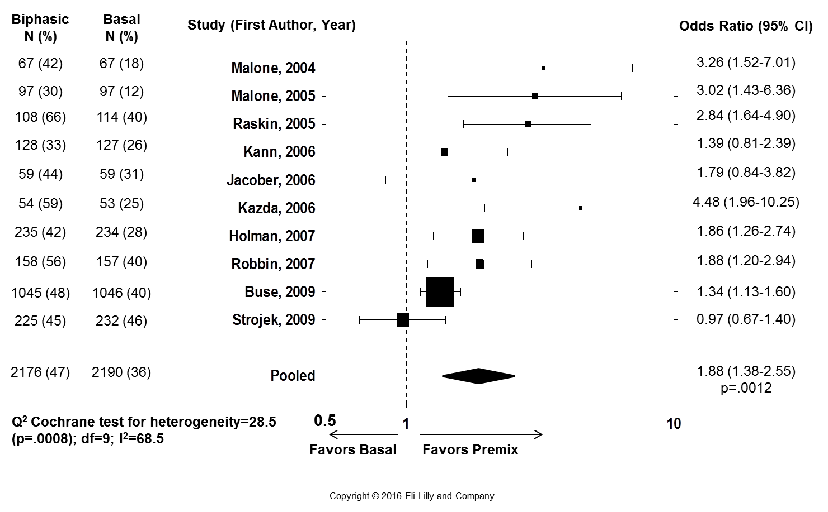
Premix vs. Basal Insulins Meta-Analysis: Percentage of Patients Achieving HbA1c <7%
Data from Giugliano D et al. Diabetes Care 2011;34:510-7
Notes:
Diab-00070768
Abbreviations:
CI=confidence interval; df=degrees of freedom; HbA1c=hemoglobin A1c
Copyright Disclosure: Figure has been recreated for Eli Lilly and Company with Data from Giugliano D et al. Diabetes Care 2011;34:510-7.
Key Points:
Most of the trials included insulin-naïve patients and adopted combination therapy with oral antihyperglycemic medications and insulin.
Patients treated with premix insulins had a greater chance to reach the HbA1c goal of <7% compared with basal insulin.
There was no evidence of publication bias (p=.15); heterogeneity was high (I²=68%) but diffuse.
Reference:
Giugliano D, Maiorino MI, Bellastella G, Chiodini P, Ceriello A, Esposito K. Efficacy of insulin analogs in achieving the hemoglobin A1c target of <7% in type 2 diabetes: meta-analysis of randomized controlled trials. Diabetes Care 2011;34(2):510-7.

Slide 124
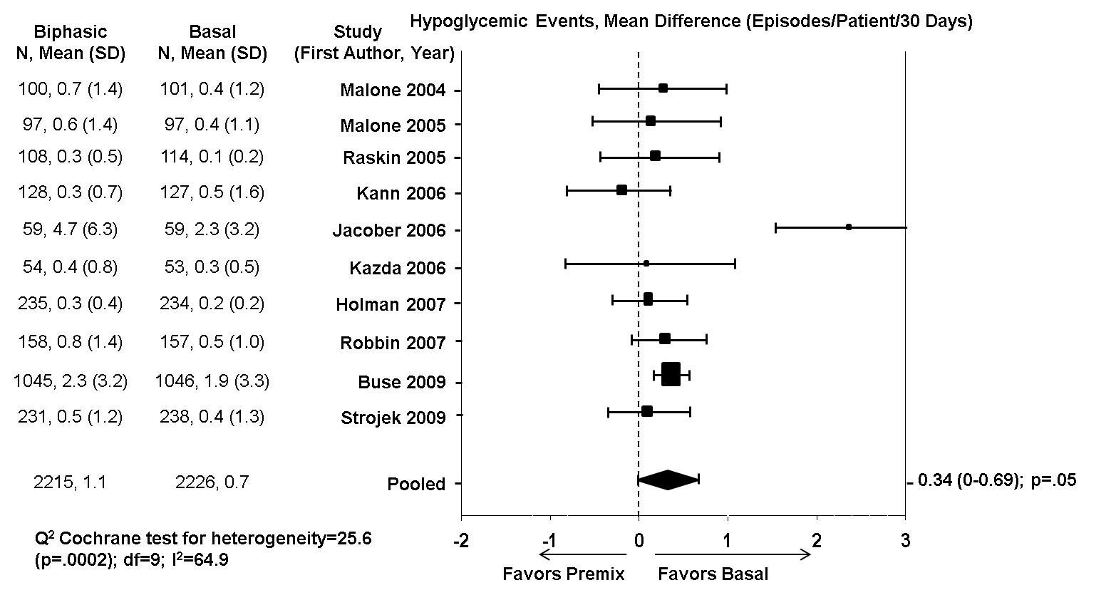
Premix vs. Basal Insulins Meta-Analysis: Incidence of Hypoglycemia
Data from Giugliano D et al. Diabetes Care 2011;34:510-7
Copyright © 2016 Eli Lilly and Company
Notes:
Diab-00070768
Abbreviations:
CI=confidence interval; df=degrees of freedom; SD=standard deviation
Copyright Disclosure: Figure has been recreated for Eli Lilly and Company with Data from Giugliano D et al. Diabetes Care 2011;34:510-7.
Key Points:
Most of the trials included insulin-naïve patients and adopted combination therapy with oral antihyperglycemic medications and insulin.
Patients treated with premix insulins had a significant increase in hypoglycemic events compared with basal insulin, but significant heterogeneity was observed. Exclusion of one trial (Jacober, 2006) with the highest hypoglycemic rate completely eliminated heterogeneity.
Reference:
Giugliano D, Maiorino MI, Bellastella G, Chiodini P, Ceriello A, Esposito K. Efficacy of insulin analogs in achieving the hemoglobin A1c target of <7% in type 2 diabetes: meta-analysis of randomized controlled trials. Diabetes Care 2011;34(2):510-7.

Slide 125
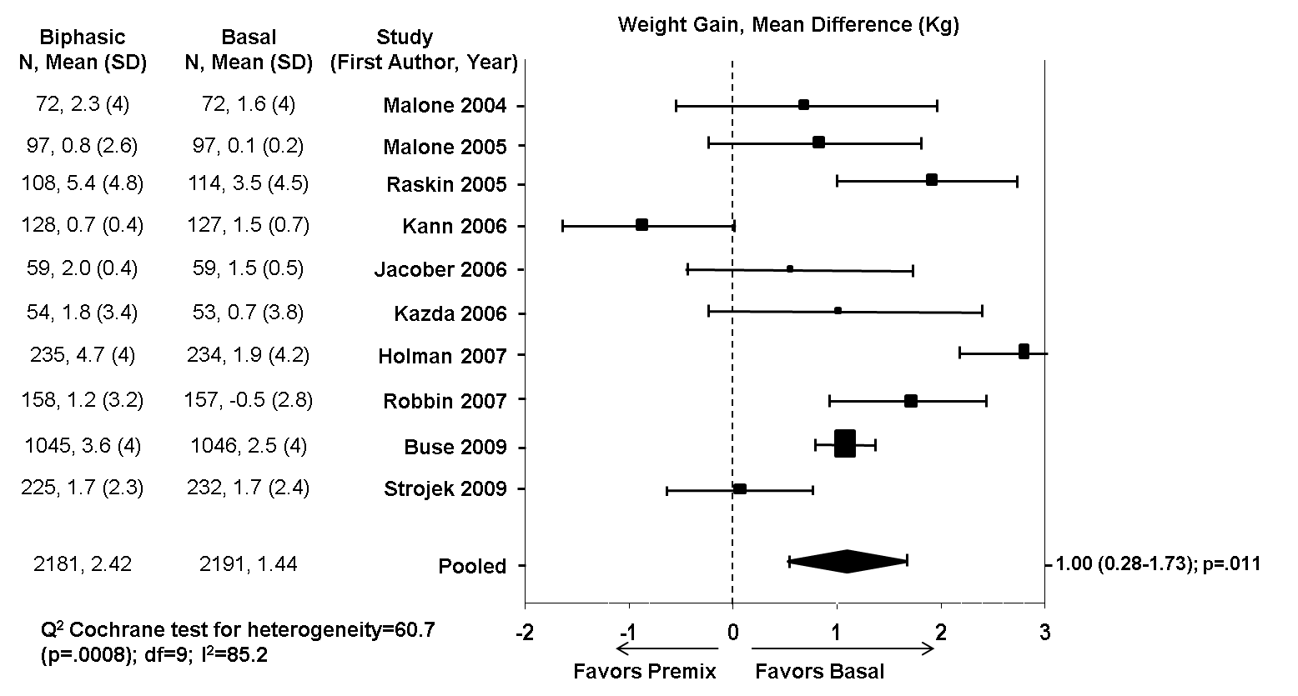
Premix vs. Basal Insulins Meta-Analysis: Weight Gain
Data from Giugliano D et al. Diabetes Care 2011;34:510-7
Copyright © 2016 Eli Lilly and Company
Notes:
Diab-00070768
Abbreviations:
CI=confidence interval; df=degrees of freedom; SD=standard deviation
Copyright Disclosure: Figure has been recreated for Eli Lilly and Company with Data from Giugliano D et al. Diabetes Care 2011;34:510-7.
Key Points:
Most of the trials included insulin-naïve patients and adopted combination therapy with oral antihyperglycemic medications and insulin.
Patients treated with premix insulins were associated with greater weight gain compared with basal insulin, but with high heterogeneity.
Reference:
Giugliano D, Maiorino MI, Bellastella G, Chiodini P, Ceriello A, Esposito K. Efficacy of insulin analogs in achieving the hemoglobin A1c target of <7% in type 2 diabetes: meta-analysis of randomized controlled trials. Diabetes Care 2011;34(2):510-7.

Slide 126
Premix vs. Basal Insulins: Summary of Key Findings¹⁻⁵
Compared to basal insulins, most studies showed that premix insulins were associated with:
  Significantly greater reduction in HbA1c
  Significantly higher proportions of patients achieving HbA1c levels ≤7.0%
  Comparable or higher rates of hypoglycemia
  Significantly greater weight gain
Malone JK et al. Clin Ther 2004;26:2034-44
Malone JK et al. Diabet Med 2005;22:374-81
Raskin P et al. Diabetes Care 2005;28:260-5
Holman RR et al. N Engl J Med 2007;357:1716-30
Giugliano D et al. Diabetes Care 2011;34:510-7
Copyright © 2016 Eli Lilly and Company
Notes:
Diab-00070768
Abbreviation:
HbA1c=hemoglobin A1c
Background:
Malone et al, 2004: 105 patients with type2 diabetes mellitus (T2DM) (insulin-naïve) were randomized in a 32-week, open-label, prospective, crossover study to 25% insulin lispro, 75% insulin lispro protamine suspension (LM25) BID+metformin (Met) vs. insulin glargine QD+Met. Metformin was dosed from 1500-2500 mg/day.¹
Malone et al, 2005: 97 patients with T2DM (insulin-experienced) were randomized in an open-label, 32-week, crossover study to treatment with either LM25 BID+Met (1500-2550 mg/day) or insulin glargine QD+Met (1500-2550 mg/day) for 16 weeks, followed by 16 weeks of the other treatment.²
Raskin et al: A 28-week parallel-group study randomized 233 insulin-naïve patients with HbA1c ≥8.0% on >1000 mg/day metformin ± oral antihyperglycemic medications (OAMs). Metformin was adjusted up to 2550 mg/day before insulin therapy was initiated with 5-6 units of biphasic insulin aspart 70/30 (BIAsp30) twice daily (BID) or 10-12 units of glargine at bedtime (HS) and titrated to target plasma glucose (PG) (4.4-6.1 mmol/L).³
Holman et al: Study compared the efficacy and safety of adding BIAsp30 BID, prandial insulin aspart thrice daily (TID), or basal insulin detemir once daily (QD) or BID in the treatment of 708 patients with T2DM who had suboptimal glycemic control while receiving maximally tolerated doses of metformin and sulfonylurea. These data are the results of the first year of the 3-year Treating to Target in type2 Diabetes (4-T) study.⁴
Guigliano et al, 2011: Meta-analysis of 10 trials comparing premix vs. Basal insulin regimes, most including insulin-naïve patients and adopting combined regimens of insulin+OAMs.⁵
References:
Malone JK, Kerr LF, Campaigne BN, Sachson RA, Holcombe JH; Lispro Mixture-Glargine Study Group. Combined therapy with insulin lispro Mix 75/25 plus metformin or insulin glargine plus metformin: a 16-week, randomized, open-label, crossover study in patients with type 2 diabetes beginning insulin therapy. Clin Ther 2004;26(12):2034-44.
Malone JK, Bai S, Campaigne BN, Reviriego J, Augendre-Ferrante B. Twice-daily pre-mixed insulin rather than basal insulin therapy alone results in better overall glycaemic control in patients with type2 diabetes. Diabet Med 2005;22(4):374-81.
Raskin P, Allen E, Hollander P, Lewin A, Gabbay RA, Hu P, Bode B, Garber A; INITIATE Study Group. Initiating insulin therapy in type 2 Diabetes: a comparison of biphasic and basal insulin analogs. Diabetes Care 2005;28(2):260-5.
Holman RR, Thorne KI, Farmer AJ, Davies MJ, Keenan JF, Paul S, Levy JC; 4-T Study Group. Addition of biphasic, prandial, or basal insulin to oral therapy in type 2 diabetes. N Engl J Med 2007;357(17):1716-30.
Giugliano D, Maiorino MI, Bellastella G, Chiodini P, Ceriello A, Esposito K. Efficacy of insulin analogs in achieving the hemoglobin A1c target of <7% in type 2 diabetes: meta-analysis of randomized controlled trials. Diabetes Care 2011;34(2):510-7.

Slide 127
Content Overview
Progression of T2DM
Insulin Initiation in T2DM
Introduction to Premix Insulins
Premix vs. Basal Insulin Regimens
Premix vs. Basal-Bolus Regimens
Comparison of Premix, Basal-Bolus, and Basal Insulin Regimens
Guidelines and Treatment Algorithms
Conclusions
Copyright © 2016 Eli Lilly and Company
Notes:
Diab-00070768
Abbreviation:
T2DM=Type 2 diabetes mellitus

Slide 128
Clinical Trials: Premix Insulin BID vs. Basal-Bolus Insulin
First Author, Year | Trial Design and Duration | Treatment Arms | Population
Bowering et al, 2012¹ | 48-week, multinational, randomized, prospective, open-label study | Glargine + Lispro vs. LM25 QD-TID | N=426; insulin-naïve on OAMs
Liebl et al, 2009² | 26-week, multicenter, randomized, treat-to-target study | Detemir + Aspart vs. BiAsp30 BID | N=719; with or without concomitant basal insulin
Rosenstock et al, 2008³ | 24-week, multicenter, randomized, open-label, active-controlled study | Glargine + Lispro vs. LM50 TID | N=374; On ≥30 IU of insulin glargine
Aschner et al, 2015⁴ | 24-week, multinational, randomized, parallel-arm, open-label study | Glargine QD ± Glulisine vs. Premix insulin QD or BID | N=934; on concomitant metformin ± insulin secretagogues
Jain et al, 2010⁵ | 36-week, open-label, randomized trial | Glargine + Lispro vs. LM50 TID | N=484; insulin-naïve
Guigliano et al, 2011⁶ | Meta-analysis of 3 RCTs | Basal-bolus vs. Premix BID regimens | N=559; insulin-experienced
Bowering K et al. Diabet Med 2012;29:e263-72
Liebl A et al. Diabetes Obes Metab 2009;11:45-52
Rosenstock J et al. Diabetes Care 2008;31:20-5
Aschner A et al. J Diabetes Complications 2015;29:838-45
Jain SM et al. Diabetes Obes Metab 2010;12:967-75
Giugliano D et al. Diabetes Care 2011;34:510-7
Copyright © 2016 Eli Lilly and Company
Notes:
Diab-00070768
Abbreviations:
BiAsp30=biphasic insulin aspart 70/30; BID=twice daily; IU=international units; LM25=25% insulin lispro, 75% insulin lispro protamine suspension; LM50=50% insulin lispro, 50% insulin lispro protamine suspension; OAM=oral antihyperglycemic medication; QD=once daily; RCT=randomized clinical trials; TID=thrice daily
References:
Bowering K, Reed VA, Felicio J, Landry J, Ji L, Oliviera J. A study comparing insulin lispro mix 25 with glargine plus lispro therapy in patients with type 2 diabetes who have inadequate glycaemic control on oral anti-hyperglycaemic medication: results of the PARADIGM study. Diabet Med 2012;29(9):e263-72.
Liebl A, Prager R, Binz K, Kaiser M, Bergenstal R, Gallwitz B; PREFER Study Group. Comparison of insulin analogue regimens in people with type 2 diabetes mellitus in the PREFER Study: a randomized controlled trial. Diabetes Obes Metab 2009;11(1):45-52.
Rosenstock J, Ahmann AJ, Colon G, Scism-Bacon J, Jiang H, Martin S. Advancing insulin therapy in type 2 diabetes previously treated with glargine plus oral agents: prandial premixed (insulin lispro protamine suspension/lispro) versus basal/bolus (glargine/lispro) therapy. Diabetes Care 2008;31(1):20-5.
Aschner P, Sethi B, Gomez-Peralta F, Landgraf W, Loizeau V, Dain MP, Pilorget V, Comlekci A. Insulin glargine compared with premix insulin for management of insulin-naïve type 2 diabetes patients uncontrolled on oral antidiabetic drugs: the open-label, randomized GALAPAGOS study. J Diabetes Complications 2015;29(6):838-45.
Jain SM, Mao X, Escalante-Pulido M, Vorokhobina N, Lopez I, Ilag LL. Prandial-basal insulin regimens plus oral antihyperglycaemic agents to improve mealtime glycaemia: initiate and progressively advance insulin therapy in type 2 diabetes. Diabetes Obes Metab 2010;12(11):967-75.
Giugliano D, Maiorino MI, Bellastella G, Chiodini P, Ceriello A, Esposito K. Efficacy of insulin analogs in achieving the hemoglobin A1c target of <7% in type 2 diabetes: meta-analysis of randomized controlled trials. Diabetes Care 2011;34(2):510-7.

Slide 129
LM25 QD-TID vs. Glargine + Lispro (PARADIGM): Trial Design
48-week, parallel, prospective, multinational, randomized open-label study
Target FPG of 4.5-6.0 mmol/L (80-109 mg/dL)
LM25 QD, Progressing to TID (N=214)
Inclusion criteria:
Age 30-80 years with T2DM
HbA1c levels ≥7.0% and <11.0%
On ≥1 OAM without insulin for ≥90 days before study start
Randomization
N=426
Glargine + Lispro (N=212)
-12
0
12
24
36
48
Weeks
Randomization stratified by country, HbA1c (≤69 mmol/mol [≤8.5%] and >69 mmol/mol [>8.5%]), and continuing use of a sulfonylurea
Bowering K et al. Diabet Med 2012;29:e263-72
Copyright © 2016 Eli Lilly and Company
Notes:
Diab-00070768
Study Code: F3Z-CR-IOPH
Clinicaltrials.gov identifier: NCT00548808
Abbreviations:
HbA1c=hemoglobin A1c; LM25=25% insulin lispro, 75% insulin lispro protamine suspension; OAM=oral antihyperglycemic drug; FPG=fasting plasma glucose; QD=once daily; T2DM=Type 2 diabetes mellitus; TID=thrice daily
Key Points:
Patients were enrolled in Australia, Brazil, Canada, China, India, South Korea, and Mexico, from November 2007 to August 2009.
Patients continued metformin plus pioglitazone and/or sulfonylureas.
Pioglitazone discontinued 2 weeks before randomization in countries where concomitant use with insulin is contraindicated.
Patients with a body mass index (BMI)≥35 kg/m², functional capacity Class III/IV cardiac disease, impaired renal function, active liver disease, or more than 1 episode of severe hypoglycemia within 24 weeks prior to study entry were excluded.
LM25 was added first at evening meal, then at breakfast, and finally at lunch, in order to target the meals with the higher blood glucose values first.
Sulfonylureas were discontinued before adding the second injection of LM25 (in the LM25 group) or the first injection of insulin lispro (in the glargine + lispro group).
Background:
Randomized open-label study to test the hypothesis that, in terms of glycemic control, initiation and intensification with LM25, is noninferior to initiation and intensification with glargine + lispro.
Reference:
Bowering K, Reed VA, Felicio J, Landry J, Ji L, Oliviera J. A study comparing insulin lispro mix 25 with glargine plus lispro therapy in patients with type 2 diabetes who have inadequate glycaemic control on oral anti-hyperglycaemic medication: results of the PARADIGM study. Diabet Med 2012;29(9):e263-72.

Slide 130
LM25 QD-TID vs. Glargine + Lispro (PARADIGM): Reduction in HbA1c and Percentage of Patients Meeting Glycemic Targets
Baseline
HbA1c (%)
9.0
9.0
p=NS
Change in HbA1c (%)
Percentage of Patients
p=NS
p=NS
Similar reductions in HbA1c and similar percentages of patients attaining glycemic targets between the two treatment groups
Bowering K et al. Diabet Med 2012;29:e263-72
Copyright © 2016 Eli Lilly and Company
Notes:
Diab-00070768
Study Code: F3Z-CR-IOPH
Clinicaltrials.gov identifier: NCT00548808
Abbreviations:
HbA1c=hemoglobin A1c; LM25=25% insulin lispro, 75% insulin lispro protamine suspension; NS=nonsignificant; QD=once daily; TID=thrice daily
Key Points:
The primary analysis conducted using an analysis of covariance (ANCOVA) with baseline HbA1c as a covariate, and treatment group, country and sulfonylurea use as factors.
Patients experienced significant reductions in HbA1c from baseline to endpoint with both treatments (p<.001).
Difference between glargine + lispro and LM25 at endpoint was not significant, which supports the hypothesis that LM25 is noninferior to glargine + lispro with regard to glycemic control in this population.
No statistically significant differences between treatment groups were found in the percentage of patients achieving HbA1c targets or postprandial plasma glucose levels.
Background:
Randomized open-label study to test the hypothesis that, in terms of glycemic control, initiation and intensification with LM25, is noninferior to initiation and intensification with glargine + lispro.
Reference:
Bowering K, Reed VA, Felicio J, Landry J, Ji L, Oliviera J. A study comparing insulin lispro mix 25 with glargine plus lispro therapy in patients with type 2 diabetes who have inadequate glycaemic control on oral anti-hyperglycaemic medication: results of the PARADIGM study. Diabet Med 2012;29(9):e263-72.

Slide 131
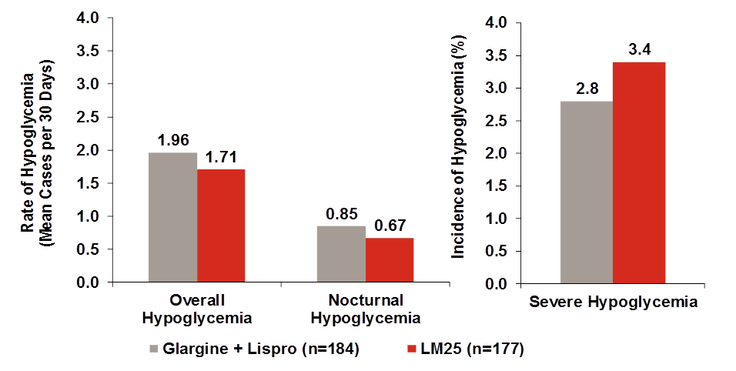
LM25 QD-TID vs. Glargine + Lispro (PARADIGM): Hypoglycemia
Similar rates of hypoglycemic events between the two treatment groups
Bowering K et al. Diabet Med 2012;29:e263-72
Copyright © 2016 Eli Lilly and Company
Notes:
Diab-00070768
Study Code: F3Z-CR-IOPH
Clinicaltrials.gov identifier: NCT00548808
Abbreviations:
LM25=25% insulin lispro, 75% insulin lispro protamine suspension; QD=once daily; TID=thrice daily
Key Points:
Similar hypoglycemia rates were observed between treatment groups.
In the LM25 group, a similar percentage of patients using 1 or 2 injections experienced hypoglycemia (56.1 and 60.8%, respectively); the rate was somewhat lower among patients using 3 injections, 48.5%.
Similar percentages were seen in the glargine + lispro group: 56.7% in the glargine alone group; 52.4% in patients using glargine + 1 lispro injection; 49.0% in patients using glargine + 2 lispro injections, and 44.2% in patients using glargine + 3 lispro injections.
Background:
Randomized open-label study to test the hypothesis that, in terms of glycemic control, initiation and intensification with LM25, is noninferior to initiation and intensification with glargine + lispro.
Reference:
Bowering K, Reed VA, Felicio J, Landry J, Ji L, Oliviera J. A study comparing insulin lispro mix 25 with glargine plus lispro therapy in patients with type 2 diabetes who have inadequate glycaemic control on oral anti-hyperglycaemic medication: results of the PARADIGM study. Diabet Med 2012;29(9):e263-72.

Slide 132
LM25 QD-TID vs. Glargine + Lispro (PARADIGM): Weight Gain
p=NS
Similar weight gain among patients treated with either treatment regimen
Bowering K et al. Diabet Med 2012;29:e263-72
Copyright © 2016 Eli Lilly and Company
Notes:
Diab-00070768
Study Code: F3Z-CR-IOPH
Clinicaltrials.gov identifier: NCT00548808
Abbreviations:
LM25=25% insulin lispro, 75% insulin lispro protamine suspension; NS=nonsignificant; QD=once daily; TID=thrice daily
Background:
Randomized open-label study to test the hypothesis that, in terms of glycemic control, initiation and intensification with LM25, is noninferior to initiation and intensification with glargine + lispro.
Reference:
Bowering K, Reed VA, Felicio J, Landry J, Ji L, Oliviera J. A study comparing insulin lispro mix 25 with glargine plus lispro therapy in patients with type 2 diabetes who have inadequate glycaemic control on oral anti-hyperglycaemic medication: results of the PARADIGM study. Diabet Med 2012;29(9):e263-72.

Slide 133
Content Overview
Progression of T2DM
Insulin Initiation in T2DM
Introduction to Premix Insulins
Premix vs. Basal Insulin Regimens
Premix vs. Basal-Bolus Regimens
Comparison of Premix, Basal-Bolus, and Basal Insulin Regimens
Guidelines and Treatment Algorithms
Conclusions
Copyright © 2016 Eli Lilly and Company
Notes:
Diab-00070768
Abbreviation:
T2DM=Type 2 diabetes mellitus

Slide 134

Initiating Therapy With Twice-Daily Premix Insulin Analogs
Premix analog twice daily – start with low dose and increase gradually
Insulin naïve patients
Start as 10 U sc prebreakfast and pre-evening meals¹
Patients already on once-daily insulin
Calculate total daily dose¹
  Total daily dose ÷ 2
  Give ½ sc prebreakfast and ½ sc pre-evening meal
OAM recommendation²
  Continue metformin
  Other OAMs (sulfonylureas or α-glucosidase inhibitors) can also be maintained
PG measurements²
  Monitor prebreakfast (fasting) and pre-evening meal plasma glucose
Copyright © 2016 Eli Lilly and Company
Notes:
Diab-00070768
Abbreviations:
OAM=oral antihyperglycemic medication; PG=plasma glucose; sc=subcutaneously; U=units
Key Points:
Other alternative recommendations exist, such as:
Divide dose 2/3 sc pre-breakfast and 1/3 sc pre-evening meal³
Other OAMs (sulfonylureas may be continued to improve glycemic control, but increases risk of hypoglycemia)
Monitor occasional bedtime PGs as well.
References:
Hirsch IB, Bergenstal RM, Parkin CG, Wright E, Buse JB. A real-world approach to insulin therapy in primary care practice. Clinical Diab 2005;23:78-86.
IDF 2012. Global Guideline for Type 2 Diabetes. https://www.idf.org/guidelines. Last accessed: January 25, 2016.
Roth J, Milke B, Müller N, Zitterbart U, Rechtacek S, Rechtacek T, Kloos C, Wolf G, Müller UA. People with type 2 diabetes on premixed insulin therapy: how is the daily insulin dose partitioned and are there effects on the metabolic control? Exp Clin Endocrinol Diabetes 2015;123(6):368-70.

Slide 135
Initiating Therapy With Premix Insulin Analogs BID (Escalation From Basal Insulin)
Start with Mix 25/75 or 30/70 – 12 U with breakfast, 6 U with dinner
(Or divide basal insulin to 2/3 dose in the morning and 1/3 dose in the evening)
High FPG
Add 2-4 U to evening dose
High evening PG
Add 2-4 U to morning dose
Check glucose before bed and early morning to avoid hypoglycemia
Check glucose before lunch to avoid hypoglycemia
Repeat until target is reached
Repeat until target is reached
Consult with diabetologist if fail to achieve target in 6 months
Data from Mosenzon O and Raz I. Diabetes Care 2013;36:(Suppl 2):S212-8
Copyright © 2016 Eli Lilly and Company
Notes:
Diab-00070768
Abbreviations:
BID=twice daily; FPG=fasting plasma glucose; PG=plasma glucose; U=units
Copyright Disclosure: Figure has been recreated for Eli Lilly and Company with Data from Mosenzon O and Raz I. Diabetes Care 2013;36:(Suppl 2):S212-8.
Key Point:
Figure represents guidance for physicians on changing from basal insulin to a premix insulin analog including titration to goal.
Reference:
Mosenzon O, Raz I. Intensification of insulin therapy for type 2 diabetic patients in primary care: basal-bolus regimen versus premix insulin analogs: when and for whom? Diabetes Care 2013;36( Suppl 2):S212-8.

Slide 136

Identifying Patients who Benefit the Most Using Humalog® Mix25™ Therapy
Clinical Characteristics
Type 2 diabetes patients with A1C >7%
Patient Assessment: Current Therapy? Symptoms? BG Results?
Insulin naive patients on OAMs
Usually asymptomatic
Pre-breakfast BG >110 mg/dL (6.1 mmol/L)
Once daily pre-evening dosing

Slide 137
Humalog® Mix25™:
Initiating Therapy
Mix25 Once Daily Dosing
Start with low dose and increase gradually
Starting dose and meal:
10 U subcutaneous (sc) injection
pre-evening meal
OAM recommendation:
Maintain at least metformin 1-1.5 g/day in divided doses
Other OAM can also be maintained*
BG measurements:
Monitor pre-breakfast fasting BG every 3-4 days†
*OAM to be used in accordance with the locally approved package insert. Some OAMs may be contraindicated.
†Physicians and patients should decide if additional BG measurements may be needed. Abbreviations: BG = blood glucose.

Slide 138
Humalog® Mix25™
Dose Adjustment
Dose adjustment should occur every 3-4 days (twice weekly)
Mix25 Once Daily Dosing (pre-dinner)
Adjust dose based on pre-breakfast fasting blood glucose (BG) using:
BG <50 mg/dL→ decrease by -4 units
BG 50-79 mg/dL → decrease by -2 units
BG 110-139 mg/dL → +2 units
BG 140-199 mg/dL → +4 units
BG ≥ 200 mg/dL → +6 units

Slide 139
Insulin Dose Titration Algorithms Once-, Twice-, and Thrice-daily LM25
Once-daily LM25ª |  | Twice-daily LM25^{b,c,e} |  | Thrice-daily LM25^{b,d}
Fasting Blood Glucose mmol/l (mg/dl) | Next Day Pre-evening Meal Dose Change | Pre-evening Meal/Fasting Blood Glucose mmol/L (mg/dL) | Next day Pre-breakfast/ Pre-evening Meal Dose Change | Pre-evening Meal Blood Glucose mmol/L (mg/dL) | Next Day Pre-lunch Dose Change
<2.8 (<50) | -4 units | <2.8 (<50) | -4 units | <2.8 (<50) | -3 units
2.8-4.4 (50-79) | -2 units | 2.8-4.4 (50-79) | -2 units | 2.8-4.4 (50-79) | -2 units
4.5-6.0 (80-109) | No change | 4.5-6.0 (80-109) | No change | 4.5-6.0 (80-109) | -1 unit
6.1-7.7 (110-139) | +2 units | 6.1-7.7 (110-139) | +2 units | 6.1-7.7 (110-139) | No change
7.8-11.0 (140-199) | +4 units | ≥7.8 (≥140) | +4 units | ≥7.8 (≥140) | +2 units
>11.0 (>199) | +6 units
Bowering et al. Diabet Med 2012;29(9):e263-72.
Notes:
ªLM25 therapy was initiated with one 10-U injection administered within 15 min prior to the evening meal
^{b}Additional injections of LM25 were added to the patient’s regimen when HbA_{1c} and/or blood glucose targets were not achieved with the existing insulin injections
^{c}A second LM25 injection, if required, was administered before breakfast, composed of half of the previous total pre-evening meal dose
^{d}A third injection of 3-U of LM25, if required, was administered before lunch
^{e}Patients taking a sulphonylurea discontinued prior to adding the second LM25 injection
Key Points:
Patients’ glycaemic needs as reflected by self-monitored blood glucose measurements were based on the dose and number of injections.
Blood glucose concentration targets for fasting and preprandial conditions were less than 6.1 mmol/L (110 mg/dL) (Roche plasma, Roche Diagnostics, Indianapolis, IN, USA).
The dose regimen can be adjusted by patients at any time during the study according to the dose titration algorithms (LM25 injections).
Reference:
Bowering K, Reed VA, Felicio J, Landry J, Ji L, Oliveira J. A study comparing insulin lispro mix 25 with glargine plus lispro therapy in patients with Type 2 diabetes who have inadequate glycaemic control on oral anti-hyperglycaemic medication: results of the PARADIGM study. Diabet Med 2012;29(9):e263-72.
Insu00051819

Slide 140

Why mix 50 could be appropriate option for intensification from twice daily low mix insulins?
Humalog Mix50 as a suitable option
Trial evidence and adoption into major guidelines
Risk of hypoglycaemia limiting further low mix insulin dose escalation
Suboptimal glucose control with low mix insulins despite dose optimization
Need for coverage of additional post-prandial peaks (eg. lunch)

Slide 141
Humalog® Mix50™:
Initiating TID Therapy
Recommended Starting dose:
Divide current total daily insulin (TDI) dose by 3 and give
subcutaneously at premeal 1/3 the total dose for each main meal¹
[e.g., A patient on 12 units of NPH twice daily has TDI dose of 24
units (12x2), could be switched to 8 units (24÷3) before each of 3
main meals]
Increase dose gradually and adjust accordingly¹⁻⁴
Oral antihyperglycemic medication recommendation (OAM):
Maintain at least metformin 850-1700 mg/day in divided doses
Other OAMs can also be maintained^{1,2}
BG measurements during early initiation:
Frequently monitor and adjust pre-breakfast, pre-lunch, and
pre-supper BG and assess every 3-4 days**
**Additional measurements are often needed (for example, once per day or more frequently).
This decision is the responsibility of the practicing physician.
¹Rosenstock J, et al. Diabetes Care 2008; 31:20-25 ²Hirsch HIB, et al. Clinical Diabetes 2005; 23:78-86
³Kazda C. et al., J Diabetes Complications 2006; 20:145-152 ⁴Robbins DC, et al. Clin Ther 2007; 29(11):2349-2364
Notes:
Rosenstock J, Ahmann AJ, Colon G, Scism-Bacon J, Jiang H, Martin S. Advancing insulin therapy in type 2 diabetes previously treated with glargine plus oral agents: prandial premixed (insulin lispro protamine suspension/lispro) versus basal/bolus (glargine/lispro) therapy. Diabetes Care. 2008 Jan;31(1):20-25.
Hirsch HIB, Bergenstal RM, Parkin CG, Wright E, Buse JB. A Real-World Approach to Insulin Therapy in Primary Care Practice, Clinical Diabetes 23:78-86, 2005
Kazda C, Hulstrunk H, Helsberg K, Langer F, Forst T, Hanefeld M. Prandial insulin substitution with insulin lispro or insulin lispro mid mixture vs. basal therapy with insulin glargine: a randomized controlled trial in patients with type 2 diabetes beginning insulin therapy. J Diabetes Complications 20:145-152, 2006
Robbins DC, Beisswenger PJ, Ceriello A, Goldberg RB, Moses RG, Pagkalos EM, Milicevic Z, Jones CA, Sarwat S, Tan MH. Mealtime 50/50 basal + prandial insulin analogue mixture with a basal insulin analogue, both plus metformin, in the achievement of target HbA1c and pre- and postprandial blood glucose levels in patients with type 2 diabetes: a multinational, 24-week, randomized, open-label, parallel-group comparison. Clin Ther 2007 Nov;29(11):2349-2364.
Discussion
To initiate Humalog Mix50 therapy (50% lispro/50% insulin lispro protamine suspension) , we recommend dividing the current total daily insulin dose by 3 and injecting subcutaneously one third of the total dose prior to each main meal. (Information on pg. 21, study medications and treatments, lines 22-25, Rosenstock et al., 2008)
For example, if a patient is currently taking 12 units of NPH twice daily, that patient has total daily insulin dose of 24 units (12x2), therefore, when switching to Humalog Mix50, the patient would inject 8 units prior to each of the 3 main meals
This is exemplified in Rosenstock et al., where the starting dose was based on insulin glargine total dose at study entry divided into 3 equal doses of lispro mix 50/50 before meals. (Information on pg. 21, study medications and treatments, lines 22-25, Rosenstock et al., 2008)
However, in the case of Robbins et al., in which study participants were on 0-2 insulin injections before lead-in period (Information on pg. 2350-2351, “Design and Eligibility Criteria”, 1st paragraph, Robbins et al., 2007), insulin was initiated at 80% of the total daily Humalog Mix25 (25% lispro/75% insulin lispro protamine suspension) dose used in the lead-in period, with one third injected at each meal in patients receiving Humalog Mix50. (Information on pg. 2351, 2nd column, 2nd paragraph, lines 6-9, Robbins et al., 2007)
In patients who are insulin naïve, it may be prudent to start dosing conservatively. For example in Robbins et al., dosing was initiated at 80% of the total daily Mix25 dose used in the lead-in period. (Information on pg. 2351, 2nd column, 2nd paragraph, lines 6-9, Robbins et al., 2007). An alternative approach would be to base starting insulin doses on body weight. For patients with moderate T2D, i.e. those with FPG of 140-220 mg/dl (7.8-12.2 mmol/l), required doses are generally in the range of 0.3-0.4 U/kg/d and for severe T2D i.e. those with FPG >220 mg/dl (>12.2 mmol/L) doses required are generally in the range of 0.5-1.2 U/kg/day." (Jay Skyler's chapter on Insulin Treatment p 186-210 In: (book) Therapy for Diabetes Mellitus and Related Disorders 3rd ed. published by American Diabetes Assocn:Alexandria, VA:1998 (Clinical Education Series; editor is Harold E. Lebovitz) pg 198)
The Humalog Mix50 dose should be adjusted gradually and accordingly to achieve target BG levels. (Information on pg. 21 “Study Medications & Treatments”, 2nd paragraph, lines 2-6 , Rosenstock et al., 2008; Information on pg. 79, “Who should be started on insulin”, 3rd paragraph, lines 1-4, Hirsch et al, 2005; Information on pg. 146, “Design”, paragraph 3, lines 5-8, Kazda et al., 2006; Information on pg. 2351, “Study Drug Administration”, paragraph 3, lines 1-6, Robbins et al., 2007)
Metformin should be maintained at 850-1700 mg/day in divided doses.
Other OAMs may also be continued. (Information on pg. 21, 1st column, 2nd paragraph, lines 4-10, Rosenstock et al., 2008; Information on pg. 79 “Who should be started on insulin”, lines 1-3, Hirsch et al, 2005)
During the early phase of Mix50 initiation, it is important to frequently monitor the patient, adjust preprandial BG levels and assess every 3-4 days. It should be noted that additional measurements are often required - this decision is the responsibility of the practicing physician.

Slide 142
Humalog® Mix50™TID
Recommended Dose Adjustment
Adjust dose every 3-4 days (twice weekly) to achieve and stabilize BG targets
Based on pre-lunch BG, adjust pre-breakfast insulin | Based on pre-supper BG, adjust pre-lunch insulin | Based on fasting BG, adjust pre-supper insulin
Following dose titration below:
Blood glucose Dose adjustment mmol/L mg/dL
≤ 2.7 ≤ 50 decrease by -4 units
2.8-4.3 51-79 decrease by -2 units
4.4-6.0 80-109 no change
6.1-7.7 110-139 increase by +2 units
≥ 7.8 ≥ 140 increase by +4 units
Notes:
Discussion
Dose should be adjusted according to this algorithm every 3-4 days in order to obtain target preprandial BG levels of 6.1 mmol/L (110 mg/dL)
If the dose adjustment is based on pre-lunch BG, adjust the pre-breakfast insulin. If the dose adjustment is based on pre-supper BG, adjust the pre-lunch insulin. If the dose adjustment is based on fasting BG, adjust the pre-supper insulin.
Humalog Mix50 (50% lispro/50% insulin lispro protamine suspension)

Slide 143
Advancing Insulin Therapy With Insulin Lispro Mix 50 vs. Insulin Glargine + Insulin Lispro in Patients With T2D Previously Treated With Insulin Glargine Plus OADs
Rosenstock J et al. Diabetes Care 2008;31:20-5
Notes:
Insu-00056817
Study Code: F3Z-US-IOOQ
Clinicaltrials.gov identifier: NCT00110370
Abbreviations: Insulin lispro mix 50=50% insulin lispro, 50% insulin lispro protamine suspension; OAD=Oral antihyperglycemic drug; T2D=Type 2 diabetes
Reference:
Rosenstock J, Ahmann AJ, et al. Advancing insulin therapy in type 2 diabetes previously treated with glargine plus oral agents: prandial premixed (insulin lispro protamine suspension/lispro) versus basal/bolus (glargine/lispro) therapy. Diabetes Care 2008;31(1):20-5.

Slide 144
Insulin Lispro Mix 50 vs. Glargine + Lispro: Study Overview
Study objective
  Demonstrate noninferiority of insulin lispro mix 50 compared to insulin glargine + insulin lispro, both arms TID
Primary efficacy measure
  Change in HbA1c at endpoint
Secondary measures
  % of patients achieving HbA1c targets at endpoint (post hoc analysis)
  8-point plasma glucose profiles
  Total daily dose of insulin
  Body weight
  Hypoglycemic event rate
Rosenstock J et al. Diabetes Care 2008;31:20-5
Notes:
Insu-00056817
Study Code: F3Z-US-IOOQ
Clinicaltrials.gov identifier: NCT00110370
[Source: Rosenstock J et al. Diabetes Care 2008;31(1):20-5. /p20/2nd column/paragraph 2; /p21/2nd column/paragraph 4 “Outcome measures”; Hypoglycemia: p21/2nd column/paragraph 3]
Abbreviations: Glargine + lispro=Insulin glargine + insulin lispro; HbA1c=Hemoglobin A1c; Insulin lispro mix 50=50% insulin lispro, 50% insulin lispro protamine suspension; TID=Thrice a day
Key Points:
The percentage of patients achieving HbA1c goals was determined by a post hoc analysis. [p21/2nd column/paragraph 4 “Outcome measures”]
Hypoglycemia was reported as any symptomatic event with classic cognitive and/or adrenergic signs with or without plasma glucose confirmation. [p21/2nd column/paragraph 3]
Reference:
Rosenstock J, Ahmann AJ, et al. Advancing insulin therapy in type 2 diabetes previously treated with glargine plus oral agents: prandial premixed (insulin lispro protamine suspension/lispro) versus basal/bolus (glargine/lispro) therapy. Diabetes Care 2008;31(1):20-5.

Slide 145
Insulin Lispro Mix 50 vs. Glargine + Lispro: Study Design
24-week, multicenter, randomized, open-label, active-controlled study
Doses adjusted to reach a preprandial plasma glucose <6.1 mmol/L (<110 mg/dL)
Glargine + Lispro TID (N=187)
Inclusion criteria:
Age 30-75 years with T2D
HbA1c levels 7.5-12.0%
On ≥30 IU of insulin glargine in combination with OADs for ≥90 days before the study
Randomization
N=374
T2D with inadequate glycemic control on insulin glargine + OADs
Insulin Lispro Mix 50 TID (N=187)
-
-
2
0
6
24
2
0
6
12
18
24
12
Weeks
Weeks
Rosenstock J et al. Diabetes Care 2008;31:20-5
Notes:
Insu-00056817
Study Code: F3Z-US-IOOQ
Clinicaltrials.gov identifier: NCT00110370
[Source: Rosenstock J et al. Diabetes Care 2008;31(1):20-5. Bullet #1: Pg 20, Col 3, Para 4; Bullet #2: Pg 21, Col 2, Para 2; Study design: /p21/1st column/paragraph 4; /p21/2nd column/paragraph 2; n values: p21/3rd column/last paragraph; Inclusion criteria: Pg 21, Col 1, Para 2]
Abbreviations: Glargine + lispro=Insulin glargine + insulin lispro; HbA1c=Hemoglobin A1c; IU=International unit; Insulin lispro mix 50=50% insulin lispro, 50% insulin lispro protamine suspension; OAD=Oral antihyperglycemic drug; T2D=Type 2 diabetes; TID=Thrice a day
Key Points:
Inadequate glycemic control: hemoglobin A1C (HbA1c) ≥7.5% and ≤12%. [Pg 21, Col 1, Para 2]
Patients continued metformin and/or thiazolidinedione (TZD), and stopped sulfonylureas and glinides. [Pg 21, Col 2, Para 1]
Lispro mix 50 patients not reaching fasting plasma glucose (FPG) target could switch pre-evening meal injection to insulin lispro mix 25 (25% insulin lispro, 75% insulin lispro protamine suspension; lispro mix 25). [Pg 21, Col 1, last para]
Exclusion criteria: History of scheduled mealtime insulin use or ≥1 episode of severe hypoglycemia within the prior 6 months, body mass index (BMI)>45 kg/m², excessive insulin resistance (total daily dose [TDD] of insulin >2.0 international units [IU]/kg), congestive heart failure requiring pharmacological treatment, functional status of New York Heart Association Class III or IV, a history of renal insufficiency, or liver disease. [Pg 21, Col 1, Para 3]
Patients in each group were assigned to either a more aggressive dosing algorithm based on plasma glucose levels as well as TDD requirement (insulin doses increased by 2-10 IU if TDD was <100 IU and by 4-20 IU if TDD was >100 IU). [Pg 21, Col 1, Para 4]
Background:
24-week, multicenter, randomized, open-label study testing noninferiority of insulin lispro mix 50 TID to glargine + lispro treatment in patients with T2D failing glycemic control on oral antihyperglycemic drugs combined with insulin glargine. [/p20/col 3/3rd paragraph].
Reference:
Rosenstock J, Ahmann AJ, et al. Advancing insulin therapy in type 2 diabetes previously treated with glargine plus oral agents: prandial premixed (insulin lispro protamine suspension/lispro) versus basal/bolus (glargine/lispro) therapy. Diabetes Care 2008;31(1):20-5.

Slide 146
Insulin Lispro Mix 50 vs. Glargine + Lispro: Starting Daily Dose
Breakfast
Lunch
Dinner
Bedtime
Glargine + Lispro
1/6 Dose
1/6 Dose
1/6 Dose
3/6 Dose
Total daily insulin dose=prestudy insulin glargine dose
(insulin
lispro)
(insulin
lispro)
(insulin
lispro)
(insulin
glargine)
Insulin Lispro
Mix 50
1/3
1/3
1/3
ªIf FPG >110 mg/dL,
could switch to insulin lispro mix 25
Dose
Dose
Doseª
Preprandial PG target <6.1 mmol/L (110 mg/dL)
Rosenstock J et al. Diabetes Care 2008;31:20-5
Notes:
Insu-00056817
Study Code: F3Z-US-IOOQ
Clinicaltrials.gov identifier: NCT00110370
[Source: Rosenstock J et al. Diabetes Care 2008;31(1):20-5. Insulin lispro mix 50: PPT therapy - p21/Col 1/para 3; Glargine + lispro: BBT - Pg 21, Col 2, Para 1; Preprandial PG target: Pg 21, Col 2, Para 2; Total dose statement in box: Pg 21, Col 2, Para 1]
Abbreviations: FPG=Fasting plasma glucose; Glargine + lispro=Insulin glargine + insulin lispro; Insulin lispro mix 50=50% insulin lispro, 50% insulin lispro protamine suspension; Insulin lispro mix 25=25% insulin lispro, 75% insulin lispro protamine suspension; PG=Plasma glucose; TID=Thrice a day
Key Points:
The starting total daily dose (TDD) of insulin was equal to each subject’s prestudy dose of insulin glargine (insulin lispro mix 50 group 52.5 ± 24.1 IU and glargine + lispro group 54.9 ± 27.8 IU) (/p23/col 2/2nd paragraph)
Patients randomized to the insulin lispro mix 50 arm took 1/3 of the total dose before each meal (3 injections/day) [p21/Col 1/para 4]
Patients in the glargine + lispro group took 1/6 of the total dose as insulin lispro before each meal and half of the total dose as insulin glargine at bedtime (4 injections/day) [Pg 21, Col 2, Para 1]
Insulin doses were adjusted during the study in order to achieve a preprandial PG target <6.1 mmol/L (<110 mg/dL) (/p21/col 2/para 2)
Within each treatment arm (glargine + lispro or insulin lispro mix 50), patients were randomized to 1 of 2 recommended dosing algorithms. Doses were adjusted according to protocol specified algorithms. [Inferred from Pg 21, Col 1, Para 4 and online appendix, Table 1]
Subjects in the insulin lispro mix 50 arm could switch their dinner time injection to insulin lispro mix 25 if fasting blood glucose targets were not being achieved. [Based on Pg 21, Col 1, Para 4, last statement]
Background:
24-week, multicenter, randomized, open-label study testing noninferiority of insulin lispro mix 50 TID to glargine + lispro treatment in patients with type 2 diabetes (T2D) failing glycemic control on oral antihyperglycemic drugs combined with insulin glargine [/p20/col 3/3rd paragraph].
Reference:
Rosenstock J, Ahmann AJ, et al. Advancing insulin therapy in type 2 diabetes previously treated with glargine plus oral agents: prandial premixed (insulin lispro protamine suspension/lispro) versus basal/bolus (glargine/lispro) therapy. Diabetes Care 2008;31(1):20-5.

Slide 147
Insulin Lispro Mix 50 vs. Glargine + Lispro: Insulin Dosing Algorithm
Preprandial Blood Glucose (mg/dL [mM]) | Algorithm 1, TDD <100 IU (IU Dose Increased) | Algorithm 1, TDD ≥100 IU (IU Dose Increased)
110-150 (6.1-8.3) | 2 | 4
151-200 (8.4-11.1) | 4 | 8
201-250 (11.2-13.9) | 6 | 12
251-300 (13.9-16.7) | 8 | 16
>300 (>16.7) | 10 | 20
Preprandial Blood Glucose (mg/dL [mM]) | Algorithm 2 (IU Dose Increased)
110-200 (6.1-11.1) | 2
201-300 (11.2-16.7) | 3
>300 (>16.7) | 4
Rosenstock J et al. Diabetes Care 2008;31:20-5
Notes:
Insu-00056817
Study Code: F3Z-US-IOOQ
Clinicaltrials.gov identifier: NCT00110370
[Source: Rosenstock J et al. Diabetes Care 2008;31(1):20-5. Table 1 of online appendix]
Abbreviations: Glargine + lispro=Insulin glargine + insulin lispro; IU=International unit; Insulin lispro mix 50=50% insulin lispro, 50% insulin lispro protamine suspension; TDD=Total daily dose; TID=Thrice a day
Key Points:
Eligible patients were assigned to either: [Pg 21/Col 2/Para 4]
An aggressive dosing algorithm (Algorithm 1) based on plasma glucose levels as well as TDD requirement (insulin doses increased by 2-10 IU if TDD was <100 IU and by 4-20 IU if TDD was >100 IU).
A conservative dosing algorithm (Algorithm 2) based only on plasma glucose levels (insulin doses increased by 2-4 IU if mean preprandial plasma glucose was >110 mg/dL (6.1 mmol/L).
Starting dose for insulin lispro mix 50 treatment group was based on the total insulin glargine dose at study entry divided into 3 equal doses of insulin lispro mix 50 before meals. [Pg 21, Col 1, Para 4]
Starting dose for glargine + lispro treatment group was also based on the total insulin glargine dose at study entry, with 50% administered as insulin glargine and the other 50% given in 3 equal doses of insulin lispro. [Pg 21, Col 2, Para 1]
Background:
24-week, multicenter, randomized, open-label study testing noninferiority of insulin lispro mix 50 TID to glargine + lispro treatment in patients with type 2 diabetes (T2D) failing glycemic control on oral antihyperglycemic drugs combined with insulin glargine. [/p20/3rd paragraph].
Reference:
Rosenstock J, Ahmann AJ, et al. Advancing insulin therapy in type 2 diabetes previously treated with glargine plus oral agents: prandial premixed (insulin lispro protamine suspension/lispro) versus basal/bolus (glargine/lispro) therapy. Diabetes Care 2008;31(1):20-5.

Slide 148
Insulin Lispro Mix 50 vs. Glargine + Lispro: Baseline Characteristics
 | Glargine + Lispro (N=187) | Insulin Lispro Mix 50 (N=187)
Age, years | 54.0 ± 9.2 | 55.4 ± 9.8
Sex (male:female), % | 52:48 | 53:47
Race, %
Caucasian | 54.6 | 55.1
Black or African descent | 9.6 | 13.4
Hispanic | 28.3 | 26.2
Other | 7.5 | 5.3
Weight, kg | 99.8 ± 21.3 | 99.1 ± 19.8
BMI, kg/m² | 34.8 ± 5.5 | 34.1 ± 5.3
Duration of diabetes, years | 11.2 ± 6.2 | 10.9 ± 6.3
HbA1c, % | 8.89 ± 1.09 | 8.83 ± 1.04
Total daily glargine dose at study entry, IU (IU/kg) | 54.9 ± 27.8 (0.56 ± 0.27) | 52.5 ± 24.1 (0.53 ± 0.21)
Data are mean ± SD or % ; No statistically significant differences between groups
Rosenstock J et al. Diabetes Care 2008;31:20-5
Notes:
Insu-00056817
Study Code: F3Z-US-IOOQ
Clinicaltrials.gov identifier: NCT00110370
[Source: Rosenstock J et al. Diabetes Care 2008;31(1):20-5. /p22/Table 1; footnote based on p-values in Table 1]
Abbreviations: BMI=Body mass index; Glargine + lispro=Insulin glargine + insulin lispro; HbA1c=Hemoglobin A1c; IU=International unit; Insulin lispro mix 50=50% insulin lispro, 50% insulin lispro protamine suspension; SD=Standard deviation
Key Points: [Pg 21, Col 3, Para 4 and Pg 22, Table 1]
Patients in both treatment arms had similar baseline characteristics.
Duration of diabetes ~11 years, body weight ~99 kg, and body mass index, ~34 kg/m².
~45% of the study population was non-Caucasian.
Background:
24-week, multicenter, randomized, open-label study testing noninferiority of insulin lispro mix 50 TID to glargine + lispro treatment in patients with type 2 diabetes (T2D) failing glycemic control on oral antihyperglycemic drugs combined with insulin glargine [/p20/col 3/3rd paragraph].
Reference:
Rosenstock J, Ahmann AJ, et al. Advancing insulin therapy in type 2 diabetes previously treated with glargine plus oral agents: prandial premixed (insulin lispro protamine suspension/lispro) versus basal/bolus (glargine/lispro) therapy. Diabetes Care 2008;31(1):20-5.

Slide 149
Insulin Lispro Mix 50 vs. Glargine + Lispro: HbA1c Change From Baseline (Completer Population)
Glargine + Lispro
(n=158)
Insulin Lispro Mix 50
(n=158)
Change in Mean HbA1c (%)
Δ*=-0.22% (90% CI: -0.38% to -0.07%)
Limit for noninferiority: -0.3%
*p=.021 for comparison of endpoint HbA1c values
Rosenstock J et al. Diabetes Care 2008;31:20-5
Notes:
Insu-00056817
Study Code: F3Z-US-IOOQ
Clinicaltrials.gov identifier: NCT00110370
[Source: Rosenstock J et al. Diabetes Care 2008;31(1):20-5. /p23/Figure 1A; Pg 21, Col 3, Para 1 for limit for noninferiority; n values: Pg 21, Col 3, Para 4; p-value footnote: Pg 22, Col 3, Para 2]
Abbreviations: CI=Confidence interval; Glargine + lispro=Insulin glargine + insulin lispro; HbA1c=Hemoglobin HbA1c; Insulin lispro mix 50=50% insulin lispro, 50% insulin lispro protamine suspension; TID=Thrice a day
Key Points:
Patients were considered completers if they attained target A1c by the end of a phase and were then withdrawn from the study. [Pg 24, Col 2, Para 3]
Analysis conducted using analysis of covariance (ANCOVA) with treatment, dosing algorithm, sex, and baseline HbA1c as fixed effects.[Pg 21, Col 3, Para 2]
Baseline HbA1c was similar in both groups (glargine + lispro group: 8.9 ±1.1%; insulin lispro mix 50 group: 8.8 ± 1.0%, p=.598) (/p22/Col 3/Para 2)
Both treatment groups experienced a significant decrease in HbA1c levels from baseline at endpoint (p<.001). [/p22/Col 3/Para 2]
The difference in HbA1c change from baseline to endpoint (glargine + lispro group - insulin lispro mix 50 group) at Week 16 was -0.22% with a 90% CI, -0.38% to ‑0.07%. [/p22/Col 3/Para 2]
Noninferiority (specified with a lower limit of -0.3%) was not demonstrated. The 90% CI in the difference of the change in HbA1c was -0.38% to -0.07%. Because the lower limit of the CI was lower than -0.3%, noninferiority was not demonstrated. [/p22/Col 3/Para 2, p21/Col 3/1st paragraph]
There was a significantly higher mean total daily insulin dose in the glargine + lispro group. (/p23/Col 2, 2nd paragraph)
Background:
24-week, multicenter, randomized, open-label study testing noninferiority of insulin lispro mix 50 TID to glargine + lispro treatment in patients with type 2 diabetes (T2D) failing glycemic control on oral antihyperglycemic drugs combined with insulin glargine [/p20/col 3/3rd paragraph].
Reference:
Rosenstock J, Ahmann AJ, et al. Advancing insulin therapy in type 2 diabetes previously treated with glargine plus oral agents: prandial premixed (insulin lispro protamine suspension/lispro) versus basal/bolus (glargine/lispro) therapy. Diabetes Care 2008;31(1):20-5.

Slide 150
Insulin Lispro Mix 50 vs. Glargine + Lispro: Percentage of Patients at HbA1c Targets at 24 Weeks (Completer Population)
Glargine + Lispro
(n=158)
Insulin Lispro Mix 50
(n=158)
*
*
Cumulative Percent of Patients
HbA1c Target Value
*p<.05
Rosenstock J et al. Diabetes Care 2008;31:20-5
Notes:
Insu-00056817
Study Code: F3Z-US-IOOQ
Clinicaltrials.gov identifier: NCT00110370
[Source: Rosenstock J et al. Diabetes Care 2008;31:20-5. /p23, figure 1C; data behind the graph: Pg 23, Col 1, Para 1; ≤6.0% data: Verify against data behind graph on SMBG profile slide, Chart 1; n values: Pg 21, Col 3, Para 4]
Abbreviations: Glargine + lispro=Insulin glargine + insulin lispro; HbA1c=Hemoglobin HbA1c; Insulin lispro mix 50=50% insulin lispro, 50% insulin lispro protamine suspension; TID=Thrice a day
Key Points: [Pg 22, Col 3, last para cont. to Pg 23, Col 1, Par 1]
Patients were considered completers if they attained target HbA1c by the end of a phase and were then withdrawn from the study. [Pg 24, Col 2, Para 3]
Percentage of patients achieving HbA1c goals was analyzed using Fisher’s exact test. [Pg 21, Col 3, Para 2]
At baseline, the distribution of patients across HbA1c values was similar between the 2 groups (data not shown).
By Visit 4 (12 weeks), the glargine + lispro group began to show a trend toward a greater number of patients achieving target HbA1c values of <7.0 and ≤6.5% (data not shown); this trend became statistically significant by study conclusion.
High percentages of patients in both groups were able to achieve an HbA1c <7.5%.
Two patients in the insulin lispro mix 50 group and none in the glargine + lispro group had an HbA1c ≥10% at 24 weeks.
Background:
24-week, multicenter, randomized, open-label study testing noninferiority of insulin lispro mix 50 TID to glargine + lispro treatment in patients with type 2 diabetes (T2D) failing glycemic control on oral antihyperglycemic drugs combined with insulin glargine [/p20/col 3/3rd paragraph].
Reference:
Rosenstock J, Ahmann AJ, et al. Advancing insulin therapy in type 2 diabetes previously treated with glargine plus oral agents: prandial premixed (insulin lispro protamine suspension/lispro) versus basal/bolus (glargine/lispro) therapy. Diabetes Care 2008;31(1):20-5.

Slide 151
Insulin Lispro Mix 50 vs. Glargine + Lispro: SMBG Profile (Completer Population)
Glargine + Lispro (n=158)
Insulin Lispro Mix 50 (n=158)
Baseline
Mean Plasma Glucose (mM)
Mean Plasma Glucose (mg/dL)
*
*
Endpoint
Night
Fasting
2-hr PP
Bedtime
2-hr PP
2-hr PP
Prelunch
Meal
Pre-evening
Meal
*p<.05 (between treatments at endpoint)
Rosenstock J et al. Diabetes Care 2008;31:20-5
Notes:
Insu-00056817
Study Code: F3Z-US-IOOQ
Clinicaltrials.gov identifier: NCT00110370
[Source: Rosenstock J et al. Diabetes Care 2008;31:20-5. /p23/Figure 1 D; n values: Pg 21, Col 3, Para 4]
Abbreviations: Glargine + lispro=Insulin glargine + insulin lispro; Insulin lispro mix 50=50% insulin lispro, 50% insulin lispro protamine suspension; PP=Postprandial; SMBG=Self-monitoring blood glucose
Key Points:
Patients were considered completers if they attained target HbA1c by the end of a phase and were then withdrawn from the study. [Pg 24, Col 2, Para 3]
Subjects collected self monitored plasma glucose (PG) profiles at baseline and endpoint. [/p23/1st paragraph]
At 24 weeks, both therapies significantly reduced PG values from baseline at all time points. [/p23/1st paragraph].
Endpoint profiles were similar for both groups except for fasting and the morning 2-hour post prandial timepoints (both lower for glargine + lispro group).
55% patients in the insulin lispro mix 50 group switched their dinner time injection to insulin lispro mix 25 because they were not achieving fasting PG targets. At endpoint there was no difference in fasting PG between patients who stayed on insulin lispro mix 50 and those who switched to insulin lispro mix 25 as their evening meal insulin dose (p=.862). [/p23/2nd paragraph]
Background:
24-week, multicenter, randomized, open-label study testing noninferiority of insulin lispro mix 50 TID to glargine + lispro treatment in patients with type 2 diabetes (T2D) failing glycemic control on oral antihyperglycemic drugs combined with insulin glargine. [/p20/col 3/3rd paragraph].
Reference:
Rosenstock J, Ahmann AJ, et al. Advancing insulin therapy in type 2 diabetes previously treated with glargine plus oral agents: prandial premixed (insulin lispro protamine suspension/lispro) versus basal/bolus (glargine/lispro) therapy. Diabetes Care 2008;31(1):20-5.

Slide 152
Insulin Lispro Mix 50 vs. Glargine + Lispro: Total Daily Insulin Dose and Body Weight
TDD (IU/kg)
Weight Gain (kg)
p=.002
p=.224
p=.382
Mean TDD Dose (IU/kg)
Weight Gain (kg)
Glargine + Lispro (n=158)
Insulin Lispro Mix 50 (n=158)
Data were presented as mean ± SD
Rosenstock J et al. Diabetes Care 2008;31:20-5
Notes:
Insu-00056817
Study Code: F3Z-US-IOOQ
Clinicaltrials.gov identifier: NCT00110370
[Source: Rosenstock J et al. Diabetes Care 2008;31:20-5. Baseline mean TDD, p-value from Pg 22, Table 1; Other values: /p23/2nd paragraph; /p23/2nd - 3rd column; n values: Pg 21, Col 3, Para 4]
Abbreviations: Glargine + lispro=Insulin glargine + insulin lispro; Insulin lispro mix 50=50% insulin lispro, 50% insulin lispro protamine suspension; IU=International Unit; TDD=Total daily dose
Key Points:
At study end, the mean TDD was significantly greater for the glargine + lispro group (p=.002). In the glargine + lispro group, 48% of the TDD dose was administered as insulin glargine and the remainder was insulin lispro. [Pg 23, Col 2, Para 2]
Patients in both groups experienced similar weight gains at study endpoint. [Pg 23, Col 3, Para 1]
Background:
24-week, multicenter, randomized, open-label study testing noninferiority of insulin lispro mix 50 TID to glargine + lispro treatment in patients with type 2 diabetes (T2D) failing glycemic control on oral antihyperglycemic drugs combined with insulin glargine. [/p20/col 3/3rd paragraph].
Reference:
Rosenstock J, Ahmann AJ, et al. Advancing insulin therapy in type 2 diabetes previously treated with glargine plus oral agents: prandial premixed (insulin lispro protamine suspension/lispro) versus basal/bolus (glargine/lispro) therapy. Diabetes Care 2008;31(1):20-5.

Slide 153
Insulin Lispro Mix 50 vs. Glargine + Lispro: Symptomatic Hypoglycemia† (Randomized Population)
Incidence (% Patients)
Rate (Events/Year/Patient)
Incidence (% Patients)
Rate (Events/Year/Patient)
Glargine + Lispro (n=187)
Insulin Lispro Mix 50 (n=187)
†Irrespective of plasma glucose confirmation
Rosenstock J et al. Diabetes Care 2008;31:20-5
Notes:
Insu-00056817
Study Code: F3Z-US-IOOQ
Clinicaltrials.gov identifier: NCT00110370
[Source: Rosenstock J et al. Diabetes Care 2008;31:20-5. /p22/Table 2; n values: Pg 21, Col 3, Para 3 and Pg 22, Table 1]
Abbreviations: Glargine + lispro=Insulin glargine + insulin lispro; Insulin lispro mix 50=50% insulin lispro, 50% insulin lispro protamine suspension; TID=Thrice a day
Key Points:
Symptomatic hypoglycemia is defined as any event with classic cognitive and/or adrenergic signs with or without plasma glucose (PG) confirmation. [/p21/5th paragraph]
Severe hypoglycemia was defined as any symptomatic event requiring assistance by another person. [/p21/Col 2, Para 3)]
Incidence and mean rate of overall, nocturnal, and severe hypoglycemia were similar between both treatment groups. [Pg 23, Col 3, last para cont. to Pg 24, Col 1, Para 1]
Background:
24-week, multicenter, randomized, open-label study testing noninferiority of insulin lispro mix 50 TID to glargine + lispro treatment in patients with type 2 diabetes (T2D) failing glycemic control on oral antihyperglycemic drugs combined with insulin glargine. [/p20/col 3/3rd paragraph]
Reference:
Rosenstock J, Ahmann AJ, et al. Advancing insulin therapy in type 2 diabetes previously treated with glargine plus oral agents: prandial premixed (insulin lispro protamine suspension/lispro) versus basal/bolus (glargine/lispro) therapy. Diabetes Care 2008;31(1):20-5.

Slide 154
Insulin Lispro Mix 50 vs. Glargine + Lispro: Hypoglycemia Confirmed by Plasma Glucose Values (Randomized Population)
Incidence (% Patients)
Rate (Events/Year/Patient)
Incidence (% Patients)
Rate (Events/Year/Patient)
<4 mmol/L
(72 mg/dL)
<3.3 mmol/L
(60 mg/dL)
<2.8 mmol/L
(50 mg/dL)
<4 mmol/L
(72 mg/dL)
<3.3 mmol/L
(60 mg/dL)
<2.8 mmol/L
(50 mg/dL)
Glargine + Lispro (n=187)
Insulin Lispro Mix 50 (n=187)
Rosenstock J et al. Diabetes Care 2008;31:20-5
Notes:
Insu-00056817
Study Code: F3Z-US-IOOQ
Clinicaltrials.gov identifier: NCT00110370
[Source: Rosenstock J et al. Diabetes Care 2008;31:20-5 /p22/Table 2]
Abbreviations: Glargine + lispro=Insulin glargine + insulin lispro; Insulin lispro mix 50=50% insulin lispro, 50% insulin lispro protamine suspension; TID=Thrice a day
Key Points:
Whenever possible, subjects confirmed hypoglycemia by measuring plasma glucose (PG). [Inferred]
Symptomatic PG-confirmed hypoglycemia was reported as a symptomatic event with PG levels <4 mM (72 mg/dL); <3.3 mM (60 mg/dL); and <2.8 mM (50 mg/dL). [Note: /p21/5th paragraph, incorrectly uses ≤ instead of < for the PG levels].
Incidence and mean rate of PG-confirmed hypoglycemic events were similar between both treatment groups. [Pg 23, Col 3, last para cont. to Pg 24, Col 1, Para 1]
Background:
24-week, multicenter, randomized, open-label study testing noninferiority of insulin lispro mix 50 TID to glargine + lispro treatment in patients with type 2 diabetes (T2D) failing glycemic control on oral antihyperglycemic drugs combined with insulin glargine [/p20/col 3/3rd paragraph].
Reference:
Rosenstock J, Ahmann AJ, et al. Advancing insulin therapy in type 2 diabetes previously treated with glargine plus oral agents: prandial premixed (insulin lispro protamine suspension/lispro) versus basal/bolus (glargine/lispro) therapy. Diabetes Care 2008;31(1):20-5.

Slide 155
Insulin Lispro Mix 50 vs. Glargine + Lispro: Key Findings
Noninferiority of insulin lispro mix 50 to glargine + lispro was not demonstrated based on the prespecified margin of 0.3%
  Difference ([glargine + lispro] − [insulin lispro mix 50]) in HbA1c change from baseline to endpoint was -0.22% (90% CI -0.38 to -0.07)
Both regimens reduced mean endpoint HbA1c to <7.0%
  Glargine + lispro group had a larger proportion of patients achieving HbA1c targets of ≤6.5% and <7.0%
55% of patients on insulin lispro mix 50 TID switched to insulin lispro mix 25 at the evening meal
Significantly higher total daily dose of insulin seen in the glargine + lispro group
Weight gain and hypoglycemia were similar in both groups
Rosenstock J et al. Diabetes Care 2008;31:20-5
Notes:
Insu-00056817
Study Code: F3Z-US-IOOQ
Clinicaltrials.gov identifier: NCT00110370
[Source: Rosenstock J et al. Bullets #1,2 and sub-bullets: Pg 24, Col 1, Para 3; Bullet #3: Pg 23, Col 2, Para 2 cont to Col 3; Para 1: Abstract, Results; Bullets #4,5: Pg 23, Col 2 Para 2 cont to Col 3, Paras 1 and 2 cont to Pg 24, Col 1, Para 1]
Abbreviations: CI=Confidence interval; Glargine + lispro=Insulin glargine + insulin lispro; HbA1c=Hemoglobin HbA1c; Insulin lispro mix 50=50% insulin lispro, 50% insulin lispro protamine suspension; TID=Thrice a day
Key Point:
Although noninferiority of lispro mix 50 to glargine + lispro was not demonstrated, results for HbA1c reduction, percentage of patients achieving HbA1c targets, and hypoglycemia should be considered in the individual decision-making process of advancing insulin replacement to insulin lispro mix 50 vs. glargine + lispro in type 2 diabetes (T2D). [Pg 20, Abstract, Conclusions]
Background:
24-week, multicenter, randomized, open-label study testing noninferiority of insulin lispro mix 50 TID to glargine + lispro treatment in patients with T2D failing glycemic control on oral antihyperglycemic drugs combined with insulin glargine [/p20/col 3/3rd paragraph].
Reference:
Rosenstock J, Ahmann AJ, et al. Advancing insulin therapy in type 2 diabetes previously treated with glargine plus oral agents: prandial premixed (insulin lispro protamine suspension/lispro) versus basal/bolus (glargine/lispro) therapy. Diabetes Care 2008;31(1):20-5.

Slide 156
Insulin Lispro Mix 50 vs. Glargine + Lispro: Key Findings
Noninferiority of insulin lispro mix 50 to glargine + lispro was not demonstrated based on the prespecified margin of 0.3%
  Difference ([glargine + lispro] − [insulin lispro mix 50]) in HbA1c change from baseline to endpoint was -0.22% (90% CI -0.38 to -0.07)
Both regimens reduced mean endpoint HbA1c to <7.0%
  Glargine + lispro group had a larger proportion of patients achieving HbA1c targets of ≤6.5% and <7.0%
55% of patients on insulin lispro mix 50 TID switched to insulin lispro mix 25 at the evening meal
Significantly higher total daily dose of insulin seen in the glargine + lispro group
Weight gain and hypoglycemia were similar in both groups
Rosenstock J et al. Diabetes Care 2008;31:20-5
Notes:
Insu-00056817
Study Code: F3Z-US-IOOQ
Clinicaltrials.gov identifier: NCT00110370
[Source: Rosenstock J et al. Bullets #1,2 and sub-bullets: Pg 24, Col 1, Para 3; Bullet #3: Pg 23, Col 2, Para 2 cont to Col 3; Para 1: Abstract, Results; Bullets #4,5: Pg 23, Col 2 Para 2 cont to Col 3, Paras 1 and 2 cont to Pg 24, Col 1, Para 1]
Abbreviations: CI=Confidence interval; Glargine + lispro=Insulin glargine + insulin lispro; HbA1c=Hemoglobin HbA1c; Insulin lispro mix 50=50% insulin lispro, 50% insulin lispro protamine suspension; TID=Thrice a day
Key Point:
Although noninferiority of lispro mix 50 to glargine + lispro was not demonstrated, results for HbA1c reduction, percentage of patients achieving HbA1c targets, and hypoglycemia should be considered in the individual decision-making process of advancing insulin replacement to insulin lispro mix 50 vs. glargine + lispro in type 2 diabetes (T2D). [Pg 20, Abstract, Conclusions]
Background:
24-week, multicenter, randomized, open-label study testing noninferiority of insulin lispro mix 50 TID to glargine + lispro treatment in patients with T2D failing glycemic control on oral antihyperglycemic drugs combined with insulin glargine [/p20/col 3/3rd paragraph].
Reference:
Rosenstock J, Ahmann AJ, et al. Advancing insulin therapy in type 2 diabetes previously treated with glargine plus oral agents: prandial premixed (insulin lispro protamine suspension/lispro) versus basal/bolus (glargine/lispro) therapy. Diabetes Care 2008;31(1):20-5.

Slide 157
Insulin Lispro Mix 50 vs. Glargine + Lispro: Key Findings
Noninferiority of insulin lispro mix 50 to glargine + lispro was not demonstrated based on the prespecified margin of 0.3%
  Difference ([glargine + lispro] − [insulin lispro mix 50]) in HbA1c change from baseline to endpoint was -0.22% (90% CI -0.38 to -0.07)
Both regimens reduced mean endpoint HbA1c to <7.0%
  Glargine + lispro group had a larger proportion of patients achieving HbA1c targets of ≤6.5% and <7.0%
55% of patients on insulin lispro mix 50 TID switched to insulin lispro mix 25 at the evening meal
Significantly higher total daily dose of insulin seen in the glargine + lispro group
Weight gain and hypoglycemia were similar in both groups
Rosenstock J et al. Diabetes Care 2008;31:20-5
Notes:
Insu-00056817
Study Code: F3Z-US-IOOQ
Clinicaltrials.gov identifier: NCT00110370
[Source: Rosenstock J et al. Bullets #1,2 and sub-bullets: Pg 24, Col 1, Para 3; Bullet #3: Pg 23, Col 2, Para 2 cont to Col 3; Para 1: Abstract, Results; Bullets #4,5: Pg 23, Col 2 Para 2 cont to Col 3, Paras 1 and 2 cont to Pg 24, Col 1, Para 1]
Abbreviations: CI=Confidence interval; Glargine + lispro=Insulin glargine + insulin lispro; HbA1c=Hemoglobin HbA1c; Insulin lispro mix 50=50% insulin lispro, 50% insulin lispro protamine suspension; TID=Thrice a day
Key Point:
Although noninferiority of lispro mix 50 to glargine + lispro was not demonstrated, results for HbA1c reduction, percentage of patients achieving HbA1c targets, and hypoglycemia should be considered in the individual decision-making process of advancing insulin replacement to insulin lispro mix 50 vs. glargine + lispro in type 2 diabetes (T2D). [Pg 20, Abstract, Conclusions]
Background:
24-week, multicenter, randomized, open-label study testing noninferiority of insulin lispro mix 50 TID to glargine + lispro treatment in patients with T2D failing glycemic control on oral antihyperglycemic drugs combined with insulin glargine [/p20/col 3/3rd paragraph].
Reference:
Rosenstock J, Ahmann AJ, et al. Advancing insulin therapy in type 2 diabetes previously treated with glargine plus oral agents: prandial premixed (insulin lispro protamine suspension/lispro) versus basal/bolus (glargine/lispro) therapy. Diabetes Care 2008;31(1):20-5.

Slide 158
Insulin Lispro Mix 50 vs. Glargine + Lispro: Key Findings
Noninferiority of insulin lispro mix 50 to glargine + lispro was not demonstrated based on the prespecified margin of 0.3%
  Difference ([glargine + lispro] − [insulin lispro mix 50]) in HbA1c change from baseline to endpoint was -0.22% (90% CI -0.38 to -0.07)
Both regimens reduced mean endpoint HbA1c to <7.0%
  Glargine + lispro group had a larger proportion of patients achieving HbA1c targets of ≤6.5% and <7.0%
55% of patients on insulin lispro mix 50 TID switched to insulin lispro mix 25 at the evening meal
Significantly higher total daily dose of insulin seen in the glargine + lispro group
Weight gain and hypoglycemia were similar in both groups
Rosenstock J et al. Diabetes Care 2008;31:20-5
Notes:
Insu-00056817
Study Code: F3Z-US-IOOQ
Clinicaltrials.gov identifier: NCT00110370
[Source: Rosenstock J et al. Bullets #1,2 and sub-bullets: Pg 24, Col 1, Para 3; Bullet #3: Pg 23, Col 2, Para 2 cont to Col 3; Para 1: Abstract, Results; Bullets #4,5: Pg 23, Col 2 Para 2 cont to Col 3, Paras 1 and 2 cont to Pg 24, Col 1, Para 1]
Abbreviations: CI=Confidence interval; Glargine + lispro=Insulin glargine + insulin lispro; HbA1c=Hemoglobin HbA1c; Insulin lispro mix 50=50% insulin lispro, 50% insulin lispro protamine suspension; TID=Thrice a day
Key Point:
Although noninferiority of lispro mix 50 to glargine + lispro was not demonstrated, results for HbA1c reduction, percentage of patients achieving HbA1c targets, and hypoglycemia should be considered in the individual decision-making process of advancing insulin replacement to insulin lispro mix 50 vs. glargine + lispro in type 2 diabetes (T2D). [Pg 20, Abstract, Conclusions]
Background:
24-week, multicenter, randomized, open-label study testing noninferiority of insulin lispro mix 50 TID to glargine + lispro treatment in patients with T2D failing glycemic control on oral antihyperglycemic drugs combined with insulin glargine [/p20/col 3/3rd paragraph].
Reference:
Rosenstock J, Ahmann AJ, et al. Advancing insulin therapy in type 2 diabetes previously treated with glargine plus oral agents: prandial premixed (insulin lispro protamine suspension/lispro) versus basal/bolus (glargine/lispro) therapy. Diabetes Care 2008;31(1):20-5.

Slide 159

Conclusions
Intensifying therapy with Humalog mixtures may benefit some of your patients.
Patient characteristics:
Not achieving HbA_{1c} targets with basal or low mix insulin alone
Experiencing high postprandial BG excursions particularly at lunch
Willing to inject insulin 3 times a day
Have concerns about hypoglycaemia, particularly later in the day
1. Rosenstock J, et al. Diabetes Care. 2008;31(1):20-25. 2. Jia W, et al. Lancet Diabetes Endocrinol. 2015;3(4):254-262. 3. Peter R, et al. Expert Opin Pharmacother. 2010;11(1):33-39.

Slide 160
Summary
Individualization of both glycaemic targets and treatment regimen based on the unique characteristics and psychosocial needs of your patients are important elements in T2DM management
For T2DM patients on low mix insulins with inadequate glycaemic control, intensification with Humalog Mix50 up to three times a day could be an alternative treatment option to basal plus therapy.
Risk of hypoglycaemia and weight gain as observed in trials appear to be clinically comparable between both options

Slide 161



